Slide 1
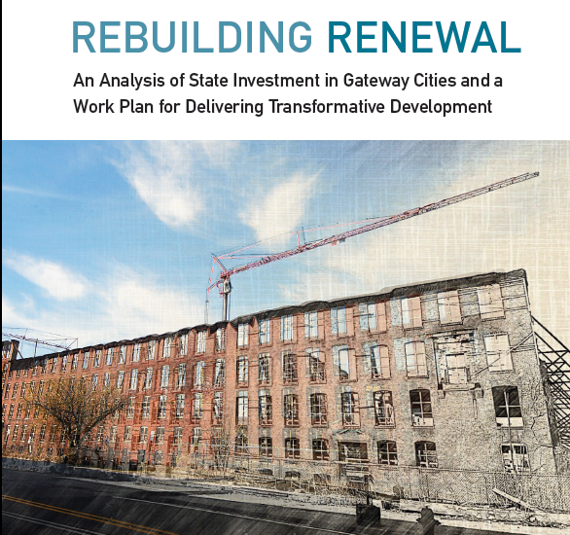
Make-It Springfield, Springfield, MA
June 30, 2016

Slide 2


Rebuilding Renewal
An Analysis of State Investment in Gateway Cities
and delivering transformative development

Slide 3
Today’s Presentation – New Gateway City Research
State investment from FY 2009-2013
  Gateway City shares by category
Real estate development trends
  Gateway Cities falling further behind during economic recovery
Case studies of catalytic investment and policy context
  Three ideas to help deliver transformative development

Slide 4
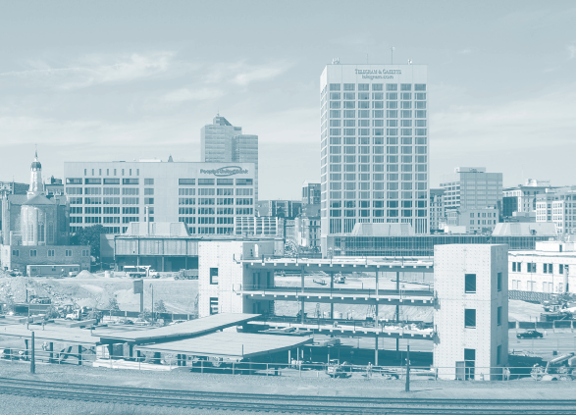
STATE INVESTMENT ANALYSIS
FY09-FY13

Slide 5
FY 09 to FY13, Massachusetts invested $3.3 billion in Gateway Cities; nearly half went to educational facilities

Slide 6
FY 09 to FY13, Gateway Cities received 39% of state total

Slide 7
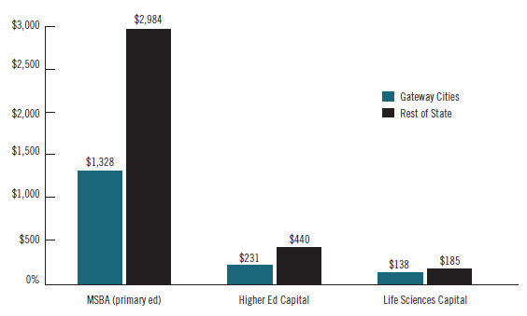
Most of this investment in educational facilities went to
K-12 schools

Slide 8
MassWorks accounted for more than half of the state’s economic development investment in Gateway Cities

Slide 9
Historic tax credits provided the most important resource for housing development in Gateway Cities

Slide 10
Massachusetts invested more in court houses than in housing or economic development between FY 09 & 13 – few large-scale investments for transformative development

Slide 11

GATEWAY CITY
REAL ESTATE MARKET TRENDS

Slide 12
Comparing Pioneer Valley Gateway Cities to State
Holyoke and Springfield have much lower household incomes and much higher poverty rates, compared to state and all Gateway Cities
Holyoke and Springfield are economic centers with jobs but many workers live in surrounding towns
Chicopee and Westfield have lower poverty rates but still have challenges and lower income than state average

Slide 13
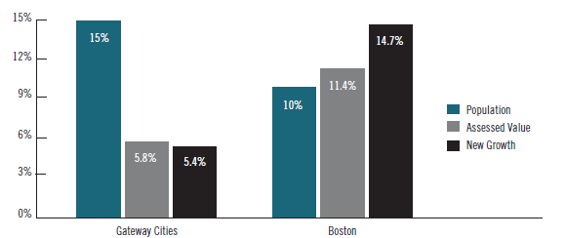
Gateway City real estate markets are underperforming their share of the state population; Boston is dramatically over-performing

Slide 14
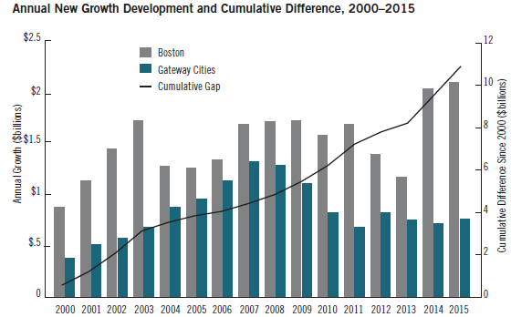
Since 2000, Boston has added $11 billion more in “new growth” to its tax rolls than Gateway Cities

Slide 15
Growth Index for Assessed Property Values 2000-2015 – Holyoke and Springfield trail MA, Boston and Worcester

Slide 16
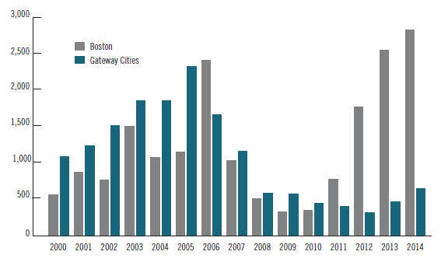
Building permits in Gateway Cities exceeded Boston every year from 2000 to 2011 (except 2006) – dramatically different story over last few years

Slide 17
Building permits in Holyoke and Springfield trail Worcester and Boston; are well-below pre-recession levels

Slide 18
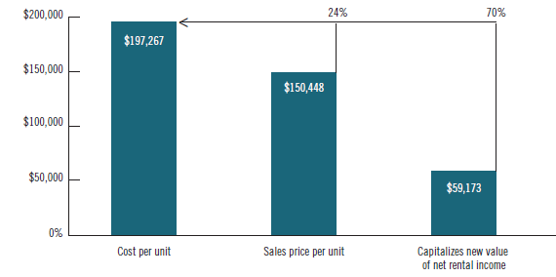
The “market gap” makes it financially unfeasible to build or redevelop in Gateway Cities

Slide 19
Some examples of catalytic investments – Gateway Cities
Lowell, MA – Hamilton Canal District
Worcester, MA – CitySquare
Each major project had a number of common elements to achieve success:
  Sustained vision and commitment of public, non-profit and private leaders
  Public investment (e.g., MassWorks) to help with infrastructure, roads, environmental remediation
  Mix of anchor tenants (hospitals, insurance, UMass) and attracting small-medium sized diverse businesses
  Connection/integration to downtown and commuter rail

Slide 20
Some examples of catalytic investments – New York State
Buffalo Billion - $1 billion on economic revitalization guided by development strategies and target industries
New York Upstate Revitalization Initiative (URI) - $1.5 billion to 3 regions
Goals of the URI:
  Significant increase in permanent private sector jobs paying above average wages
  Widespread increase in household wealth
  Leverage public investment with 5 to 1 private investment
Competitive application process based on strategies
NY used financial settlement funds – intentional choice to use those funds for upstate NY revitalization

Slide 21
Delivering Transformative Development
Identify revenues to increase the level of investment in transformative development
    Baker Administration economic development expands funding in TDI, brownfields, MassWorks, land assembly, etc.
    Given MA fiscal realities, further increases will be difficult but some options worth exploring if we want to “move the needle”
Better align investments with targeted redevelopment strategies
  Use project selection criteria such as location in TDI District and will the project attract follow-on private investment
  Creative/innovative higher education investments
Increase transparency and accountability
  Create system/methods to track and evaluate state investments

