Slide 1
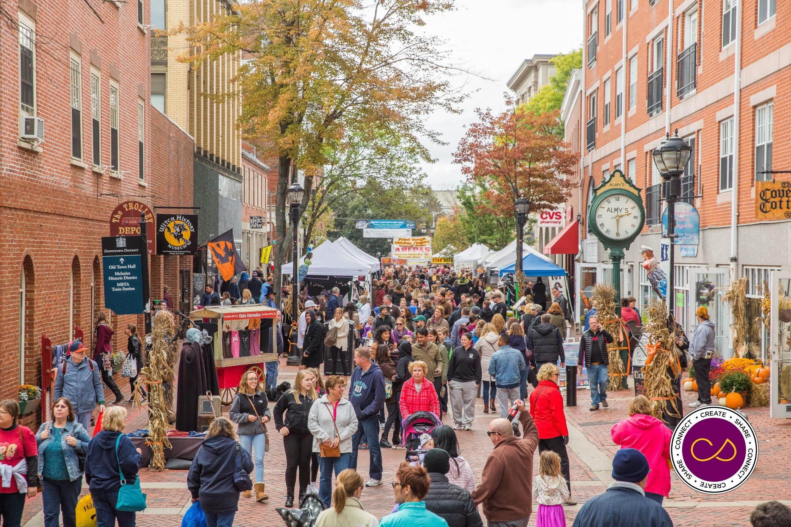
Catalyzing Transformative (equitable) Transit-Oriented Development in
Gateway Cities
Gateway City Innovation Awards & Summit
Worcester, MA
Twitter: @christophercoes
November 20, 2019
Credit: Salem Chamber of Commerce

Slide 2
Smart Growth America envisions a country where no matter where you live, or who you are, you can enjoy living in a place that is healthy, prosperous, and resilient.
Advocacy
Technical Assistance
Thought Leadership
Notes:
This is our vision, our mission and some of the programs that come under the SGA umbrella. What they have in common, and a big part of what we do, is to bring econ. dev., land use, and transportation together, with a heavy focus on equity throughout.

Slide 3
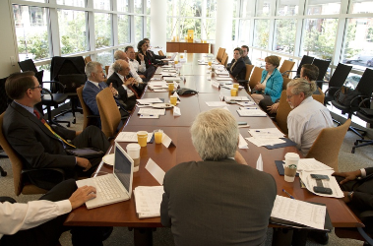
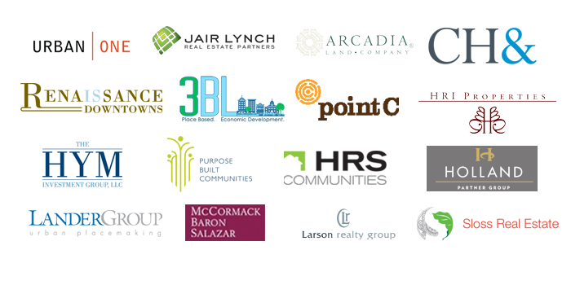
LOCUS: Responsible Real Estate Developers and Investors
A national coalition of private real estate developers and investors working to meet the country’s pent-up demand for sustainable, equitable, walkable urban places by advocating for local, state, and federal policy change.
Notes:
(Tola)

Slide 4
Audience Quiz: Have you seen this in your community?

Slide 5
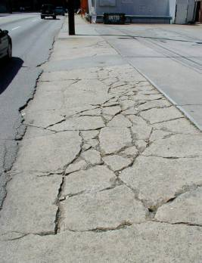
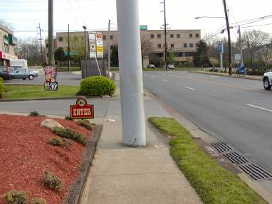
Have you seen this?
Notes:
The shift towards drivable suburban continued shape many land use and transportation decisions away from pedestrian friendly development or in many cases common sense…

Slide 6
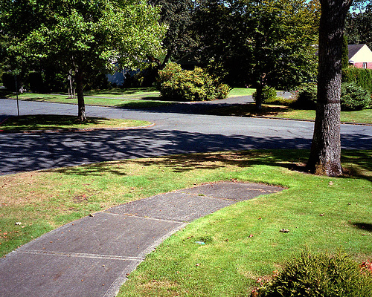
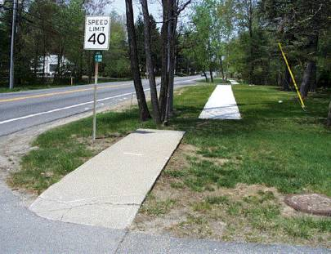
Have you seen this?
Richard Drudl

Slide 7
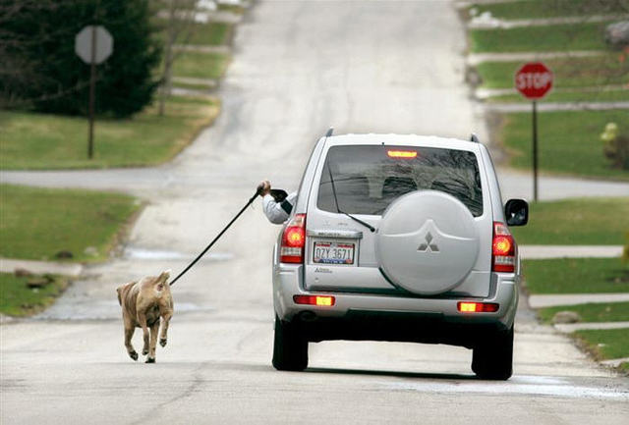
Have you seen this?
Notes:
This picture crystallizes for me the heart of drivable suburban version of taking the dog out….

Slide 8
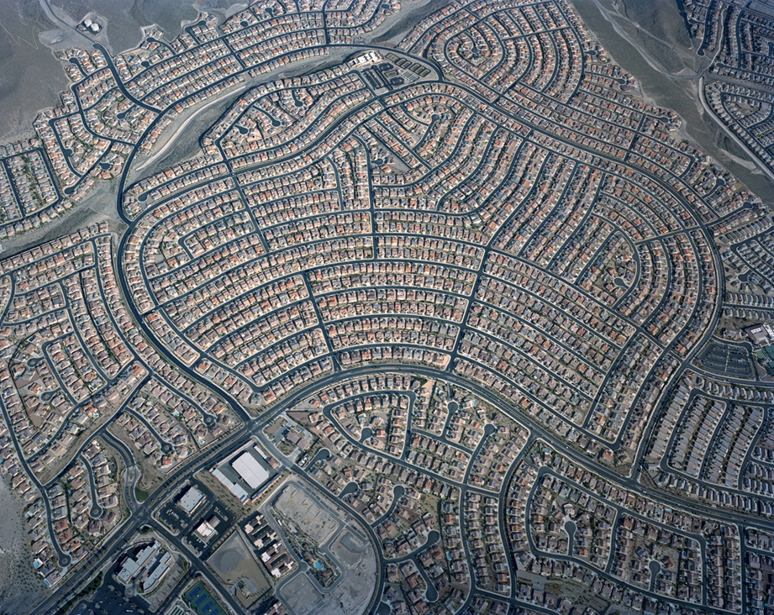
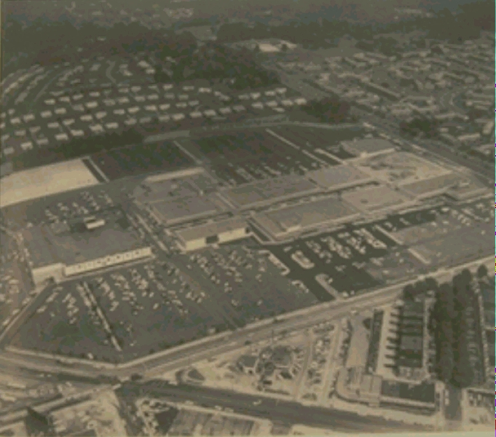
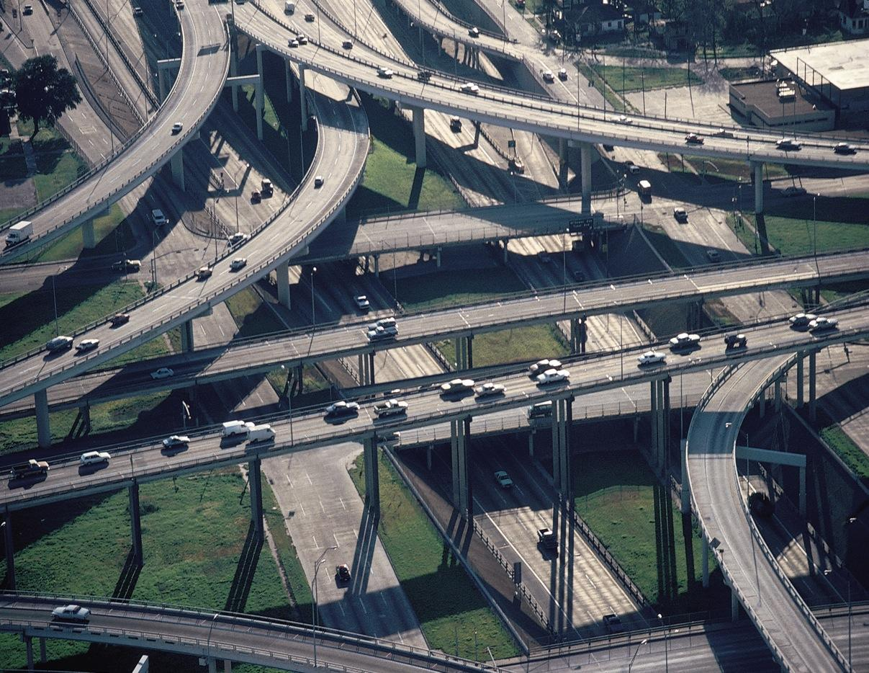
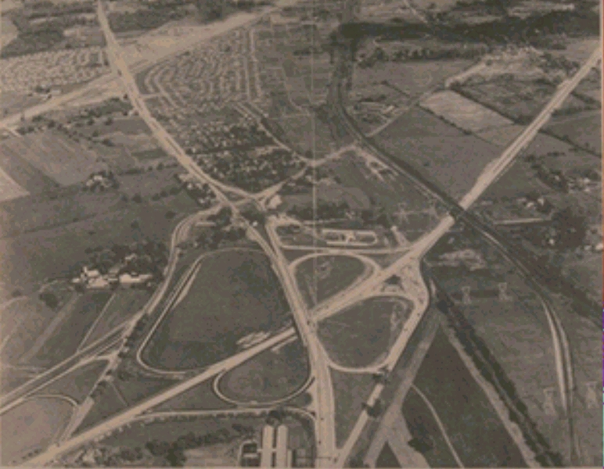
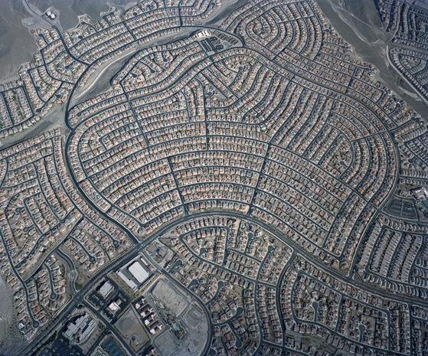
`
Notes:
Freeways ….
Which led to the regional mall….then we really got good at building highways…then into the current land development also known as sprawl…one of the biggest threats to protecting valuable outdoor space and farmland

Slide 9
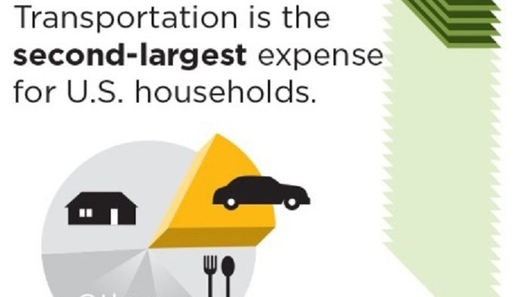
Transportation: Why It Matters

Slide 10
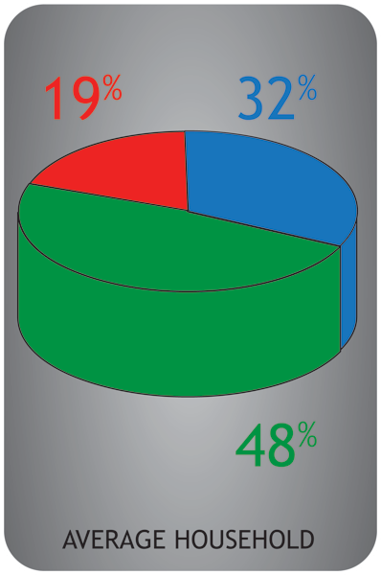
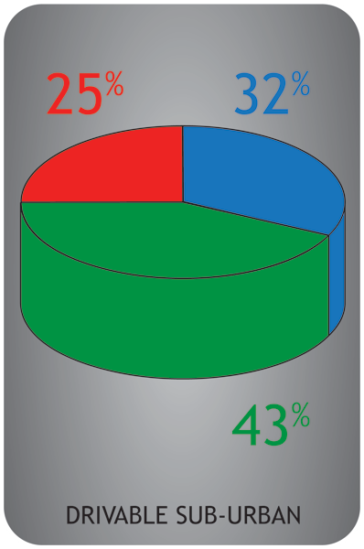
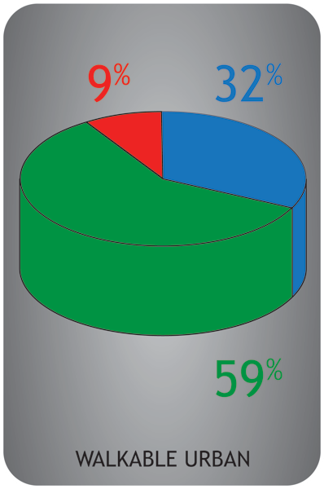
Notes:
Household economics
Average – 51% on Housing and Transpo
Drivable suburban – 57-70% on housing and transpo
Walkable Urban – 41-41%

Slide 11
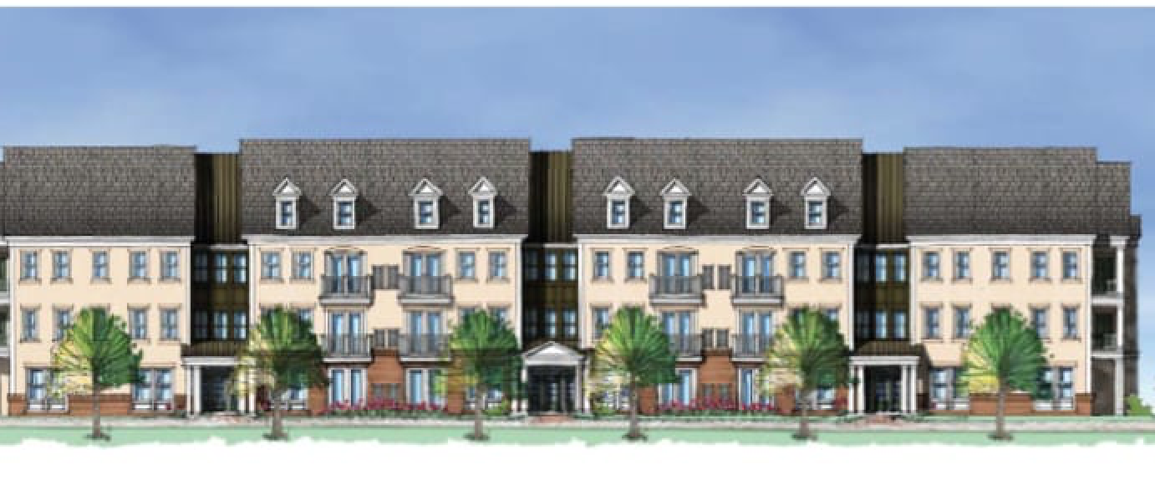
Compact, mixed-use development with multi-modal access to jobs, neighborhood-serving stores, and other amenities that also serve the needs of low- and moderate-income people
Equitable TOD Development
Notes:
Image: Rendering of Ashland Rail Transit Apartments, a large rental project with 249 two-bedroom units and 20% affordability, on a former industrial site next to an MBTA commuter rail station in Ashland, MA’s Rail Transit TOD District

Slide 12
What’s so great about equitable TOD?
Organizing development around transit hubs…
… reduces household spending on transportation, making housing more affordable.
… lowers auto-dependence, congestion, and traffic accidents.
… connects residents to better jobs and life services.
… lessens environmental impacts of development.
… stimulates economic growth and community revitalization.

Slide 13
Communities are now in a ferocious competition over place (and private capital) (whether they know it or not)

Slide 14
Five Tests of Community*
Popsicle Test – Can you walk home from the store before your popsicle melts?
Smooch Test – Is the place comfortable, safe, attractive, and intimate, suitable for a date-night stroll?
Kid Test – Can children safely explore a world beyond their own backyards?
Seniors Test – Are elder citizens a welcome part of the community? Can they get out and about and get their needs met when driving is no longer an option?
Commons Test – Does development contribute to the overall community something greater than what it takes in terms of natural and community resources?
*from Choosing Our Community’s Future, A Citizens Guide to Getting the Most Out of Development, Smart Growth America, 2005

Slide 15
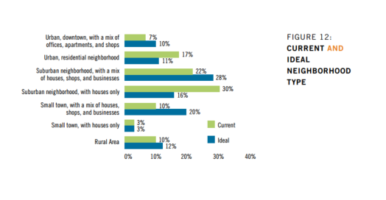
“About 10 percent of Americans would like to live in mixed-use small towns [Gateway Cities], but don't.” -- Robert Steuteville
Notes:
Data from Transit Center report, 2014 (see http://transitcenter.org/ourwork/mobility-attitudes-survey/)

Slide 16
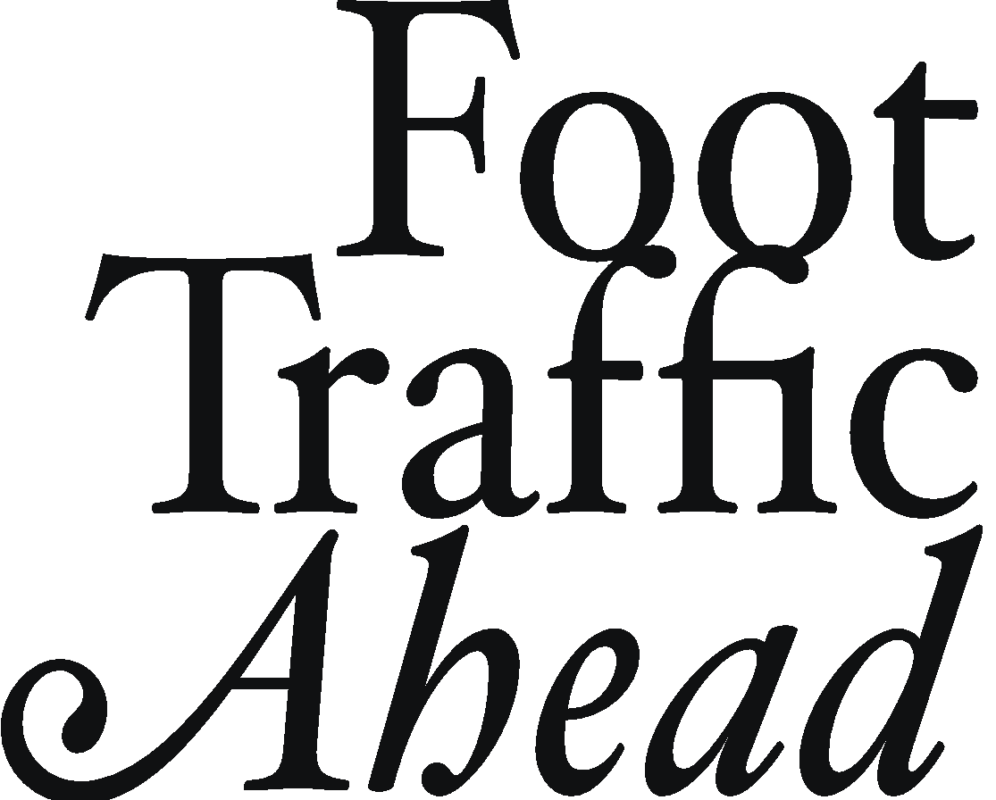
2019 Ranking Walkable Urbanism in America’s Largest Metros

Slide 17
The Old Dichotomy
CITY
VS.
SUBURBS
If a place isn’t in a city, it’s a suburb
(unless it’s rural).

Slide 18
It’s Time for New Lenses
WALKABLE URBAN
VS.
DRIVABLE
SUB-URBAN
Both of these environments can be found in a city,
a suburb, or a rural area.

Slide 19
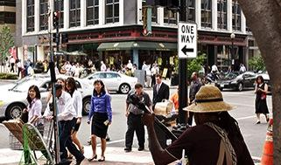
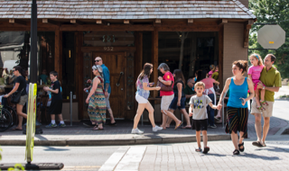
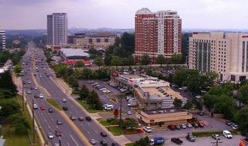
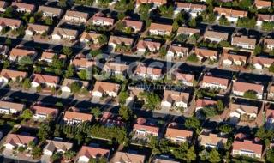
WalkUPs:
A form of development with higher density, multiple real estate product types in close proximity or within the same property, and multiple modes of transportation to move people and goods to the place.
Within the WalkUP, nearly everything is within walking distance.
METROPOLITAN LAND USE OPTIONS:
REGIONALLY SIGNIFICANT
LOCAL SERVING
WALKABLE URBAN
WALKUP: Metro Area Acreage: 1%
NEIGHBORHOOD Metro Area Acreage: 2-6%
DRIVABLE SUB-URBAN
EDGE CITY Metro Area Acreage: 3-4%
BEDROOM COMMUNITY Metro Area Acreage: 90-94 %

Slide 20
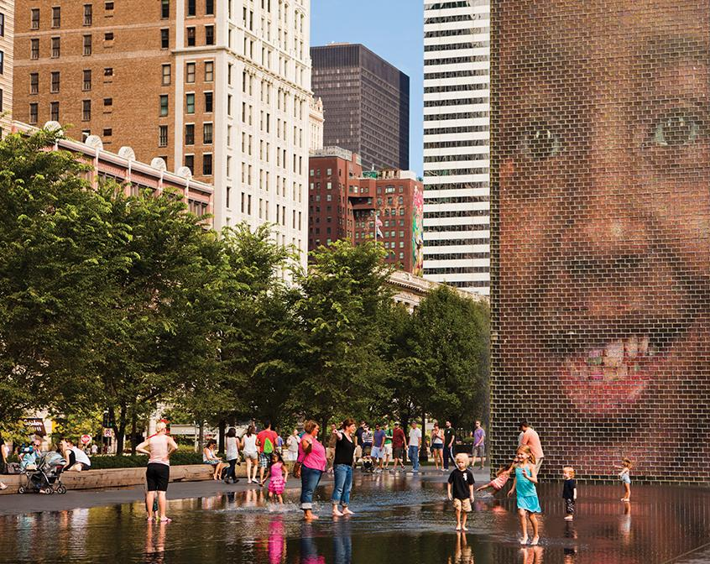
Key Findings
Walkable urban office space in the 30 largest metros commands a 105 percent rent-per-square-foot premium over rents in drivable suburban areas.
Rental multi-family commands a 61 percent rent-per-square-foot premium over rents in drivable suburban areas.
These price premiums continue to grow.
Walkable urban development is not limited to the revitalization of center cities; it is also the urbanization of suburbs.

Slide 21
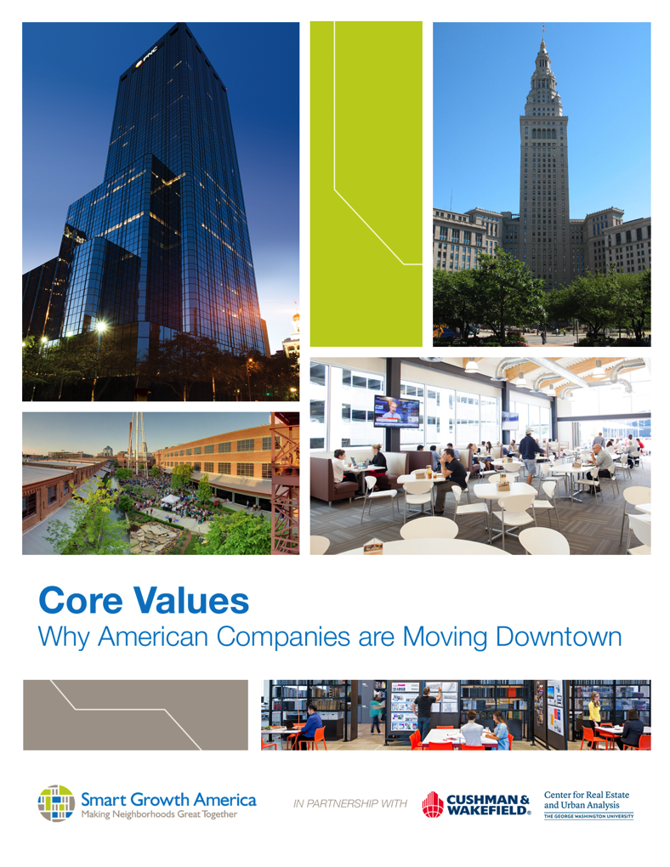
Why companies are moving to walkable places
To attract and retain talented workers
To build brand identity and company culture
To support creative collaboration
To be closer to customers and business partners
To centralize operations
Notes:
Smart Growth America conducted interviews with senior-level employees at relocated companies to understand why they chose the location they did. In the course of our interviews six common themes emerged explaining why companies chose to locate downtown:

Slide 22
Big Idea #1: Reconnect Massachusetts via Passenger Rail
How to create TOD and walkable places in MA Gateway communities?

Slide 23
“4 Crazy Ideas” to Catalyze TOD

Slide 24
Crazy Idea #1: Recapture Sense of Place

Slide 25
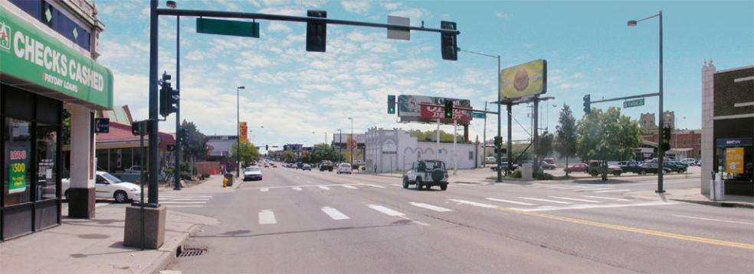
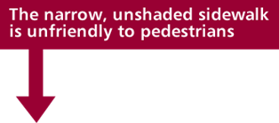
How could it work?

Slide 26
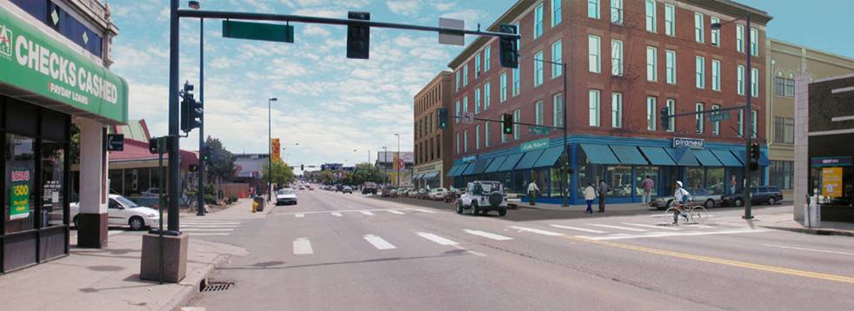
Step 1: New Development (Zoning)

Slide 27
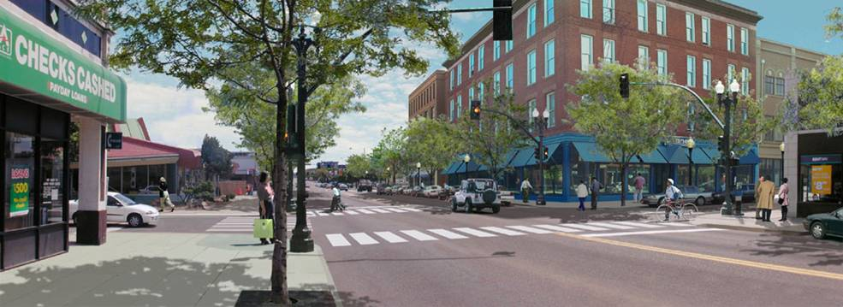
Step 2: Think About Pedestrians and Bicyclists (Complete Streets)

Slide 28
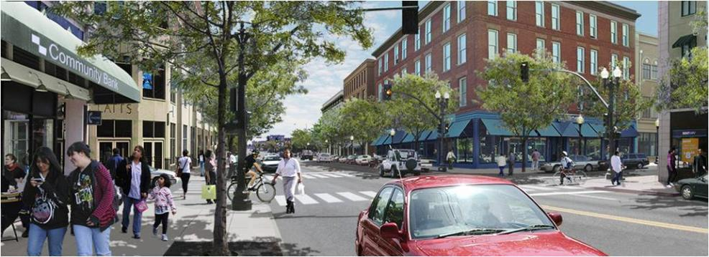
Step 3: Make the Community Vibrant

Slide 29
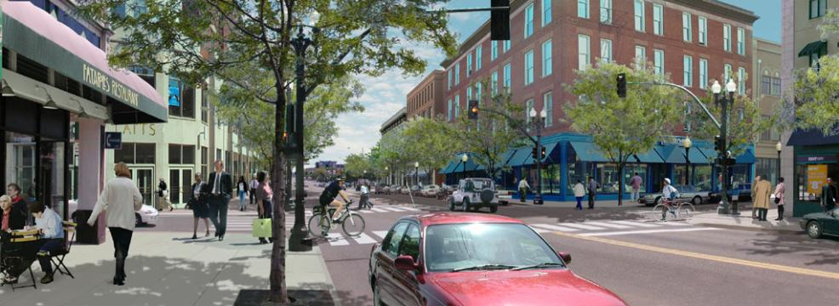
Step 4: Make the Community Affordable
Ensure new and existing development includes housing affordable to our neighbors…
…So these changes benefit our community.

Slide 30
Crazy Idea #2:
Launch Reconnect
Mass Campaign
(rail expansion!)

Slide 31
Washington’s support for transit is steady despite Administration’s resistance; make the most of key federal financing programs while they remain
RRIF expires December 2019

Slide 32
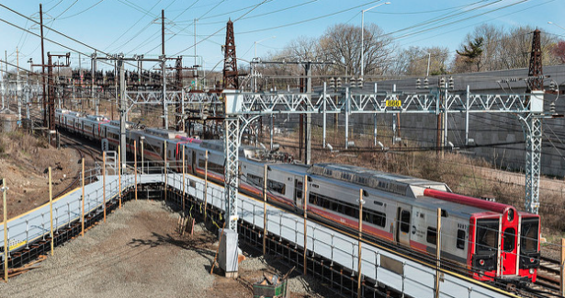
Eligible RRIF TOD Projects (up to 75% of project costs) and Applicants
Eligible applicants: States and local governments, Amtrak, railroads, government-sponsored authorities and corporations, limited option freight shippers, joint ventures
Eligible TOD Projects: Commercial and residential development, TOD-related infrastructure

Slide 33
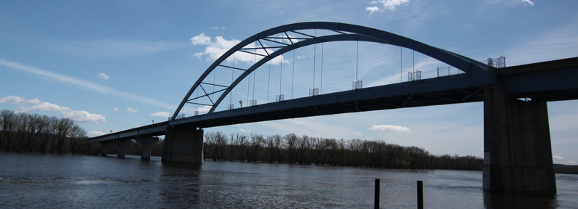
Eligible TIFIA TOD Projects (up to 33% of project costs) and Applicants
Eligible applicants: States and local governments, transit authorities, private firms, public-private partnerships, special authorities
Eligible TOD Projects: Property acquisition, demolition of existing structures, site preparation, utilities, transit station improvements, open space, safety and security improvements, building foundations, walkways, pedestrian and bicycle access, intermodal transfer facility, facilities incorporating community services, construction of space for commercial uses TOD infrastructure

Slide 34
Crazy Idea #3: Leverage Federal Opportunity Zones to Achieve eTOD

Slide 35
How does the Opportunity Zones tax incentive work?
Uses private investment vehicles to funnel up to $8 trillion in public and privately held capital gains towards economic development activities in our nation’s most distressed census tracts.
Scalable tax incentives for investing
Incentive #1: Temporary Deferral Capital Gain Taxes until Dec. 2026
Incentive #2: Step-up In Basis: 10% (5 years) or 15% (7 years)
Incentive #3: Permanent Exclusion of New Gains after (10+ years)
Place-based Requirement: 90% of qualified investments must be in an Opportunity Zones

Slide 36
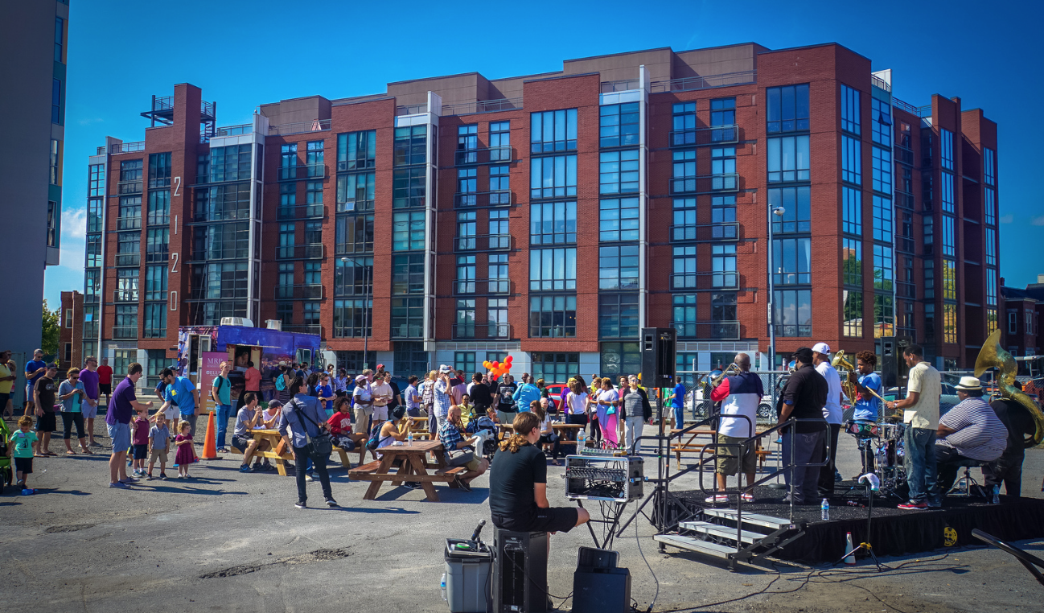
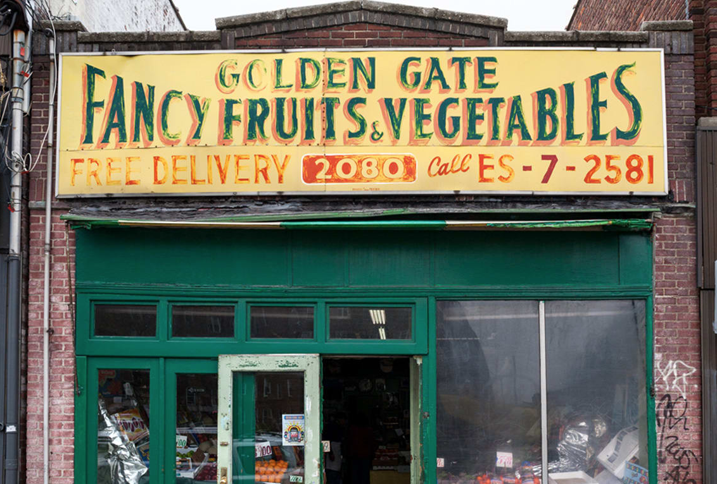
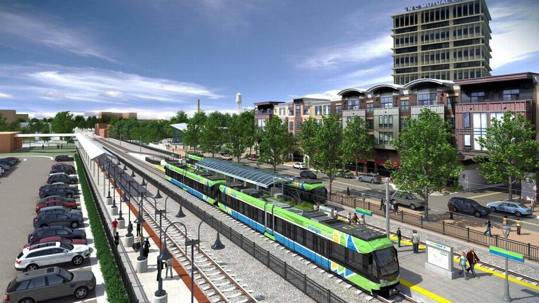
What can Opportunity Funds accomplish?
Create attainable, workforce housing
Prevent local business displacement
1. Enable redevelopment projects to offer favorable lease agreements for small, local businesses
2. Targets investments to existing small business ready to expand
3. Support businesses that support local entrepreneurship and startup
Build TOD projects
1. A city creates an Opportunity Fund
2. Identifies top corporations in the area interested in developing attainable housing
3. Corporation transfers capital into the city fund
4. Fund buys property in close proximity to corporate site and partners with real estate developers to build attainable housing
1. Create a state or local TOD Fund from commingled stakeholder assets
2. Engage various constituencies, including:
Transit agencies
Private developers
Philanthropies
3. Commit constituencies to 10-year build-out of transit and other TOD projects
Notes:
Photos (from left to right): Mixed-use building located at the intersection of DC’s Shaw/U St neighborhoods, contains a grocery store and 106 units of affordable housing / Abandoned storefront in Manhattan / Rendering of downtown Durham light rail station

Slide 37
Investors would like to invest in Opportunity Zone communities that…
Provide a path of least resistance.
Effectively align state and local development incentives.
Have easily identifiable and underwritten project pipelines.
Are interested in TOD and infill development.
Favor coordination amongst state and local regulating authorities.
Provide opportunities for both project and portfolio development.
Seek to encourage equitable development investment (social impact).

Slide 38
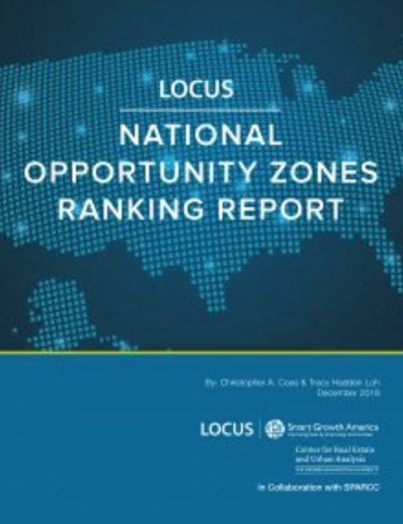
LOCUS National Opportunity Zones Ranking Report

Slide 39
Which MA OZs can become WalkUPs?
REGIONALLY SIGNIFICANT
WALKABLE
JOB DENSITY
HOUSING DENSITY

Slide 40
Top 10
Opportunity
Zones in
Massachusetts
Lynn*
Lowell*
Quincy*
Roxbury (Boston)*
Chelsea
Springfield
Charlestown (Boston)*
Malden*
Lynn (again!)*
Gloucester*
*
*

Slide 41
More WalkUPs?
Chelsea (x 2)
Springfield (x3)
Pittsfield
Jamaica Plain (Boston)
UMass-Boston
Edgeworth (Malden)
Downtown Holyoke
Main Middle (Worcester)
Alewife (Cambridge)
Revere Beach
Lower Highlands (Lowell)
South Lawrence
Mount Washington (Haverhill)
Yes, in MA Gateway Cities!

Slide 42
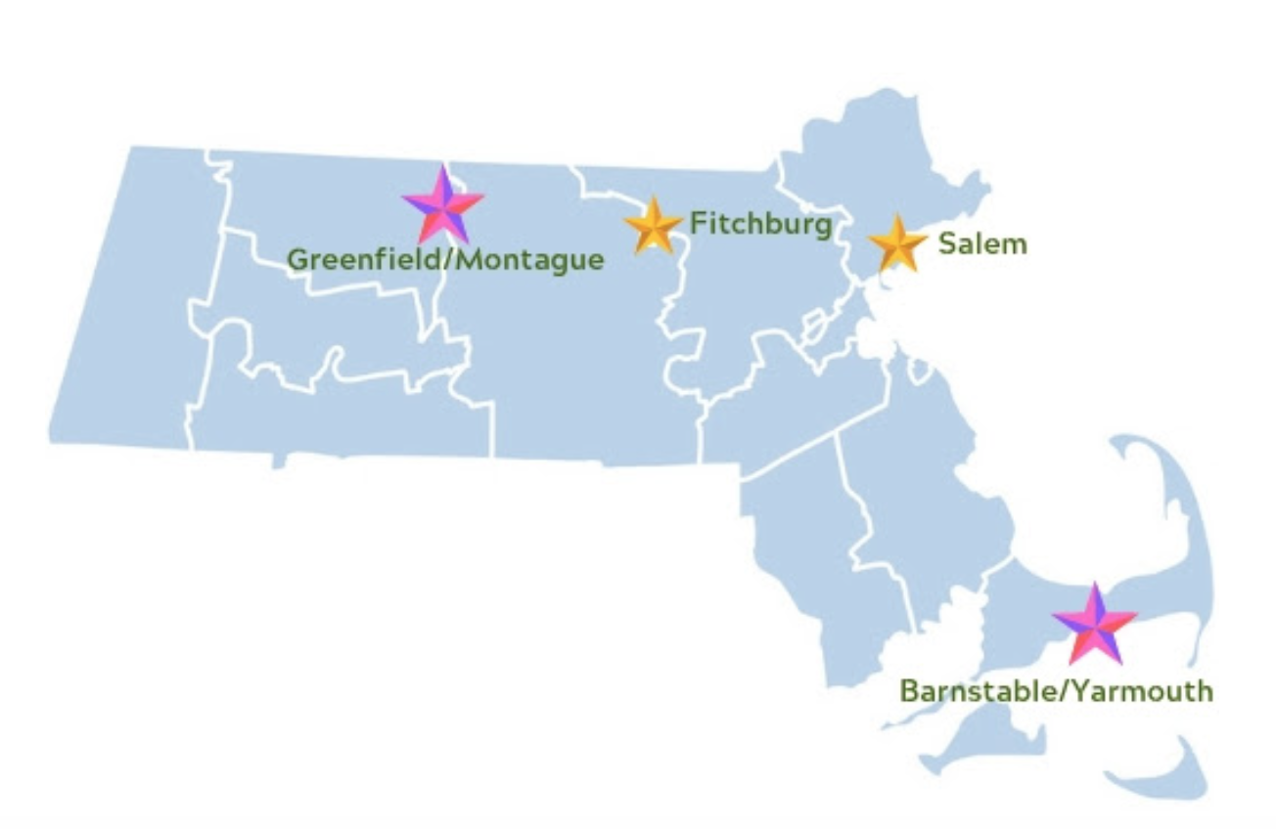
Massachusetts Opportunity Zones Academy
Aims to provide Massachusetts communities with a place-based technical assistance program that prepares them to make the most of the new federal Opportunity Zones tax incentive.

Slide 43
2019 Massachusetts Opportunity Zones Academy:
Lessons from the rest of the cohort municipalities:
Cape Cod (Barnstable/Yarmouth)
Simplify Regulations
Focus on Village Centers
Create Streets for People
Infrastructure unlocks development
Fitchburg
Use incentives to achieve vision
ID nodes and stitch together
Partner with anchors
Market your opportunities with a prospectus
Greenfield + Montague
Assessed the gap for catalytic project sites in downtown
Harness sense of place to drive economic development
Encourage redevelopment of walkable areas

Slide 44
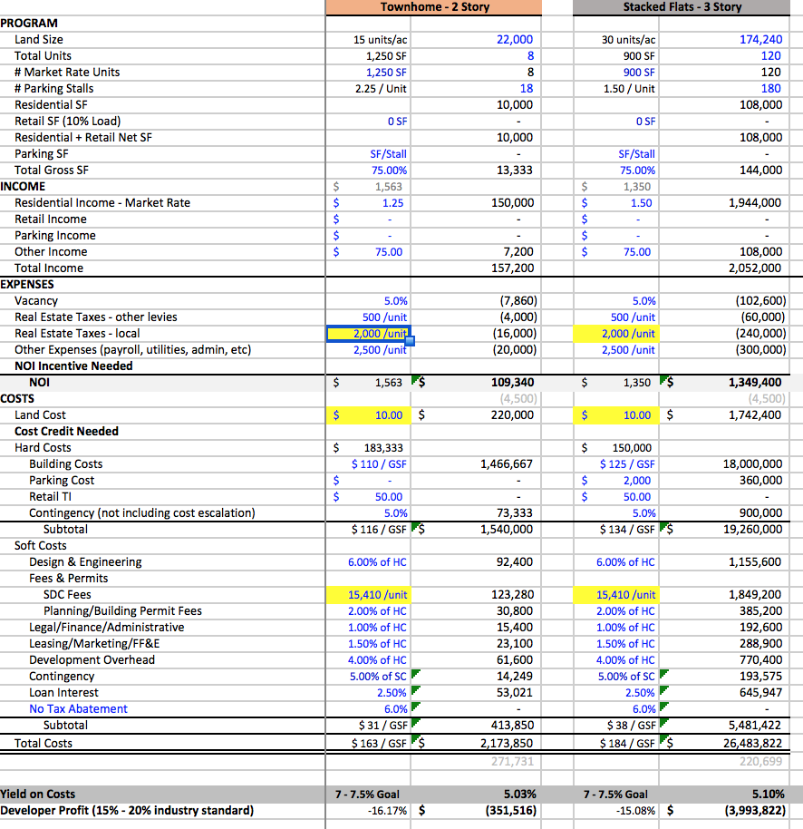
Best OZ Advice: Understand the “Gap”
How much subsidy is it going to take to close a project’s funding gap?

Slide 45
Crazy Idea #4: Create the “first” MA Gateway Cities
TOD Fund

Slide 46
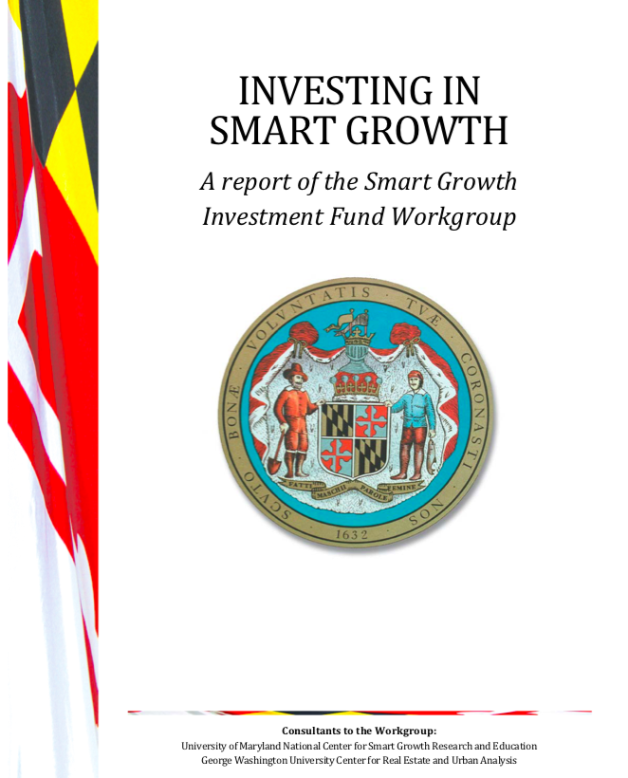
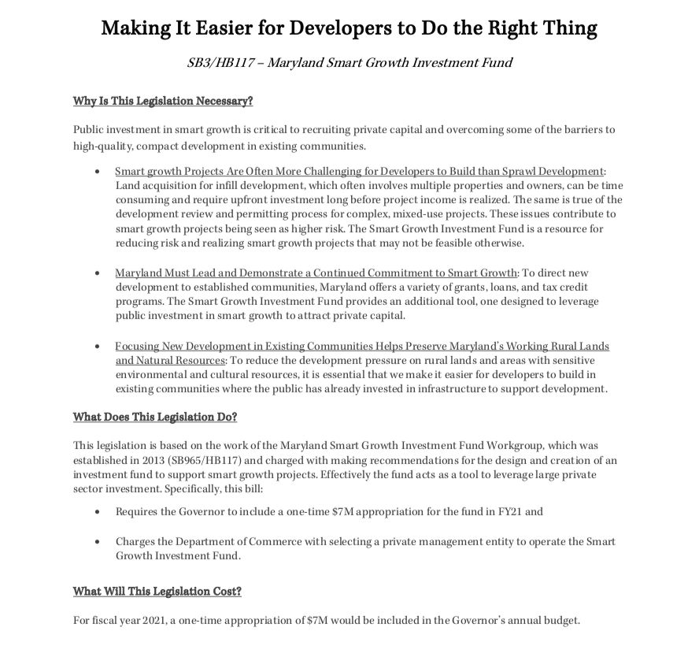

Slide 47
Thank You!
More information, please visit: locusdevelopers.org
Christopher Coes
Vice President, Smart Growth America
Director, LOCUS: Responsible Real Estate Developers and Investors
Email: ccoes@locusdevelopers.org
Twitter: @christophercoes

