Slide 1
Massachusetts students raised in higher income families earn more as adults

Slide 2
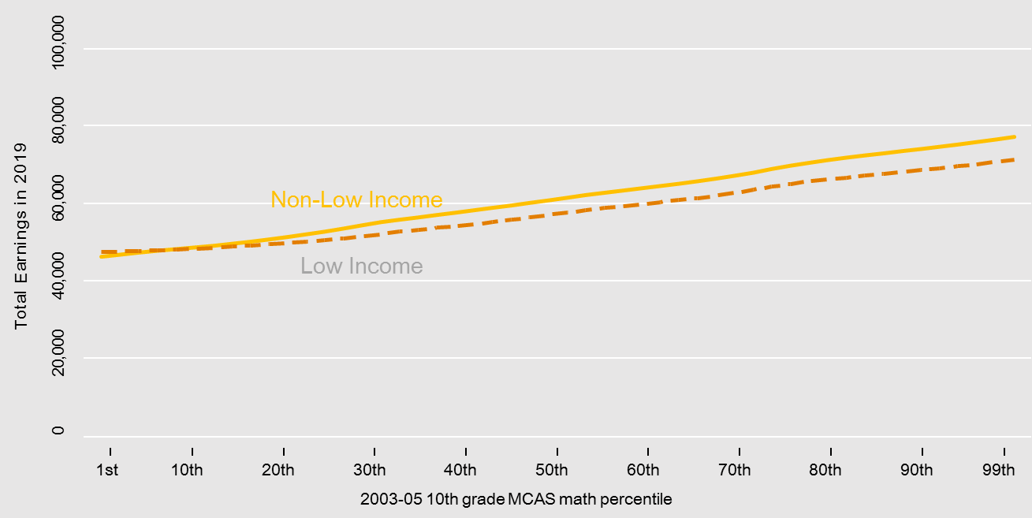
Higher education can lift all boats.
Total 2019 earnings by MCAS percentile, four-year college graduates
Source: Pappay et al (2020)

Slide 3
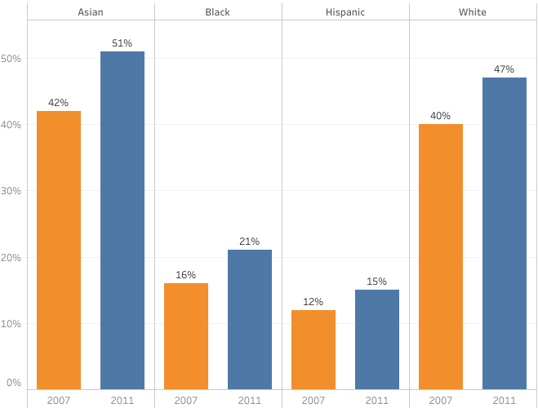
Black and Hispanic students are earning post-secondary degrees at half the rate of white students. And the gap is growing.
Source: MA Department of Elementary & Secondary Education

Slide 4
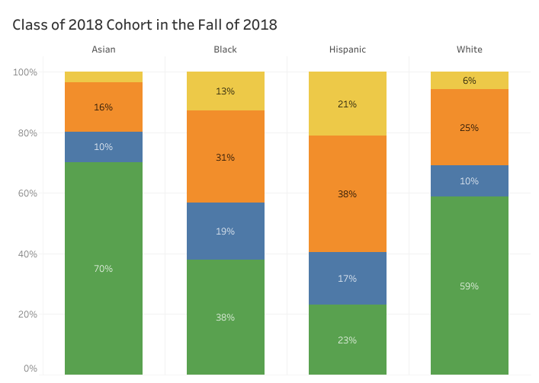
Black and Hispanic students are much less likely to move on to four-year colleges immediately after high school.
Did not graduate high school
High school graduate, not enrolled
Enrolled in 2-year college
Enrolled in 4-year college
Source: MA Department of Elementary & Secondary Education

Slide 5
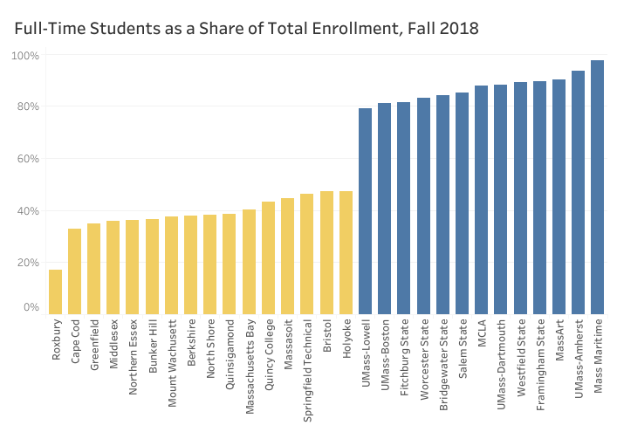
Few students at the state’s two-year institutions are able to attend full-time.
Source: IPEDS

Slide 6
Gaps in college graduation rates are large even for students
with the same MCAS scores
Source: Pappay et al (2020)

Slide 7
Massachusetts is scaling high-quality Early College programs
Source: MA Department of Elementary & Secondary Education

Slide 8
Early College programs are reaching the most underserved students
Source: MA Department of Elementary & Secondary Education

Slide 9
Early College students tackle more rigorous MassCore classes
Source: MA Department of Elementary & Secondary Education

Slide 10
FAFSA completion rates show Early College keeps students on track
Source: MA Department of Elementary & Secondary Education

Slide 11
Students in Early College are 20-percentage points more likely to continue their post-secondary education after high school
Source: MA Department of Elementary & Secondary Education

Slide 12
Students in Early College are more likely to enroll in both 2- and 4-year institutions
Source: MA Department of Elementary & Secondary Education

