Slide 1
Presentation Title
Teach Berkshire
Shirley Edgerton M.Ed.
Pittsfield Public Schools
Cultural Proficiency Coach
September 16, 2020

Slide 2
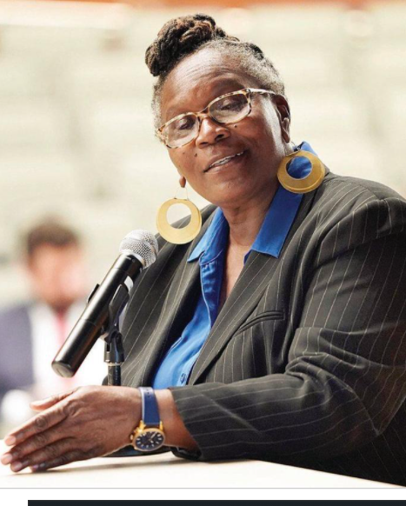
Introduction
SHIRLEY EDGERTON
District DEI trainer, Director of The Rites of Passage and Empowerment Program (ROPE) for girls.
Serving Pittsfield Public Schools. Grades K-12.
Identifies barriers that prevent educators of color from HBCUs accepting teaching positions in MA.
Provides internships for students of HBCUs to increases the diversity of educators and other related positions in Pittsfield Public Schools.
Creates strategies to strengthen existing teachers recruitment and retention.
Establish relationships with colleges in Berkshire County to recruit teachers of color.

Slide 3
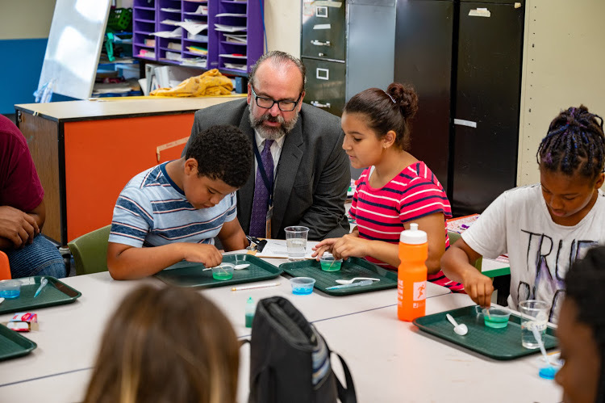
Context
Increase representation of educators that reflects the student body.
Prepare all students to become global citizens.
Administrators and other team members have attended job fairs, posted vacancies in School Spring.
PPS commitment to Diversity, Equity and Inclusion and the growing number of students of color.
Pittsfield School committee and Superintendent Dr. McCandless’s commitment to diversity equity and inclusion.
Notes:
[What had been done previously to address this need?]
[What sparked the development of your program?]

Slide 4
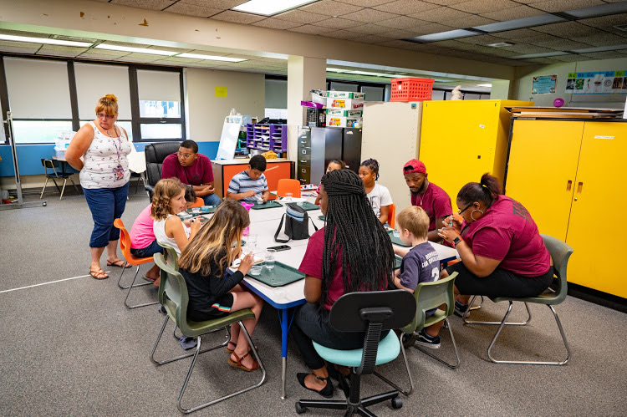
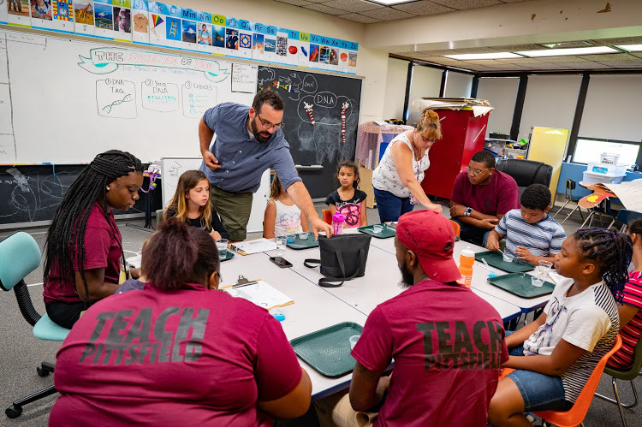
Design
Collaborations with HBCUs Connecting with colleges in western Mass.
Accessing historical and cultural sites.
Interns participating in 21st. Century Learning Centers summer program.
Identifying HBCU media platforms.
Evaluation of district’s curriculum framework
Notes:
What are the program’s features?
What is the staffing model?
[How is it funded?]
[Other important attributes]
Support and collaboration with Department of Elementary and Secondary Education.

Slide 5
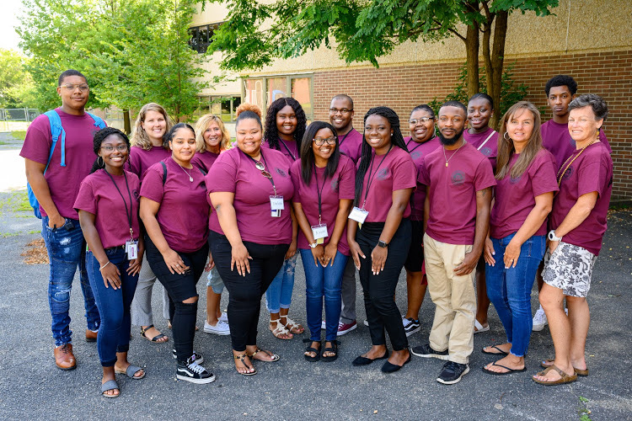
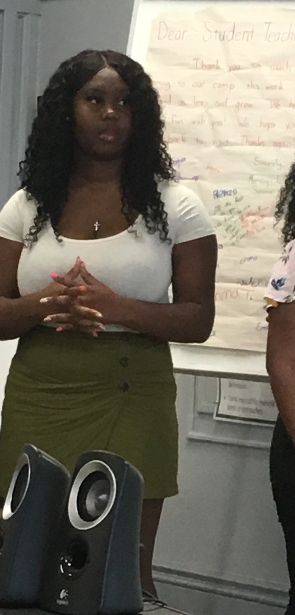
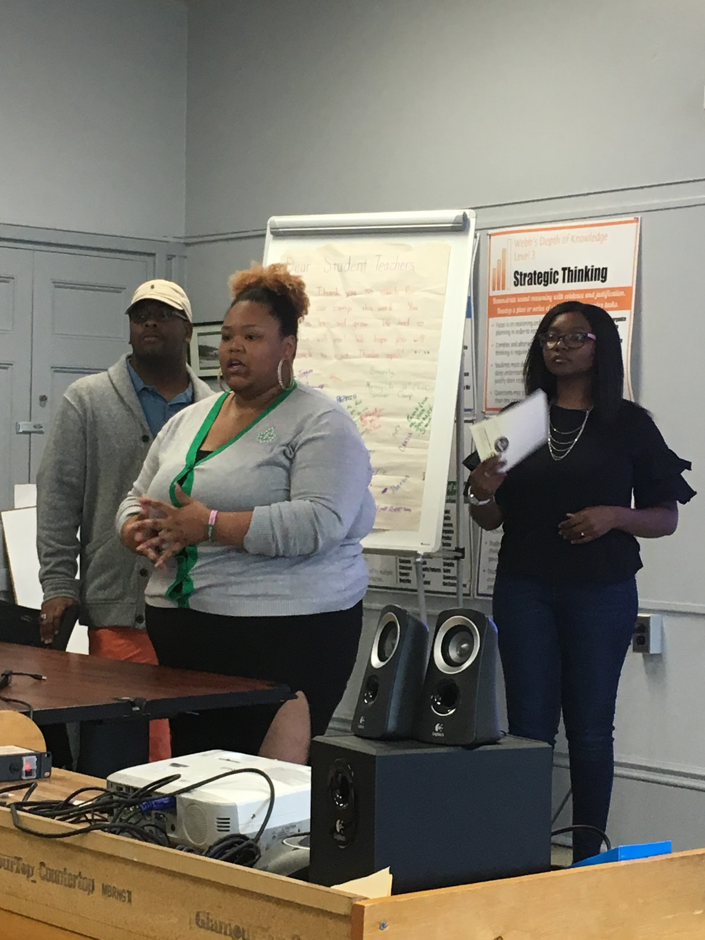
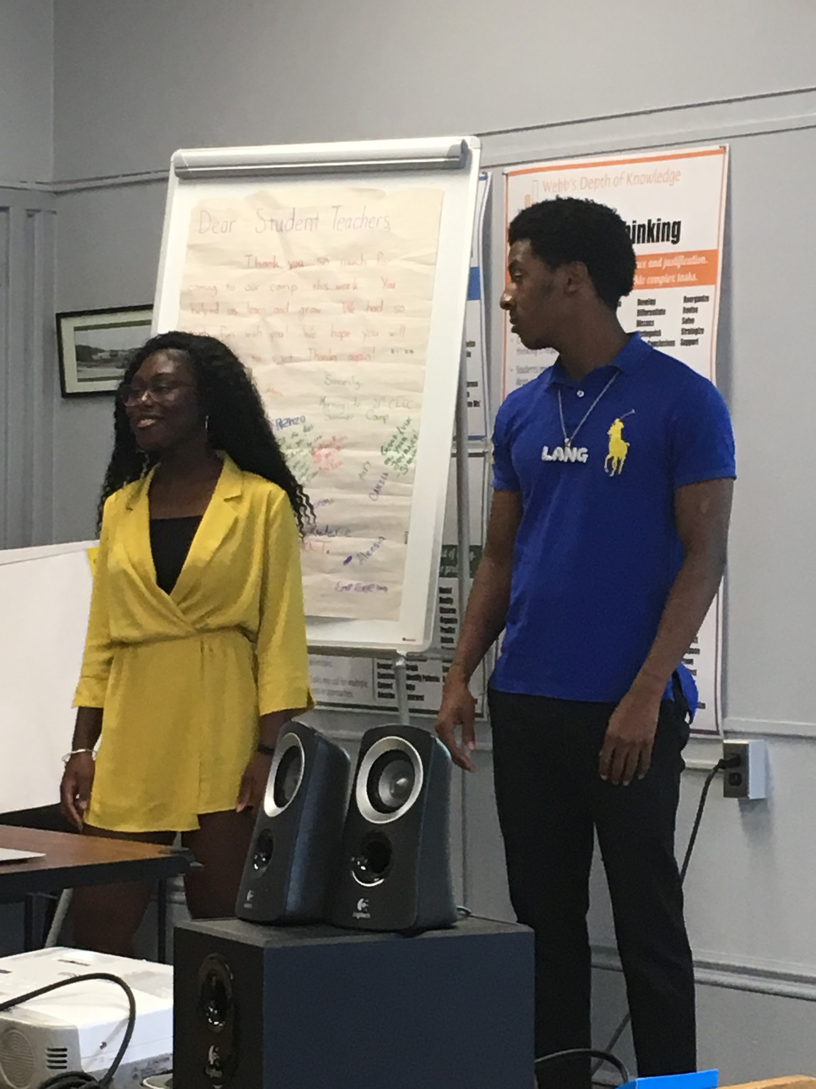
Results
Served over 100 students during internship.
Increased interest and knowledge on HBCU system as a choice for college bound students.
Established a database.
Continue to use this model for Recruitment.
Notes:
Due to Coronovirus the project served 25-30 students.
Informed administrators on next steps.
Established database.
Increased recognization of possibilities with HBCUs.

Slide 6
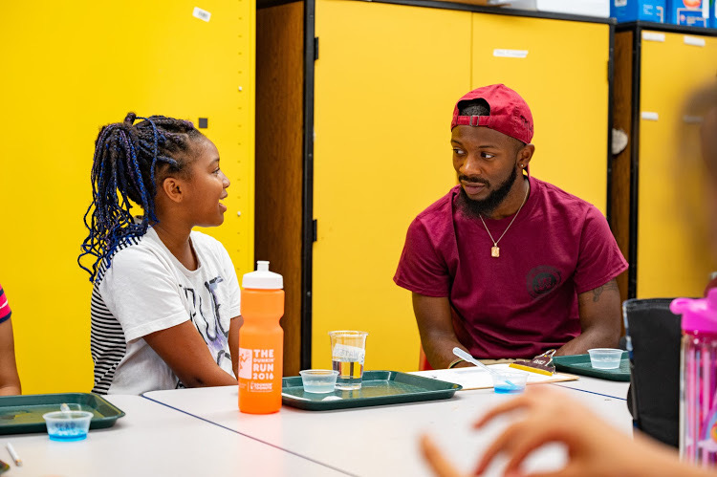
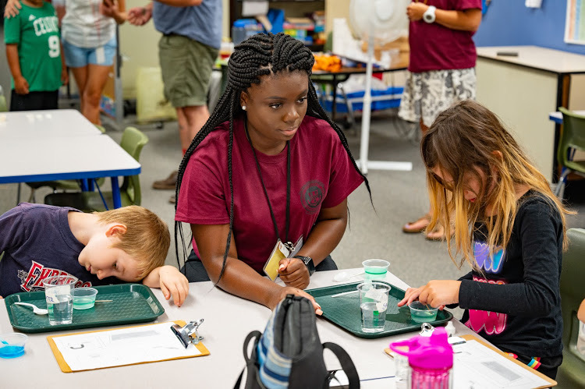
Lessons Learned
Develop flexible financial package.
Establish HBCU alumni network.
Share knowledge of HBCU system with student, families and PPS.
Ensure a welcoming culture exist in the district and community.

Slide 7
Policy Implications
POPULATION BY RACE AND ORIGIN
STATE OF MASSACHUSETTS
This table displays the Population by Race and Hispanic Origin. Though the 1990s, the non-white population and Hispanic populations ahowed significant increases.
This mirrored trends in Berkshire county and the state as a whole.
The apparent growth in the “Other” category is, in part, due to a redefinition by the bureau of the Census.
“Other” now includes persons of more than one race which heretofore had to be identified as one race or another.
 | White | Black | Asian | Other | %Non- White | Hispanic origin (of any race) | % Hispanic
1980 | 5,362,836 | 221,279 | 49,501 | 103,421 | 6.5% | 141,043 | 2.5%
1990 | 5,405,374 | 300,130 | 143,392 | 167,259 | 10.2% | 287,549 | 4.8%
2000 | 5,367,286 | 238,124 | 238,124 | 400,233 | 15.5% | 428,729 | 6.8%
BERKSHIRE COUNTY
1980 | 142,064 | 2,036 | 454 | 552 | 2.1% | 874 | 0.6%
1990 | 135,122 | 2,534 | 1,001 | 695 | 3.0% | 1,407 | 1.0%
2000 | 128,235 | 2,679 | 1,333 | 2,706 | 5.0% | 2,286 | 1.7%
CITY OF PITTSFIELD
1980 | 50,331 | 1,244 | 197 | 202 | 3.2% | 273 | 0.5%
1990 | 46,416 | 1,529 | 374 | 303 | 4.5% | 535 | 1.1%
2000 | 42,395 | 1,674 | 533 | 1,191 | 7.4% | 934 | 2.0%
Notes:
[What could cities do to support this work?] Invest in city wide cultural Competency plan
[What could the state do to support this work? Continue to provide funding, Government policies reflective DEI

Slide 8
Contact Information
Shirley Edgerton
Sedgerton@Pittsfield.net
(413) 770-9748

