Slide 1
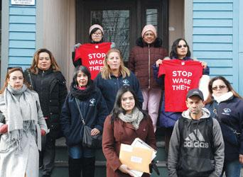
Diversifying Civic Leadership in Chelsea
Gladys Vega
Chelsea Collaborative Executive Director
October 8, 2020

Slide 2
Introduction
Founded in 1988, the Chelsea Collaborative empowers Latinx immigrants to enhance the social and economic health of the community and its people; and to hold institutional decision-makers accountable to the community.
Grassroots leadership is possible when residents have their basic needs met and stability in their lives. Our model focuses on overlapping and complementary strategies
Systemic Change
Survival (Access to food, housing, basic rights, case management)
Stability
(Uplift through skills, training, education, jobs)
Inter-Generational Leadership

Slide 3
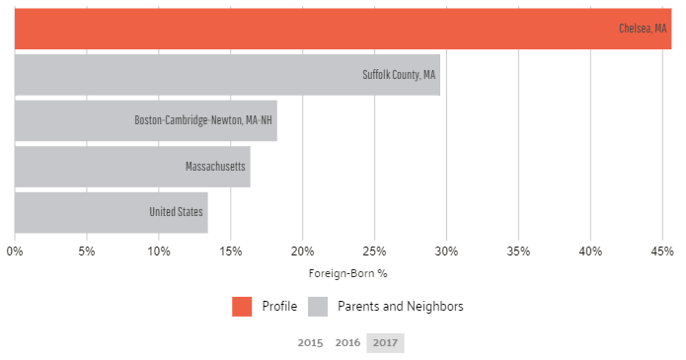
Context: Demographics
Chelsea is a city that has been built and enriched by a large Latinx community.
67% of residents are Latinx
46% of residents are foreign-born
68.1% of residents are citizens
19% of residents living in poverty
% FOREIGN BORN

Slide 4
Context
The City of Chelsea has had a long history of corruption, abuse, and mismanagement in its city government. This coincided with city leadership that did not reflect the city's diverse population.
Even though we have made up a significant portion of the city since the 1970s, until recently, Latinos had been severely underrepresented in local decision-making bodies
The city has lost local control of the government on three occasions, first in 1908 after the Great Fire, in 1989 when BU took over the public schools, and then in 1991, when the entire city government was put into state receivership to avoid bankruptcy
In 1994, the city came out of state receivership with a new City Charter, which changed the form of government from an elected Mayor and Board of Aldermen, to a City Manager and an elected City Council from more appropriately defined districts. During this time, the city also experienced, after federal government intervention, a major transformation of its police department which added minority officers for the first time.
A few years later, the federal government intervened again to require the reconfiguration of the School Committee to ensure broader representation of minority communities.
Notes:
Comment from Ben Forman @ MassINC:
It's just my opinion (and not really a comment on the draft), but I think these 2 things go together. When a city is led by people who aren't reflective of its population, problems are bound to take hold. The real irony is often the holdovers in power talk about themselves openly as the "protectors" of the city and justify their power grab by saying the newcomers aren't ready. Maybe calling this out will encourage some of them to give these views more consideration.

Slide 5
Design
Target population: Latinx and immigrants living and working in Chelsea
Everything done with a culturally competent lens and deep understanding/experience with Latinx immigrant experiences
Create a pipeline of immigrant leaders from the community
Youth AND Adults working together and supporting each other
Direct services (survival & stability)
Know Your Rights
Leadership training
Campaign development
Mobilization
Get Out the Vote – Year-Round Voter Education & Mobilization
Promotores Model – Residents engaging their neighbors, building grassroots network
Local and State Policy & Legislative Campaigns
Local ordinance on Wage Theft
City of Chelsea Sanctuary City status
Local Community Preservation Act passed
Education Promise Act (MA)
Right to Counsel (MA)

Slide 6
Design - Staffing
Collaborative Membership
Civic Leadership is an organization-wide effort that includes all staff and board members
Top 3 leaders are Latina immigrant
Diverse, bilingual and bicultural staff and board are key to our success
Board of Directors is 67% Latinx
Staff is 82% Latinx.
Board of Directors
Executive Director
Chief Operating Officer
Operations, Finance & Development
Survival Programs
Stability Programs
Civic Leadership
Operations Manager
Food Pantry Director
Economic Mobility
Housing Stability
Policy & Organizing Director
Finance Director
Case Managers
Adult Workforce Development Manager
Tenant Organizer
Worker Organizer
Development Director
Youth Workforce Development Manager
Consumer Protection Specialist
Tenant Organizer
Citizenship & Immigration Coordinator
Youth Organizer
Education Instructors (ESL, Computer, Literacy)

Slide 7
Policy Implications
LOCAL WORK
Cities must address the issues affecting their people – in their native languages
Maximize resident involvement and let residents develop their own solutions
Empower residents to sit at the table, participate in community meetings, make decisions
Celebrate our cultures
STATEWIDE WORK
Invest in immigration support services, citizenship and ESL education, programs to increase economic mobility
One size does not fit all – look to unique community for unique solutions
Shape funding, policy, and programs with community voices, resident input

Slide 8
Results
The November 2015 municipal elections brought the most sweeping change to the composition of the local legislative bodies. For the first time, the majority of both the City Council and the School Committee was made up of people of color (POC).
Specifically, 6 of 11 City Council members are Latinos (8 are POC), as are 7 seven out of 9 nine School Committee members (8 are POC). In all, today, 65% of all elected municipal officials in Chelsea are Latinos compared to less than 20% before 2014.
The Community Preservation Act passed in 2016 brought new tax revenues to support affordable housing, green space, and historic preservation.
The City of Chelsea is one of the few municipalities in the country that has adopted a Sanctuary City status in partnership with its police department along with diverse community organizations.
The city has also made great strides in increasing the number of Latinos that today sit on decision-making boards and commissions citywide.

Slide 9
Lessons Learned
LEARNING
Continually listen to community needs and perspectives to determine programs and priorities – e.g. expansion of workforce development programs, integrating social-emotional learning into youth development work
Provide members with long-term leadership opportunities from inside of the organization
Family support and cultural celebration are key to engagement and relationships
Need to conduct longer-term follow up with members, support over multiple years to truly accomplish stability and foster leadership capacity
ADVICE FOR OTHERS
Connect with your people
Build trust
Listen
Invest in a pipeline – engage youth and start building the future generation of leaders
Be willing and ready to adapt based on community needs and current events

Slide 10
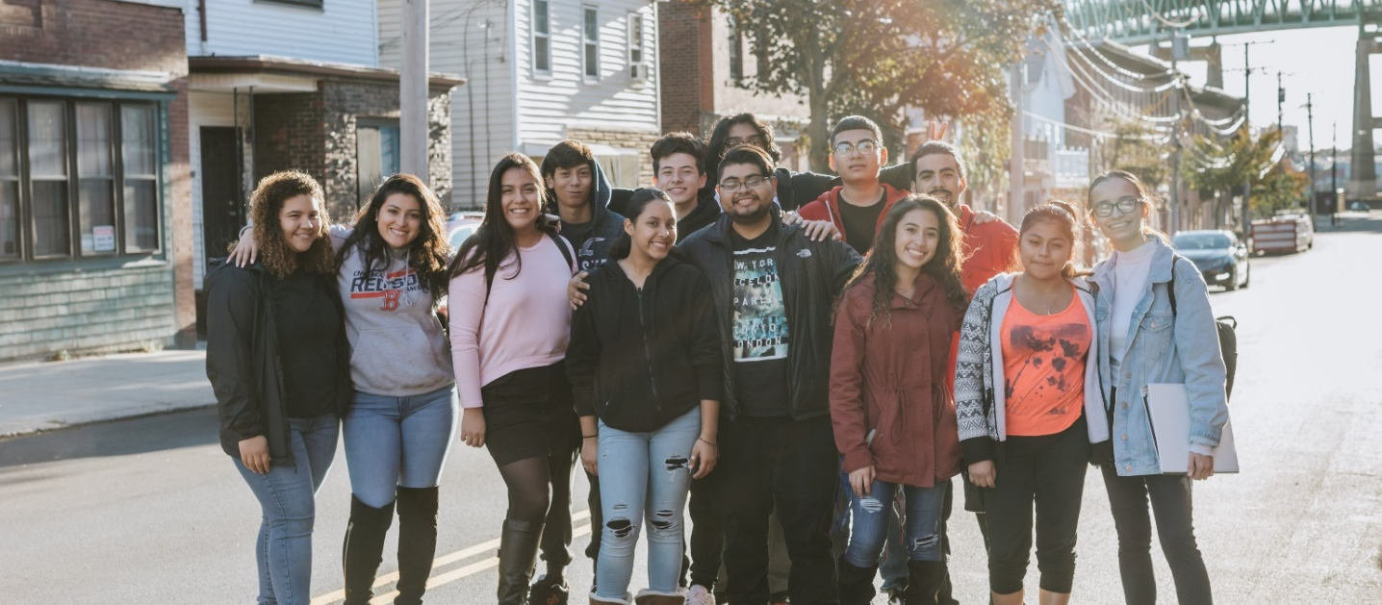
Contact Information
www.chelseacollab.org
Facebook @thechelseacollaborative
Instagram @la_colaborativa
Twitter @la_colaborativa

