Slide 1
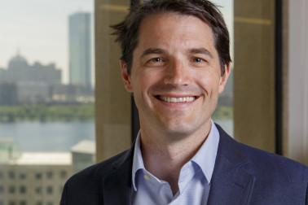
Presentation Title
Dougan Sherwood
Greater Haverhill Chamber President
October 22, 2020
Notes:
Racial and economic inequities are more glaring than ever. The economic and health impacts of COVID-19 have hit communities of color and immigrant communities disproportionately harder than the rest of our region. The rate of positive COVID-19 cases among Black and Latinx residents is 3x as high as the rate among white residents. Unemployment has hit communities of color harder, too. For example, MassINC recently reported 20% of Latinx residents are out of work. Food insecurity rates among Latinx and Black residents are 26% and 24%, compared to 13% for white residents. Thousands of laid off- or hourly workers lost wages during the shutdown, particularly immigrant families and others not able to access unemployment insurance or stimulus funding

Slide 2
Introduction
Dougan Sherwood, President of the Greater Haverhill Chamber of Commerce
Founded in 1888, for nearly 130 years, the Greater Haverhill Chamber of Commerce has done what Chamber’s do: it brings people together. It’s been a place for the business community network and to collectively have their interests represented
In 2018, the Chamber made the decision to chart a new course for itself. To redefine its purpose and its beliefs

Slide 3
Context
Haverhill, Massachusetts, is a microcosm of much larger markets.
Like many post-industrial cities, Haverhill is underperforming and has struggled to adapt to change over time.
Today, nationally, the chasm between those with money and those without money is widening. This is as true for cities as it is for people.
Change is likely to begin at the neighborhood level.
Notes:
For a 100 yr old + org, there’s a lot of history and tradition. Going too fast with change can break it apart, especially with leadership that’s from somewhere else. There’s a science and art to this. The science is understanding the critical economic value of inclusive economic growth and seeing the diversity in the community as an engine. The art is listening to people in the community, understand how they see things, build trust and relationships that allow for a real exchange. That’s why this work takes so long and why stasis is always looming. Talk about key stats in Haverhill. Use Ben’s slides. Reference no electeds or non-profit leaders. Anecdtotally, my two boards.

Slide 4
What’s Happened?
Local leaders saw an opportunity to break a mold.
Notes:
Could have been another org. Didn’t need to be a Chamber.
Right mix of locals excited and willing to do something different.
Saw the need to invite someone from outside the city in. The merger of local/passion/home and outsider/new/innovative is key.
Rebuilt Chamber from ground up, using data as North Star, focused on the economic advantage of inclusive economic development.
Strategic Plan, branding, alliances
External events: Pandemic – gave us chance to deliver value vs tithing. George Floyd – gave us platform and cover to speak loudly.

Slide 5
Then What
We Asked Two Questions:
Are Chambers of Commerce Still Relevant?
Why?
Notes:
One challenge in cities – too many mini-non-profits. Cannibalization occurs. Legit question to ask if Haverhill is better off with one-less org hosting a golf tourney.
Rebuilt Chamber from ground up, using data as North Star, focused on the economic advantage of inclusive economic development.
Strategic Plan, branding, alliances
External events: Pandemic – gave us chance to deliver value vs tithing. George Floyd – gave us platform and cover to speak loudly. Systemic racism takes on a very different meaning at the local level when you are trying to build trust in a community.
Act with a sense of urgency. Consider ourselves in a race. We can be a model for the resurgence of old mill cities that occurs when smart people work hard together.

Slide 6
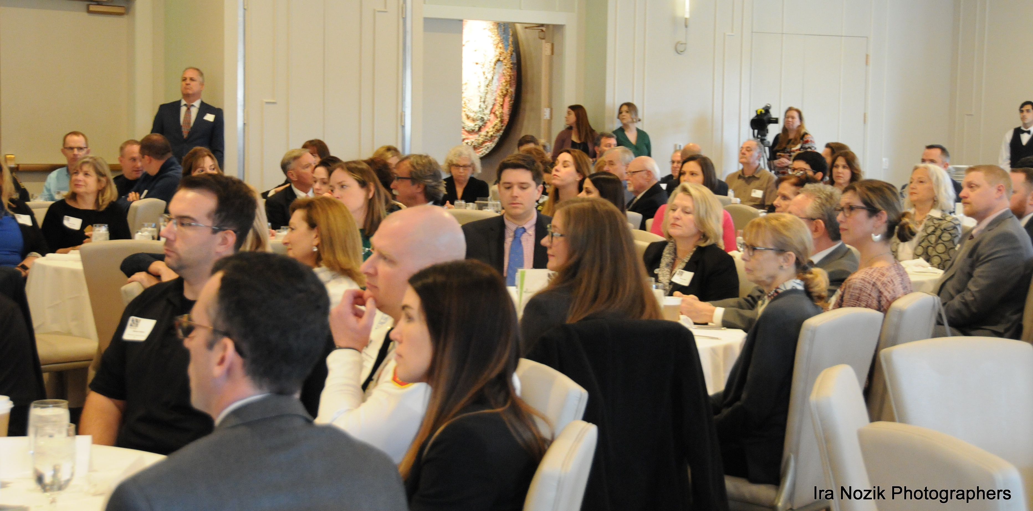
Notes:
Example of the subtle product of years of systemic racism. This pic of of anywhere USA Chamber event. True in Haverhill.
First new Board member event at a country club. Stunning moment. Critical moment.

Slide 7
Results
By beginning with ”why”, we now know what we believe in.
Inclusive economic development is key to 21st century city growth.
And
Haverhill has all of the resources necessary for it to compete at a national level.
Notes:
The result of our work has in effect redrawn the starting line.
strategic planning process that has rebranded the chamber as an organization serving its members and the larger, increasingly diverse, Haverhill community through a commitment to inclusive economic development.
Diversified board leadership
Built relationships that made room to challenge each other (e.g. institutions not speaking out publicly about BLM)
Initiatives underway: Asset mapping Haverhill LatinX community, creating campaigns to recognize leaders of color in the community, partnering with local BIPOC orgs to introduce DEI/anti-racist programming into the business community, getting into the conversation about local statues. Pressing for conversations that this moment insists we have that we can’t have anywhere other than at the city level.
Opportunities surface: LGBT Chamber’s first partner

Slide 8
Lessons Learned
Bringing locals and outsiders together is critical to progress
Local economic development can stall without a clear understanding of purpose
There is joy in bringing new groups of people together
This is generational work
Notes:
“Everything is broken. Don’t change anything”.
Board construct closely resembles city demographics
Programming validated by increased demand from institutions; local bank is pulling away from support of Christmas traditions in favor of our initiative to recognize leaders of color in the biz community.

Slide 9
Policy Implications
It’s important that government, non-profits and for for-profits understand their lanes, what they’re good at and what others are good at. The intersection of the three is where good local governance emerges.
State and Federal partners need to understand the capacity of organizational leaders

Slide 10
Contact Information
Dougan@haverhillchamber.com / info@haverhillchamber.com
@GrHavChamber
@GrHaverhillChamber
@greaterhaverhillchamber

