Slide 1
Gateway Cities Innovation Award
Ivette Olmeda
MassDevelopment’s Worcester Transformative Development Initiative (TDI) Fellow
October 22, 2020
Notes:
Good Morning, Thank you XXX for the nice introduction.
my name is Ivette Olmeda, MassDevelopment Transformative Development Initiative Fellow in Worcester. First I want to thank you to MassINC for putting this amazing series of case studies.
I’m truly humble & honored ..

Slide 2
Introduction
MassDevelopment, the state’s finance and development agency, works with businesses, nonprofits, banks, and communities to stimulate economic growth across MA.
MassDevelopment’s Transformative Development Initiative (TDI) is a program for Gateway Cities designed to accelerate economic growth within focused districts.
The vision of the Worcester TDI partnership – including City of Worcester, Clark University, the Main South Community Development Corporation (CDC), YMCA of Central Mass, Regional Environmental Council (REC), business owners & residents – is to shift perceptions of Main South and further build a diverse, vibrant, and walkable neighborhood by engaging local business and property owners, organizing a business association, and developing strategic reuse plans for vacant sites.
Notes:
Talking Point
.
#3 The program works with cross-sector partnerships to engage community members in actionable planning, implement local economic development initiatives, and spur further public and private investment. I’ve been proud to work with local partners to engage local business and property owners, organize a business association, and develop strategic reuse plans for vacant sites to help Main South become a walkable and vibrant neighborhood.

Slide 3
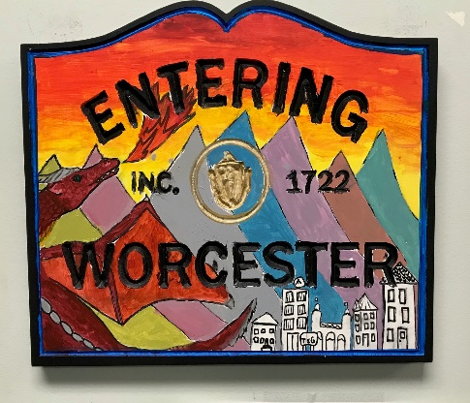
TDI Main South Map
Downtown
Webster Square
Notes:
The focus area for the TDI district is a roughly five block stretch of Main Street in the heart of the Main South Neighborhood bordered by King Street and Wellington Street. The northern endpoint of the District is just under a half mile from City Hall and the southern endpoint of the District is just over a half mile from the Clark University campus. The Main South neighborhood in general is located between Downtown Worcester and the Webster Square neighborhood. It represents an important connector and has a long and proud history as home to Worcester’s blue-collar working class..
The goal for the future is to intensively focus on a commercial corridor and the surrounding non-profit and residential properties within Main South to help encourage, guide, and leverage future investment and economic development

Slide 4
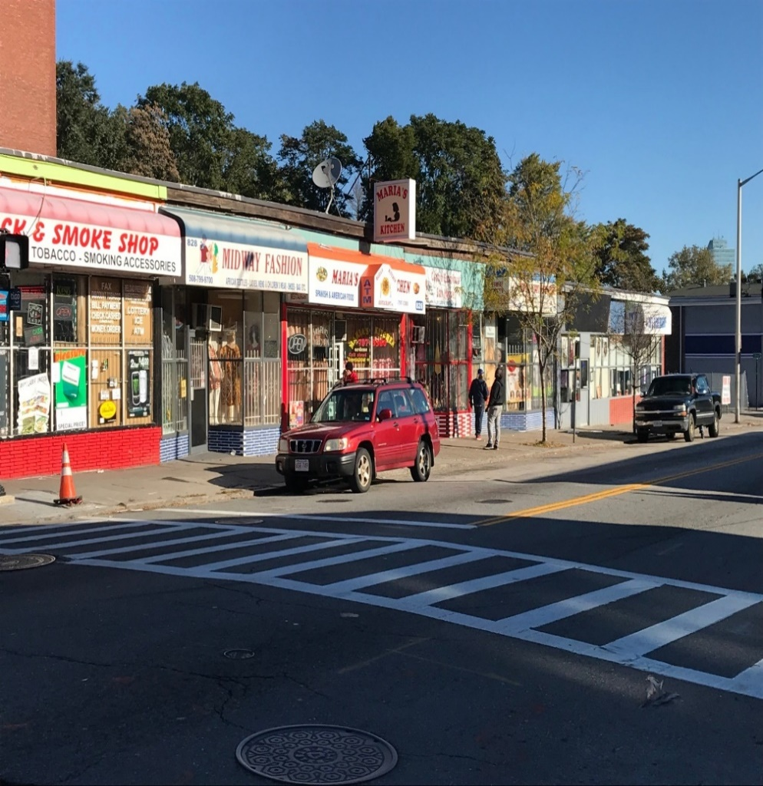
Context
The Main South Business Association (MSBA), created in 2019, is a network of local small business owners who are collaborating to strengthen individual businesses, improve the neighborhood through events and activities, and bring more positive attention to the district.
Main South has 87 small businesses; one-on-one introductory meetings with business owners revealed the need for a formal business association to facilitate communication and help turn ideas into tangible results.
Notes:
Talking Points
2. The MSBA provides an avenue for local business owners to connect, exchange resources & work together to improve the quality of life of the neighborhood.
3. The TDI Partnership (who I’m working on a weekly basis * My roll as a Fellow) is a number of partners in Main South, including the Main South CDC and a network of engaged residents, have a long history of working to create housing opportunities, lead neighborhood improvement efforts & instill pride in Main South.

Slide 5
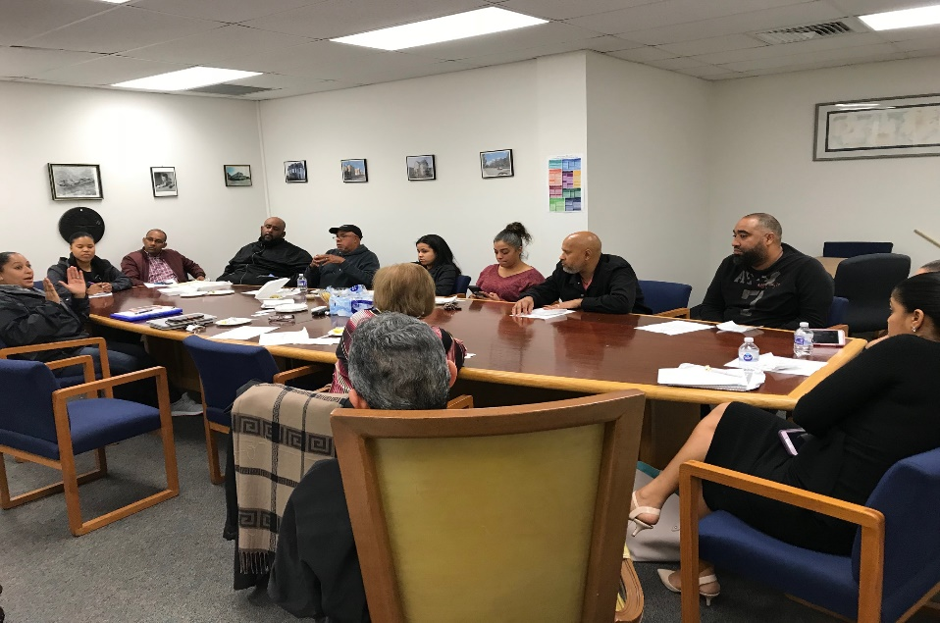
Design
The Main South Business Association (MSBA) serves small businesses in the greater Main South neighborhood.
MSBA began as a group primarily for the Spanish-speaking business owners, and the group’s leadership is all bilingual.
The group is now looking to better expand its programming for the multicultural district. MSBA members elected an executive committee.
The Transformative Development Initiative (TDI) Fellow assists with many of the day-to-day functions.
The Main South CDC received an Urban Agenda Grant to assist with further developing the organization.
Donations from members; goal to create formal dues process & membership application to help with sustainability.
Notes:
Talking Points
#2 add: This has helped bring in business owners who have not been able to connect to resources and peers in the past. To be inclusive they also ranslate its materials for the many languages spoken in Main South.
#3 The group is now looking to better expend its programming for the multicultural district. MSBA members elected an executive committee: president, vice president, treasurer & secretary and established a d\membership dues because they believe on start with their own investment.
#4 Currently no full-time staff. The role of a Fellow and have someone working on the ground directly. and the organization has received some smaller TDI-related grants

Slide 6
Results
The Main South Business Association (MSBA) is comprised of 22 small business owners

Slide 7
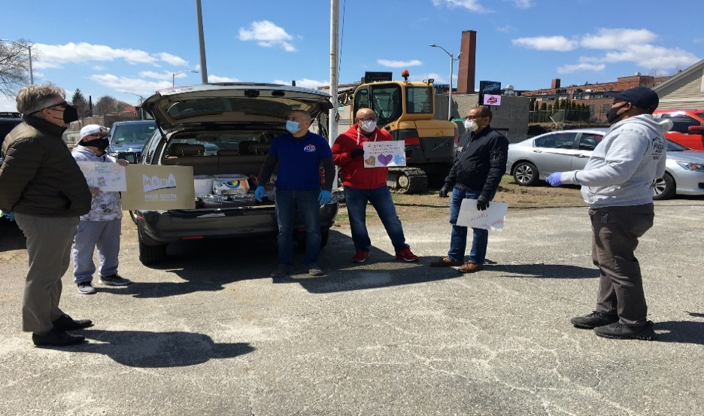
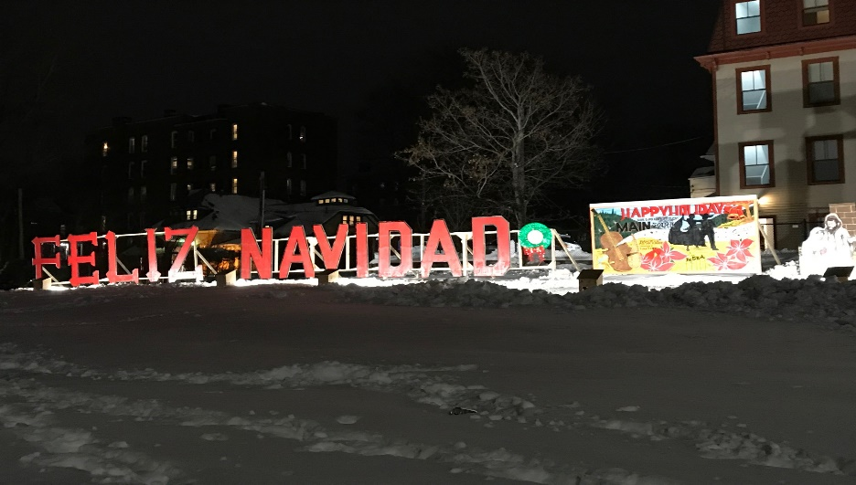
Results
Programming has included:
Back-to-school event
Feliz Navidad placemaking; holiday-themed artwork & lighting to help increase foot traffic to local businesses
When COVID-19 hit, MSBA communicated financial resources to local business owners to help them stay afloat & organized restaurants to donate food to first responders and other community members in need.
Receiving technical assistance helps to formalize an ongoing process for the association.
Notes:
Talking Points:
Programming has included:
Social Responsibility
Back-to-school event; donated 150 backpacks to area children in need
Feliz Navidad placemaking; holiday-themed artwork & lighting to help increase foot traffic to local businesses
#2 TDI program is a program that recognize the importance to do disseminate financial resources for small and minority businesses to improve the diversity, equity and inclusion. PPP, CBDG Funds and TDI Local Relief Funds.
#3 With Effort underway to develop mission statement, bylaws & further formalize the organization for sustainability. As I speak today the MSBA mission statement is ………
Effort underway to develop mission statement, bylaws & further formalize the organization

Slide 8
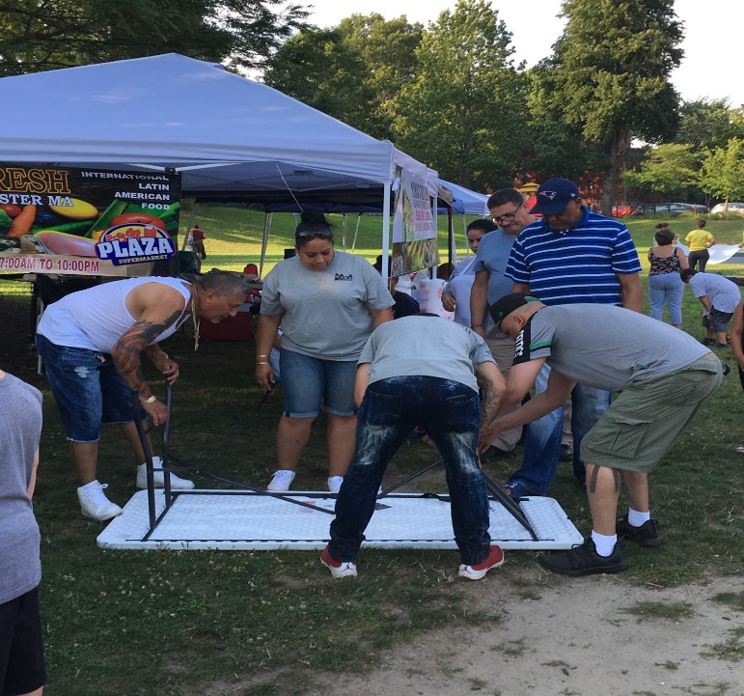
Lessons Learned
Establish meeting schedule.
Create branding & logo.
Goal to create a Main South business directory & develop an MSBA website to market local businesses and services.
First, build relations and trust with business owners.
Foster “team” mentality.
No cookie-cutter model for neighborhood associations; find out what brings your neighbors together.
Complimentary by Creative You-nique Print Shop – Jessica Reyes-Carrion
Notes:
Talking Point
#1 Established structure
#2 Branding & logo – Create an early pride sense, a better position for the association to be recognize in the neighborhood.

Slide 9
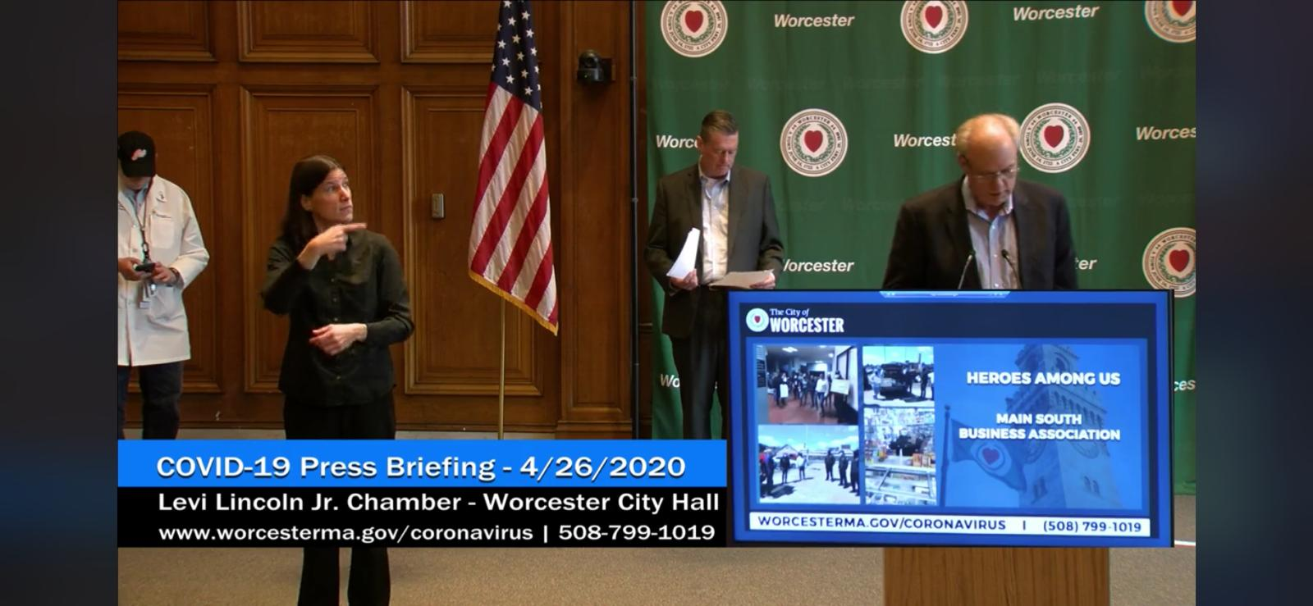
Policy Implications
Helpful to have city/state recognize & encourage efforts.
MassDevelopment’s Transformative Development Initiative (TDI) created TDI fellows, a position dedicated to building capacity in & identifying resources for Gateway Cities like Worcester.
Early technical assistance for group facilitation and small grants for implementing programming can help in getting groups like these off the ground.
Would help to know more about what business association models look like and what can lead them to be sustainable long term.
Notes:
Talking point
#1 -(i.e. Worcester Mayor Joseph Petty gave the Main South Business Association a shout-out as one of the Worcester “Heroes Among Us” during a press conference a few months ago, doing a lot to build pride among our members)
#3 many years can pass if we don’t capitalize this efforts.

Slide 10
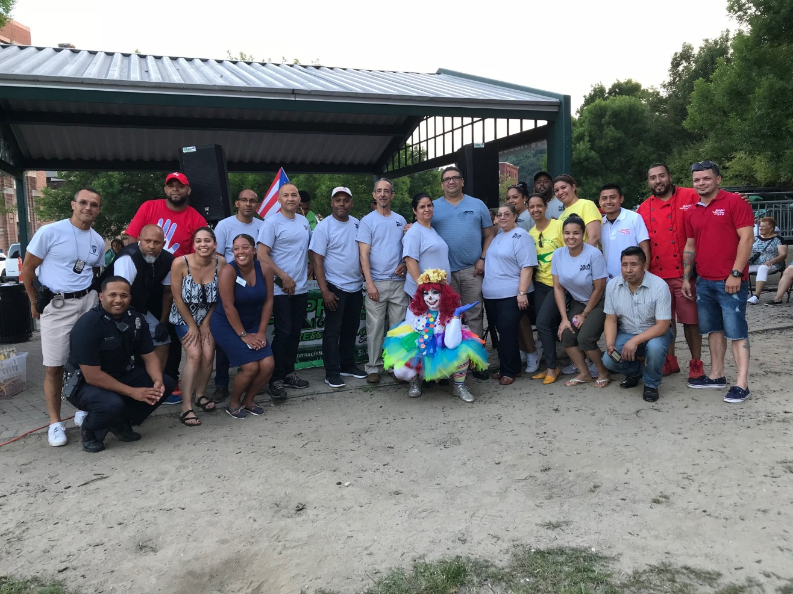
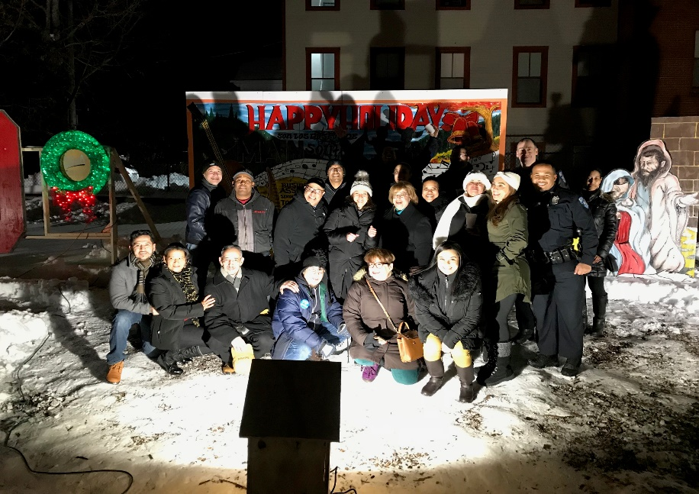
Contact Information
iolmeda@massdevelopment.com
Twitter: @MassDev
Instagram: @my_tdi
LinkedIn: @massdevelopment
Main South Business Association members

