Slide 1
CULTURAL INCLUSION PROGRAM FOR NON-PROFIT BOARDS
Joan Kulash
Executive Director, Community InRoads
10/08/20

Slide 2
MISSION
Community InRoads is dedicated to fostering a collaborative network of effective nonprofits so that the residents in Lawrence and Haverhill have access to the resources they need to reach their fullest potential.
Our programs: We provide pro bono consulting, executive roundtables, workshops and board development for our nonprofits so that they in turn can better serve the community.
Our services are free to the nonprofits thanks in large part to our volunteer professionals.

Slide 3
THANKS TO OUR PROGRAM SUPPORTERS
Grantors and Individuals:
The Stevens Foundation, Foundation M, Artemas Stearns Trust, Charlotte Home, Catherine McCarthy Foundation, Eastern Bank, and The White Fund
Corporate Sponsors — Class of 2021:

Slide 4
LAWRENCE & HAVERHILL IN THE NEWS
“CITY OF THE DAMNED”

Slide 5
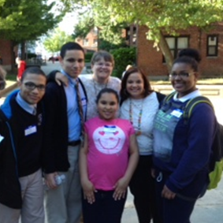
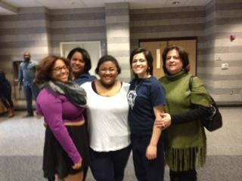
LAWRENCE & HAVERHILL: THE REALITY
WARMTH, TALENT, DETERMINATION & SAVVY PROFESSIONALS

Slide 6
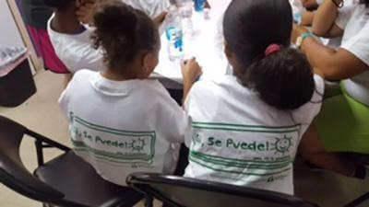
LAWRENCE & HAVERHILL NONPROFITS
PROVIDE ACCESS TO THE NECESSARY RESOURCES TO REACH THEIR FULLEST POTENTIAL
Food pantries
Open space/environment
Youth development/leadership
Access to the arts
Affordable housing
Support for victims of domestic violence
…….and more

Slide 7
THE ISSUE: INEQUITABLE REPRESENTATION OF PEOPLE OF COLOR ON NPO BOARDS
BOTH National and Local
According to BoardSource, 86% of nonprofit Board members in the U.S. are white.
74% of Lawrence residents are Latino, yet the overwhelming majority of Board members are white and not from Lawrence.
91% of Lawrence public school students are Latino
Growing number of young Latino & other professionals of color in Lawrence & Haverhill
Want to get involved
Want to give back
Have the professional skills & talents a board needs

Slide 8
SO…….WHY?
According to non-profits
Did not know enough qualified local professionals of color
They stop showing up
According to local professionals of color
Those who had joined boards stopped showing up
Didn’t understand the Role of a Board
Not part of the group
Felt tokenized
Segregated worlds

Slide 9
WHERE TO BEGIN? COMMUNITY PARTNERS
YWCA Northeastern Mass:
Vilma Martinez-Dominguez and Clare Gunther
Steering Committee of Local Leaders
Northern Essex Community College
--Lane Glenn
Lawyers Clearinghouse
--Machiko Sano Hewitt

Slide 10
DIVERSITY IS MORE THAN A CHECKBOX
Goals of program:
Recruit, train, & place professionals of color on nonprofit Boards
Retain and engage
Build relationships: A larger “we”
Must create Board cultures that are diverse, welcoming and inclusive

Slide 11
RECRUITING PROFESSIONALS OF COLOR
Attend 1-2 hour interview:
Live, work or have roots in Lawrence or Haverhill
Professional
Have skills needed by non-profit Board or committee
Have time to attend 100% of sessions and follow-on Board work
Fill out application:
FINAL DECISION: Nominating committee (subset of Steering Committee)

Slide 12
RECRUITING PROFESSIONALS OF COLOR
Stable, “non-toxic”
Directors & Officers insurance
Send 1-3 representatives to all sessions
Provide tours and interviews to interested recruits
**Assign mentor/partner for each new recruit
Consider ways to develop inclusive Board culture

Slide 13
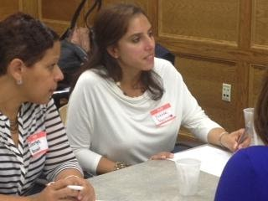
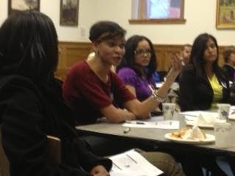
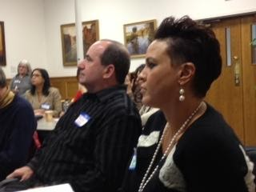
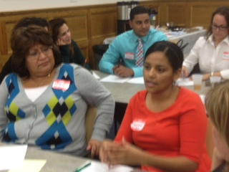
INTERACTIVE TRAININGS ON BOARD GOVERNANCE & INCLUSION
BOARD REPS & RECRUITS ATTEND TOGETHER AS A COHORT

Slide 14
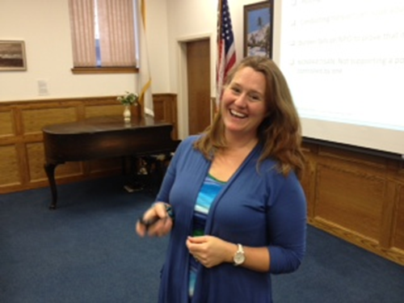
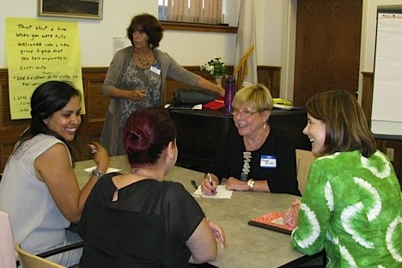
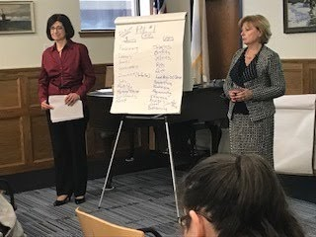
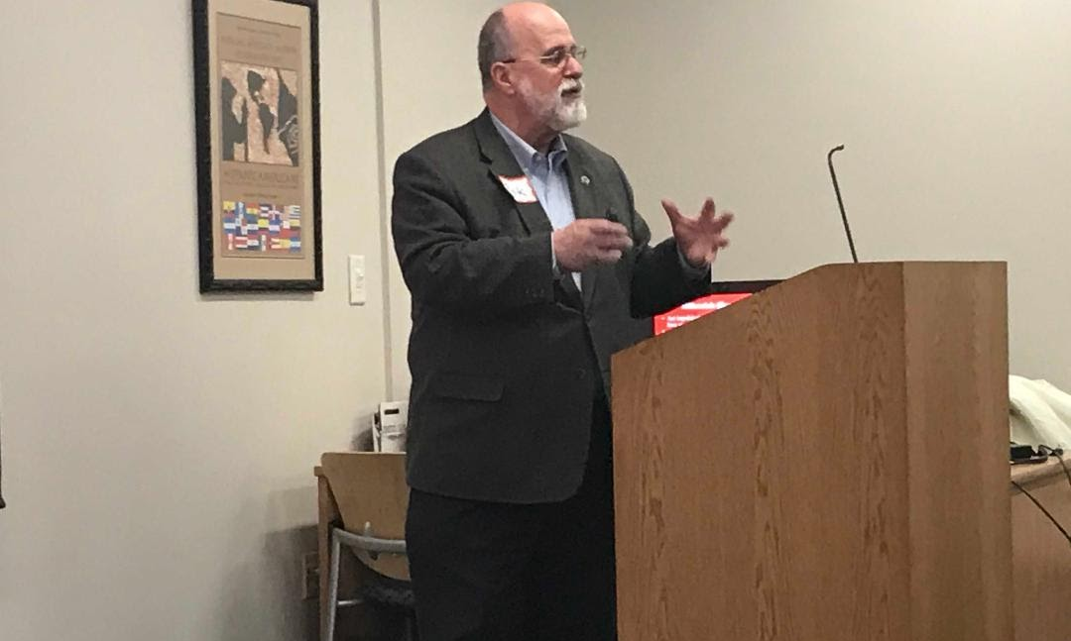
TRAININGS DELIVERED BY SUBJECT MATTER EXPERTS
Klein Hornig, LLC
Co-Creating Communities of Practice
Richard R Blain & Assoc
Barrett & Scibelli CPA, YMCA’s CFO

Slide 15
THANK YOU TO WORKSHOP INSTRUCTORS
Anthony E. Hubbard and Manuel Vazquez, Mintz Levin, LLC
Teresa Santalucia, Klein Hornig, LLC
Stephanie Muscat, Independent Nonprofit Consultant
Elizabeth Reinhardt & Machiko Sano Hewitt Law Offices of Elizabeth S. Reinhardt
Rick Blain Richard R. Blain and Associates
Judith Kamber, Co-creating Communities
Jadihel Taveras, Independent Diversity Consultant
Denise Molina Capers, Independent Diversity Consultant
Bernadette Orr, Open Gate Consulting
Anabelle Rondon, Independent Diversity Consultant
Filomena Scibelli & Christopher Barrett, Barrett & Scibelli, CPAs
Cathy Landry, CFO of YMCA
Kate Leahy, 3 Beans for Nonprofits (finance)

Slide 16
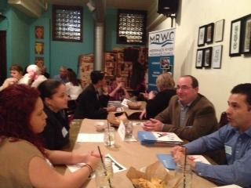
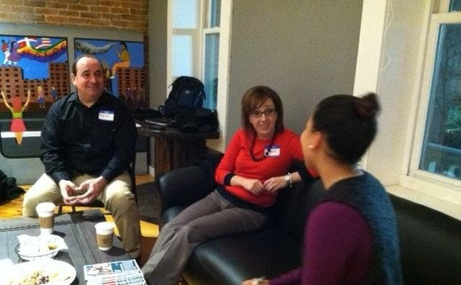
MATCHING RECRUITS ONTO BOARDS:
The Board Walk – Speed dating format
Recruits each meet individually with Community InRoads’ staff
Recruits engage in in-depth meetings with Boards of interest
Board Matching and Onboarding (mutual decision)

Slide 17
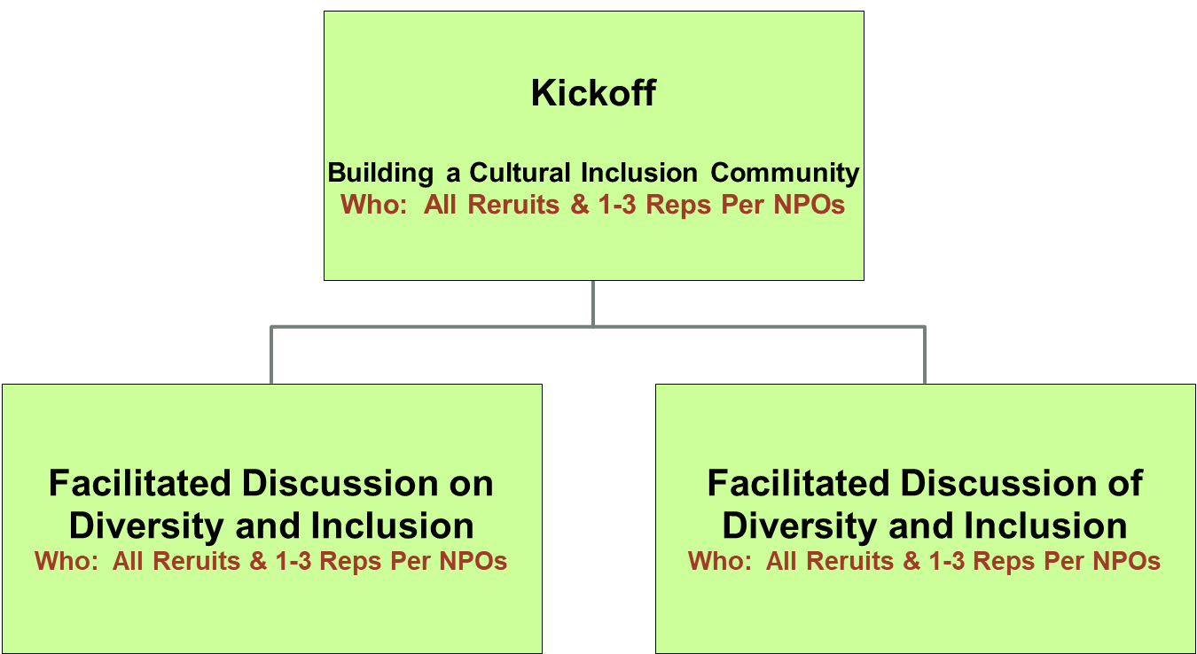
THE FLOW:
One session
per month

Slide 18
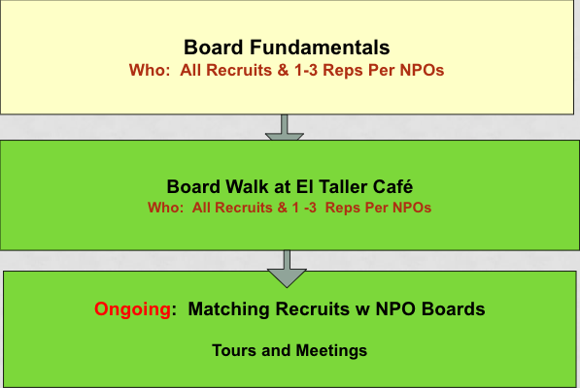
THE FLOW:
NUTS & BOLTS OF BOARD GOVERNANCE & FACILITATED DIALOGUE ON INCLUSION

Slide 19
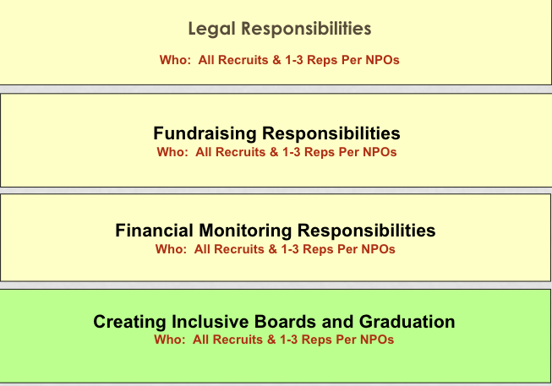
THE FLOW:
NUTS & BOLTS OF BOARD GOVERNANCE & FACILITATED DIALOGUE ON INCLUSION

Slide 20
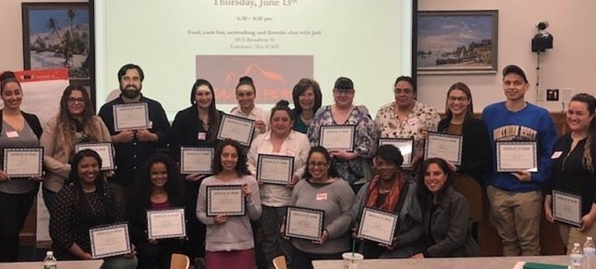
GRADUATION

Slide 21
NORTHERN ESSEX COMMUNITY COLLEGE CERTIFICATE
All program graduates eligible for NECC Certificate in Nonprofit Governance
Community InRoads provides scholarship for 3 required classes
(Strategic Planning, Marketing, Volunteer Management)

Slide 22
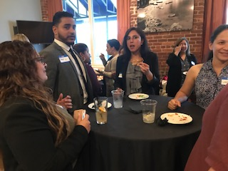
REUNION ALL GRADUATES FROM BEGINNING

Slide 23
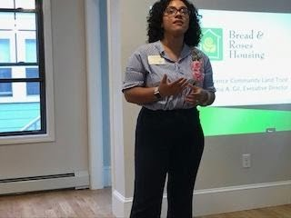
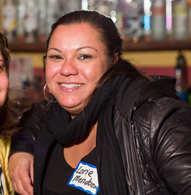
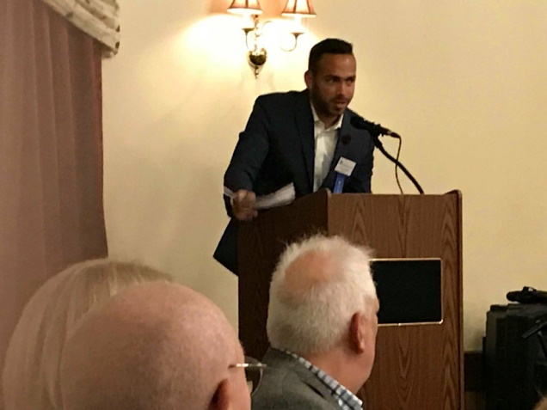
THE REAL WORK: MONITORING ALL PLACEMENTS
Ensure Board Engagement
1:1 meetings with recruits,
Follow on meetings with recruits & mentors/ED/Chairs,

Slide 24
The Difference……
“Diversity is being invited to the party.
Inclusion is being asked to dance.”
(Vernā Myers)

Slide 25
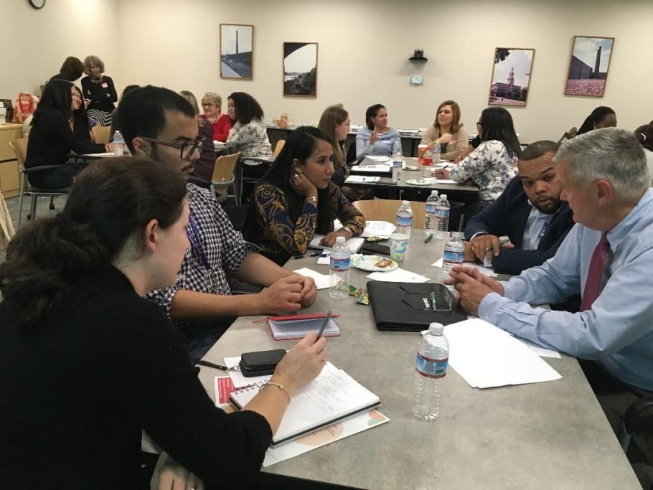
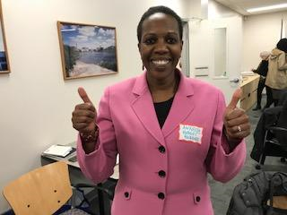
TO DATE
112 professionals of color - prepared to join local boards
90 professionals of color - joined local boards or committees
22 nonprofits – benefitted from Cultural Inclusion graduates on their boards

Slide 26
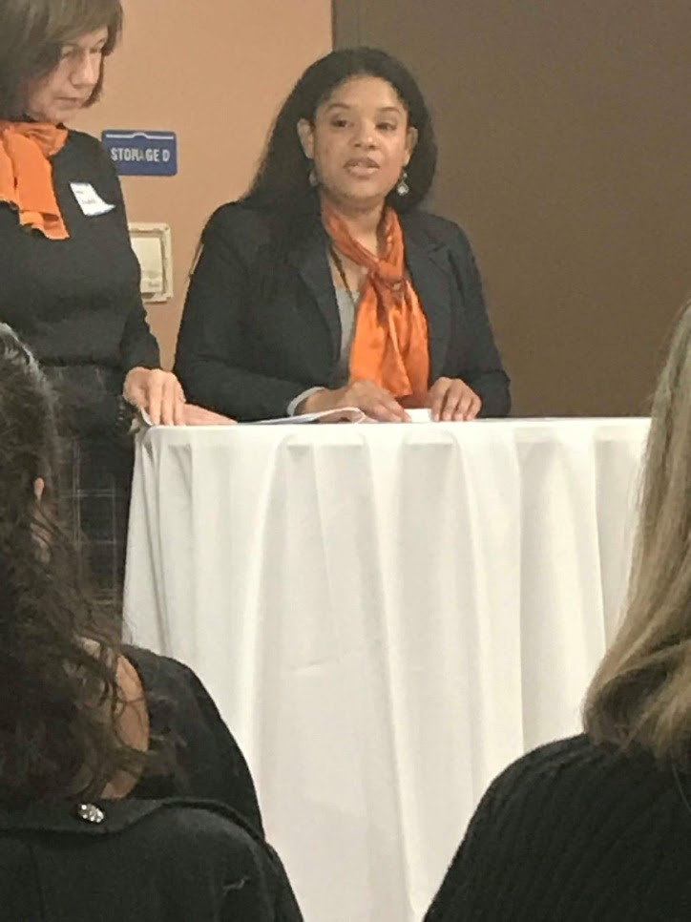
CULTURAL INCLUSION GRAD – NEW PART TIME CULTURAL INCLUSION COORDINATOR
Next Steps:
Entering our 9th year with 16 new recruits
Adding to the inclusion discussions
Diversity and Inclusion beyond the Board
Further follow-up after placements
Lawyer, Educator, Cornell-certified in
Diversity Equity & Inclusion

Slide 27
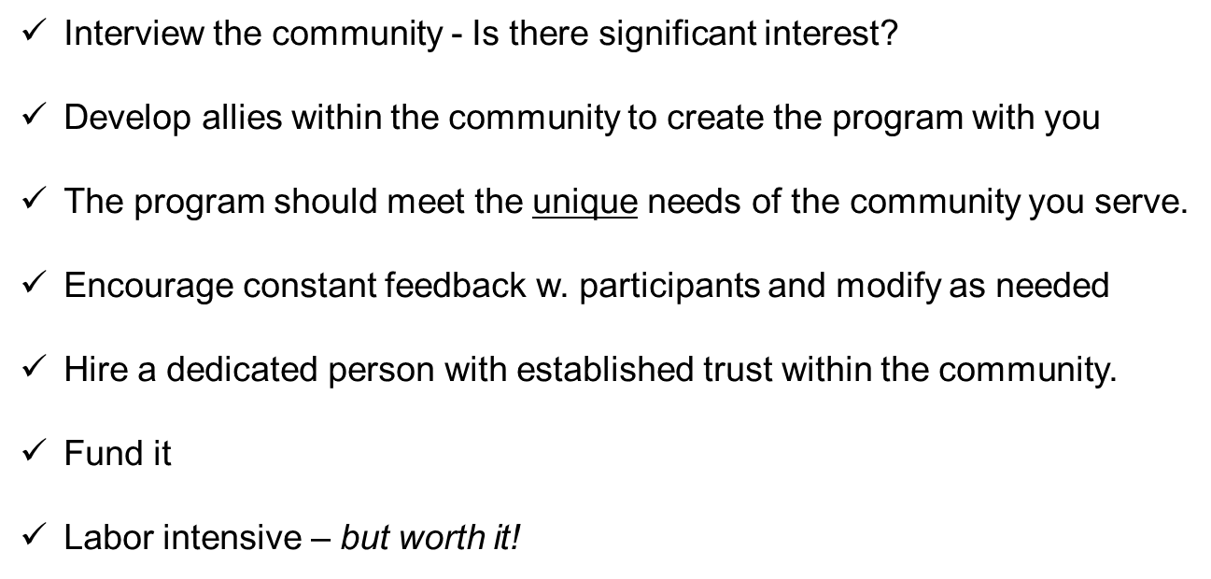
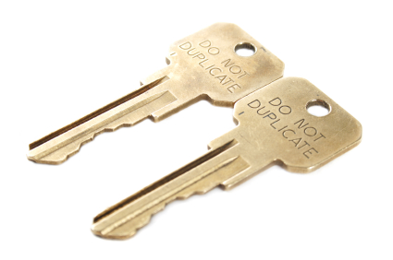
Keys for duplication

Slide 28
Contact Information
Contact Joan Kulash
jkulash@communityinroads.org
978-604-8803
www.communityinroads.org
Facebook.com/communityinroads

