Slide 1
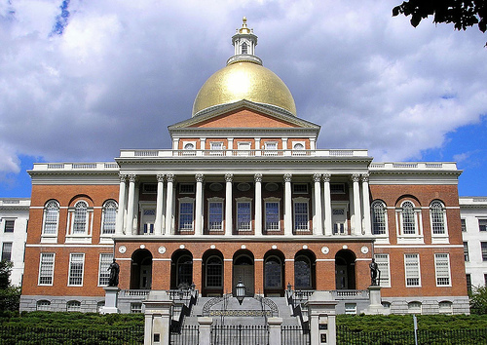

Interpreting Public Opinion through
the Lens of Political Economy
January 13, 2021

Slide 2
Finding #1
The demand for redistribution increases
when the income distribution skews to the right.

Slide 3
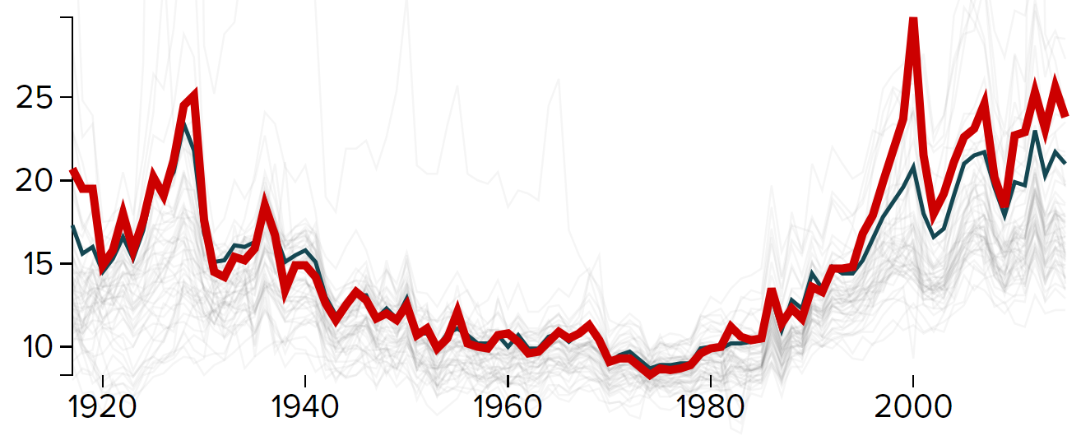
Massachusetts has one of the widest economic divides in the US.
Source: Economic Policy Institute

Slide 4
Massachusetts is increasingly redistributing income through health expenditure.
Medicaid spending as a share of state’s own-source revenues
Source: Urban Institute

Slide 5
Finding #2
Means-tested programs do not reduce poverty.

Slide 6
Progressive spending increases the share of resources received
by those most in need, but reduces the total amount of social spending
Trends in state spending by category (indexed to FY01)
Source: Massachusetts Budget and Policy Center

Slide 7
Finding #3
Public perceptions about access to opportunity
heavily influence attitudes about redistribution.

Slide 8
Economic inequality leads to greater economic segregation.
Share of residents living in middle-income neighborhoods by metro area
Source: B. Forman & C. Koch. “Geographic Segregation: The Role of Income Inequality.” Communities & Banking (Fall 2012).

Slide 9
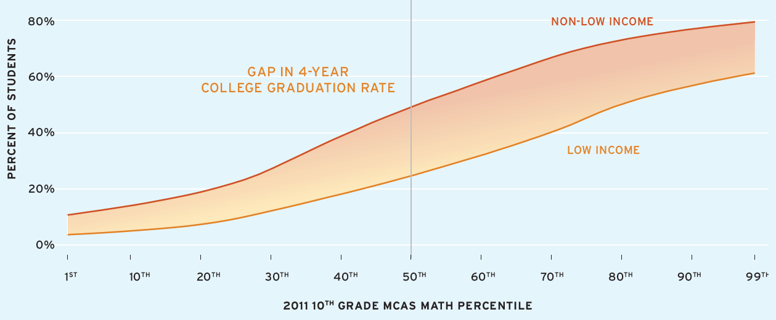
Perceptions about access to opportunity heavily influence public attitudes about redistribution.
Source: Pappay et al (2020)

Slide 10
Finding #4
Inequality is self-correcting in a democracy.

Slide 11
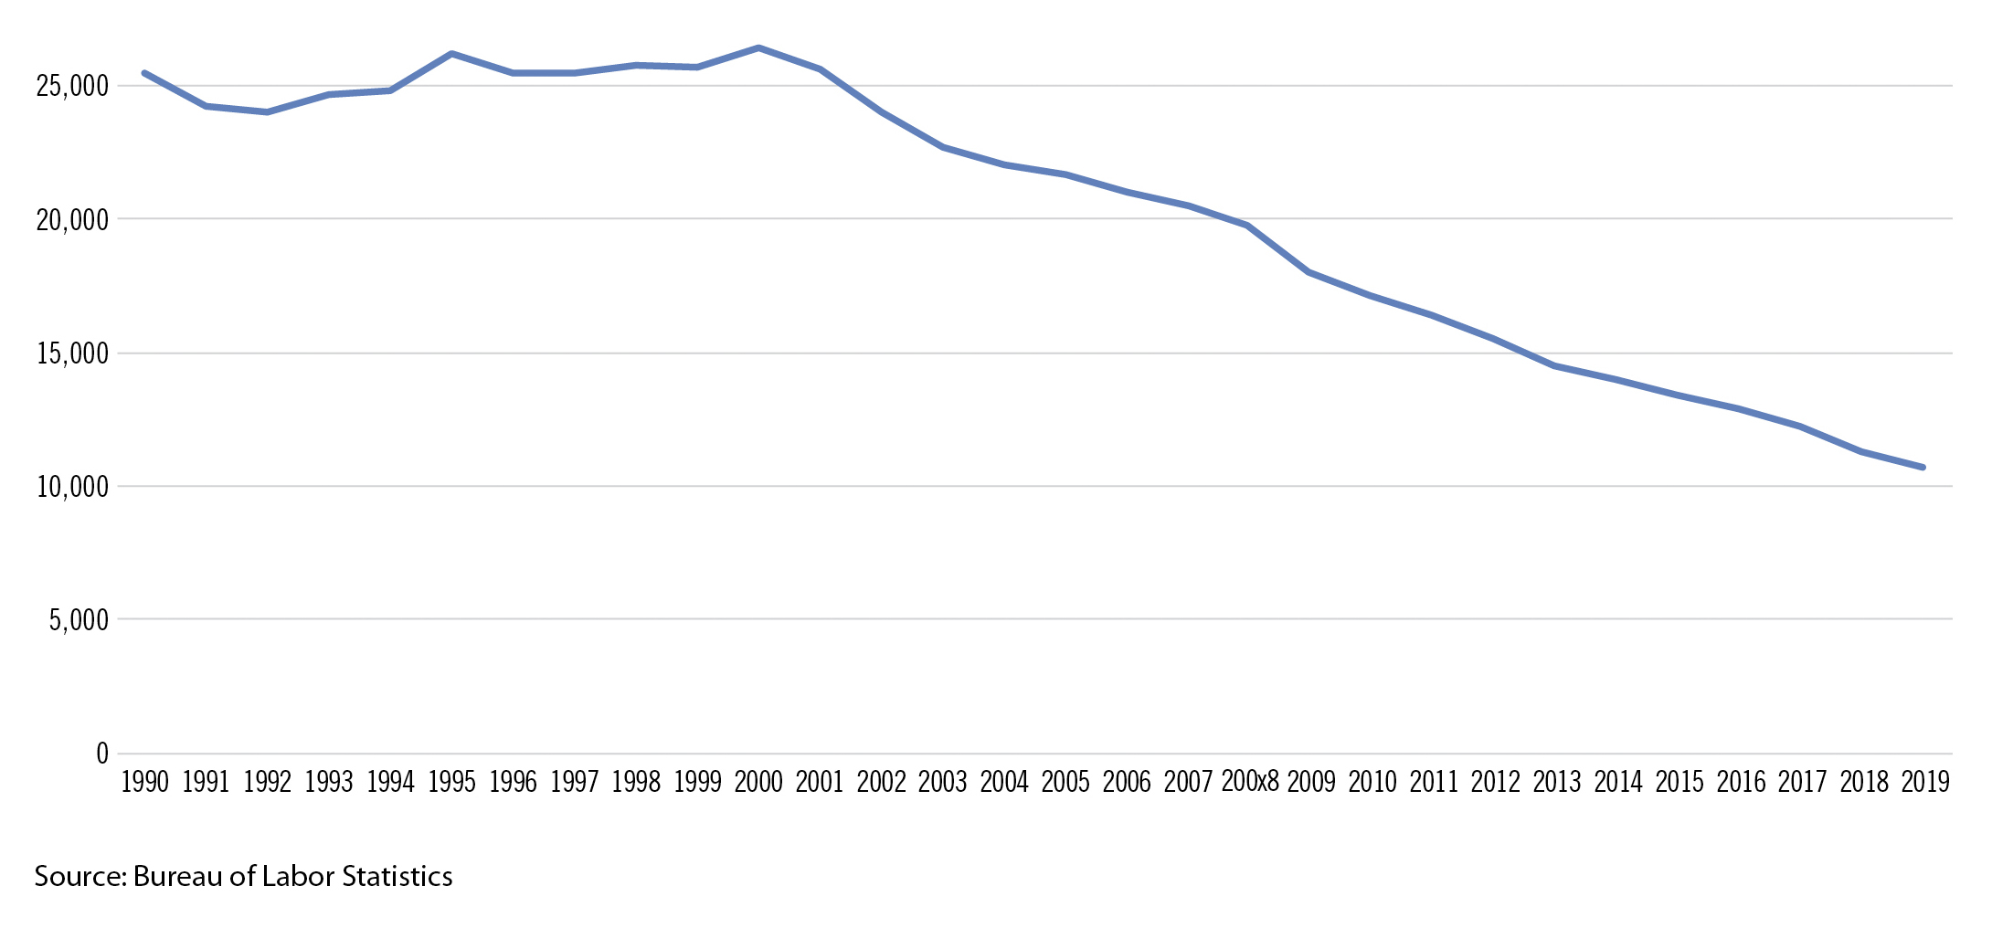
Access to reliable information about state and local policy to hold government accountable is steadily declining
(and increasingly behind a pay wall).
Newspaper Employment in Massachusetts

Slide 12
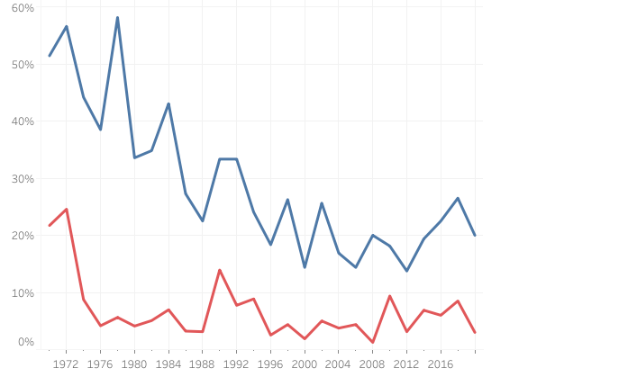
Competitive elections and party competition has fallen.
Percent of seats contested in primary election
Democratic Primary
Republican Primary
Source: MassINC’s analysis

Slide 13
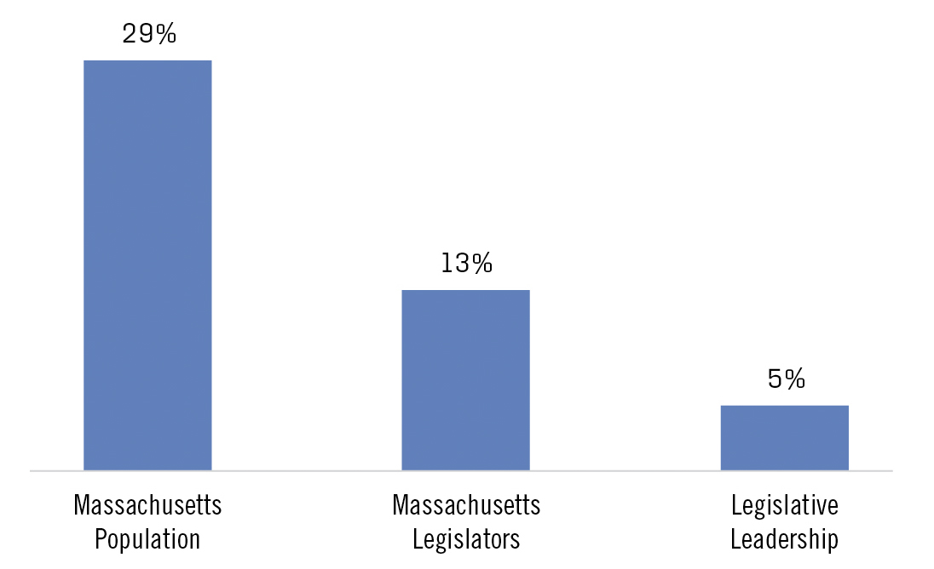
Elected officials do not represent our diversity.
People of Color as a Share of:
Source: Authors’ analysis of data from National Conference of State Legislatures and US Census Bureau

Slide 14
Finding #5
In economies with high requirements for
skilled labor and rapid industrial change,
businesses often side with labor.

Slide 15
Massachusetts already has a relatively high corporate tax burden.
Source: Tax Foundation

Slide 16
Where do we go from here?

Slide 17
Double-down on efforts to generate more sustainable development patterns.
Take advantage of this opening to rebuild leadership in the business community.
Tackle the structural challenges that undermine the health of state and local democracy.

