Slide 1
Viewing Justice Reinvestment from a
Correctional Officer’s Perspective
Massachusetts Criminal Justice Reform Coalition Policy Summit
February 11, 2021

Slide 2
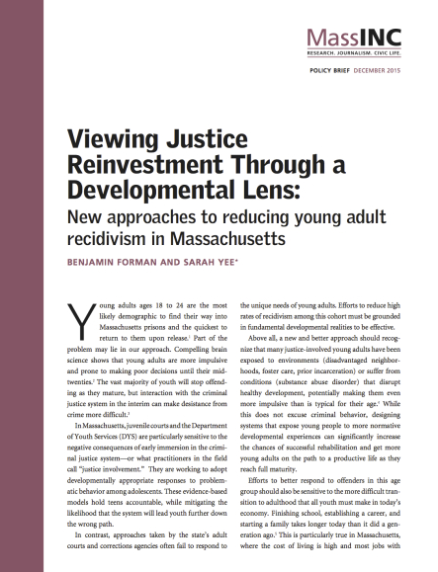
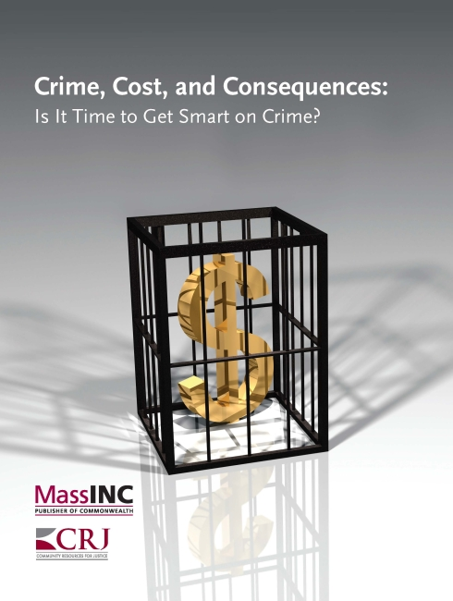
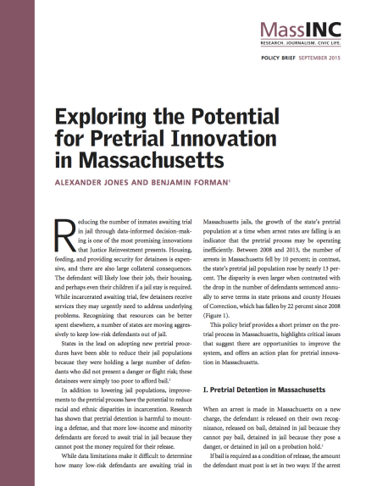
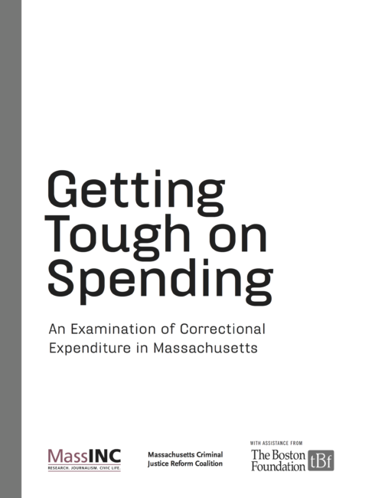
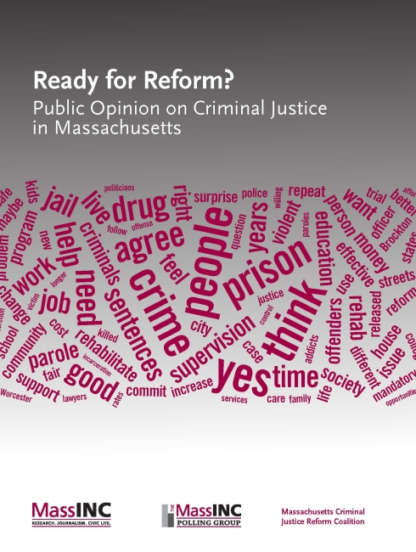
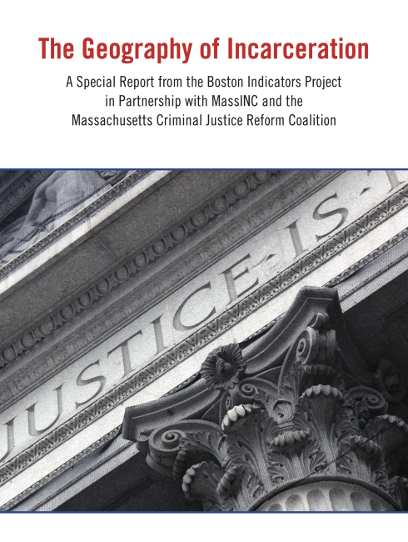
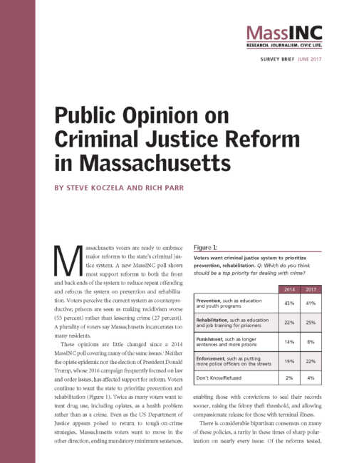
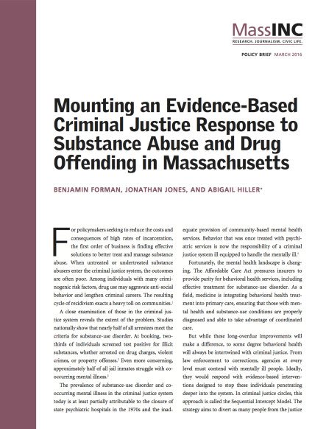
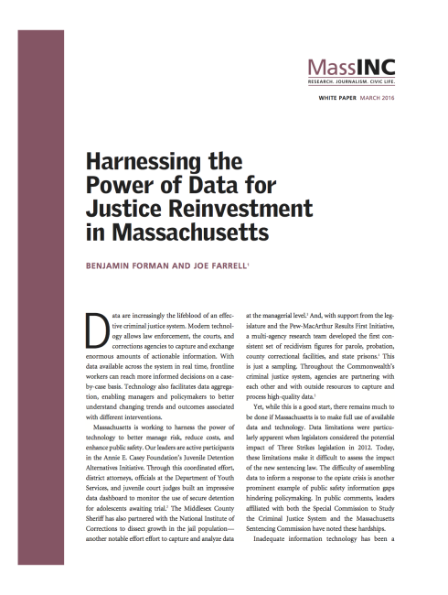
MassINC has explored criminal justice reform from many vantage points, but never from the perspective of frontline workers.

Slide 3
From the perspective of racial justice, this research reveals two imperatives:
Incarcerations per 100,000 residents
To run effective correctional facilities with limited resources, we must eliminate racial disparities.
Given persistent racial disparities, we must make extra effort to dramatically improve prison conditions.
Source: ACS PUMS, 2018

Slide 4
Correctional officers play a major role supporting rehabilitation by performing complex human services work.
Officers believe rehabilitation is an important goal; they believe they can play the most important role in their agency helping individuals desist from crime.
Officers support treatment teams by helping determine what works and encouraging inmates to comply with treatment protocols.
Officers recognize criminal thinking and help correct thought distortions.
Officers aid in the transition to the community by serving as liaisons to partner organizations.

Slide 5
The overcrowding that plagued correctional facilities made it hard for officers to perform their rehabilitative role.
Share of State and County Correctional Facilities Operating above 150% of Design Capacity

Slide 6
Tough on crime policies put correctional officers under tremendous stress with serious implications for their health and wellbeing.
Multiple sources of job strain:
Documented health consequences:
Exposure to violence and the constant threat of violence.
Work-family conflict.
Exposure to pathogens.
Role strain.
Organizational stressors.
Chronic illnesses induced by stress, including heart disease and hypertension, are alarmingly elevated.
Between 20 and 50 percent of officers experience symptoms of PTSD.
On average, studies find the stress of the job reduces the life span of officers by 16 years.
The incidence of suicide among DOC officers is roughly four times higher than those with similar demographics nationally.

Slide 7
While not entirely by design, Massachusetts has halved its incarcerated population.
DOC and County Correctional Populations, 1990 - 2021

Slide 8
Relative to crime rates, incarceration rates in Massachusetts are now much closer to pre-tough on crime era levels.
Relative Change in Incarceration and Crime Rates, 1990 - 2020

Slide 9
Lower staff ratios now provide much greater opportunity for rehabilitation.
Change Population vs. Staff, 2011 - 2021
Population-to-Staff Ratios, Sheriffs and DOC

Slide 10
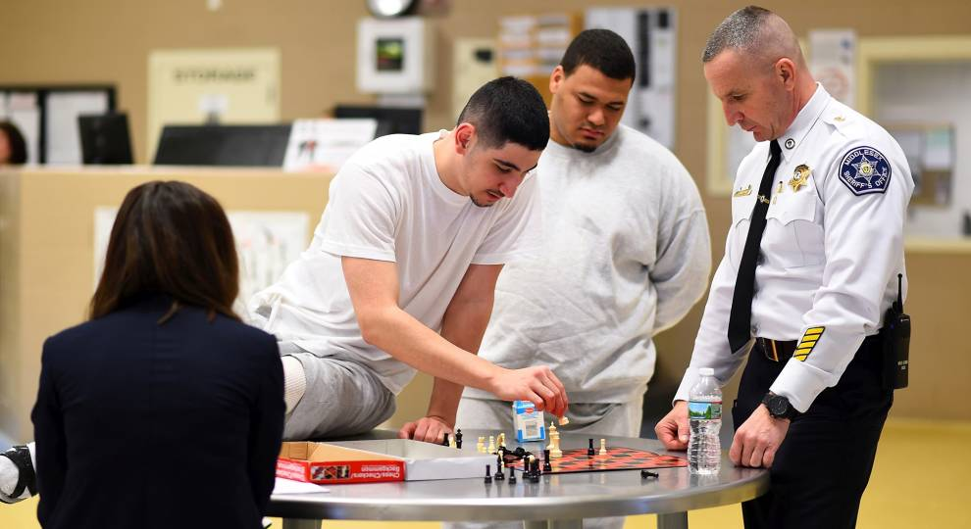
How do we take advantage of this opportunity to ensure that all correctional facilities in Massachusetts are healthy workplaces for officers and therapeutic environments for prisoners?

Slide 11
Justice reinvestment must include a strategy to increase return on investment in corrections.
Policy Recommendations
Develop minimum staffing levels for all facilities.
Provide rotations in the community to give officers opportunities to build relationships with communities
Increase correctional officer educational incentives and benefits.
Develop clear budgets for training and employee wellness programs.
Update the corrections masterplan with heavy involvement of officers.
Survey correctional officers.

