Slide 1
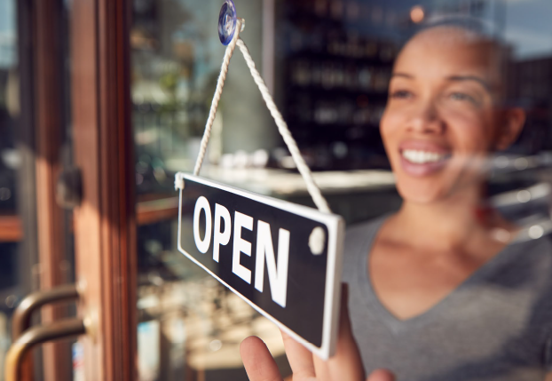


Unleashing the Potential of Entrepreneurs of Color
A Blueprint for Economic Growth and Equitable Recovery
Gateway Cities Leadership Summit
July 22, 2021

Slide 2
#1. Declining levels of entrepreneurship
present strong headwinds for
regional economic development.

Slide 3
Annual Number of New Companies in Massachusetts with Employees per 100,000 residents

Slide 4
#2. Entrepreneurs of color are increasingly
starting new companies, but they remain dramatically underrepresented in the Massachusetts economy.

Slide 5
Growth in Massachusetts workers self-employed in incorporated businesses, 2010 - 2018
Source: Analysis of IPUMS-USA, ACS PUMS, five-year samples

Slide 6
Share of Massachusetts workers self-employed in incorporated businesses, 2010 and 2018
Source: Analysis of IPUMS-USA, ACS PUMS, five-year samples

Slide 7
#3. Entrepreneurs of color are especially
underrepresented in advanced industries,
which draw new wealth into regional economies.

Slide 8
Share of SBIR-SSTR grants awarded to entrepreneurs of color in Massachusetts
Source: SBIR-SSTR database

Slide 9
#4. “Livelihood” entrepreneurship reduces
poverty and closes harmful racial wealth gaps.

Slide 10
Annual earnings for wage and self-employed workers, 2018
Source: Analysis of IPUMS-USA, ACS PUMS, five-year samples

Slide 11
#5. Entrepreneurs of color are
underrepresented in Gateway Cities

Slide 12
Share of Massachusetts businesses and minority-owned businesses in Gateway Cities

Slide 13
Share of Massachusetts nonwhite population and minority-owned businesses in Gateway Cities

Slide 14
City’s share of minority-owned businesses relative to share of business establishments

Slide 15
City’s share of minority-owned businesses relative to share of non-white residents
1.00 = Parity

Slide 16
#6. Massachusetts needs an aggressive strategy
to close gaps in business ownership
by the end of the decade.

Slide 17

A Three-Point Plan
Skills & Relationships
Access to Capital
Access to Markets
Notes:
I realize I’m laying out the plan, without talking about the challenges that entrepreneurs of color face. The report unpacks the research, but I think it’s better today to let the panel speak from experience.

Slide 18
#7. Entrepreneurial ecosystems
grow at a regional scale.

Slide 19
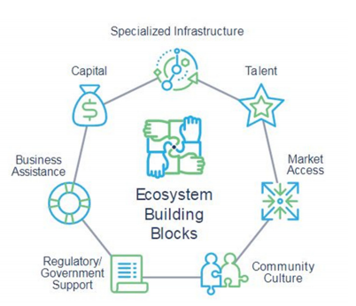
Source: Kauffman Foundation

Slide 20
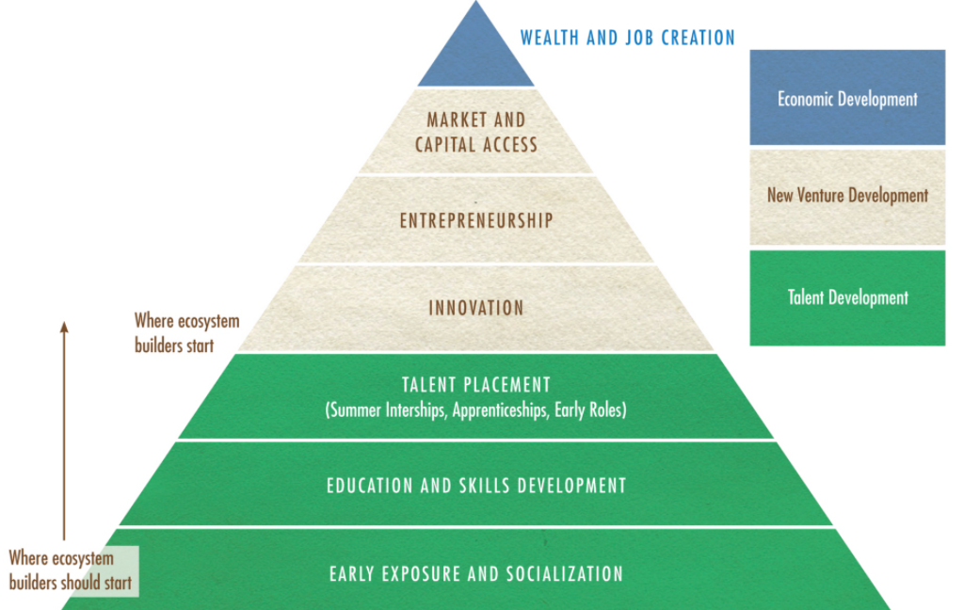
Source: Rodney Sampson, OHUB

