Slide 1
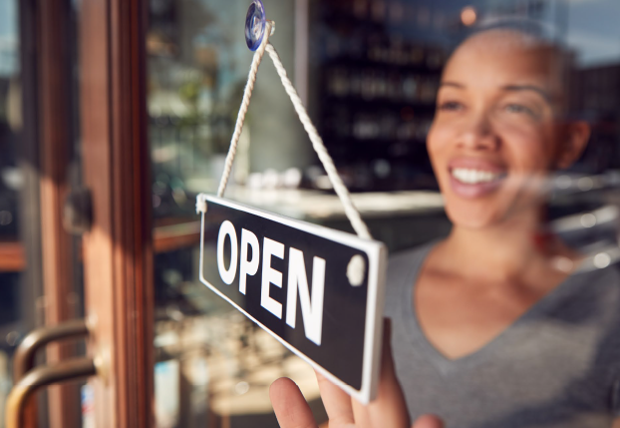


Infrastructure for Equitable Economic Growth
Nineth Annual Gateway Cities Innovation Institute Awards & Summit
September 30, 2021

Slide 2
#1. Declining levels of entrepreneurship
present strong headwinds for
regional economic development.

Slide 3
Annual Number of New Companies in Massachusetts with Employees per 100,000 residents

Slide 4
#2. Entrepreneurs of color are increasingly
starting new companies, but they remain dramatically underrepresented in the Massachusetts economy.

Slide 5
Growth in Massachusetts workers self-employed in incorporated businesses, 2010 - 2018
Source: Analysis of IPUMS-USA, ACS PUMS, five-year samples

Slide 6
Share of Massachusetts workers self-employed in incorporated businesses, 2010 and 2018
Source: Analysis of IPUMS-USA, ACS PUMS, five-year samples

Slide 7
#3. Entrepreneurs of color are
underrepresented in Gateway Cities

Slide 8
Share of Massachusetts businesses and minority-owned businesses in Gateway Cities
Source: Analysis of data from Massachusetts Supplier Diversity Office

Slide 9
Share of Massachusetts businesses, minority-owned businesses, and People of Color in Gateway Cities
Source: Analysis of data from Massachusetts Supplier Diversity Office

Slide 10
Number of State-Designated Minority-Owned Businesses in Gateway Cities by Sector
Source: Analysis of data from Massachusetts Supplier Diversity Office

Slide 11
Annual Number of New Companies in Massachusetts with Employees per 100,000 residents

