Slide 1
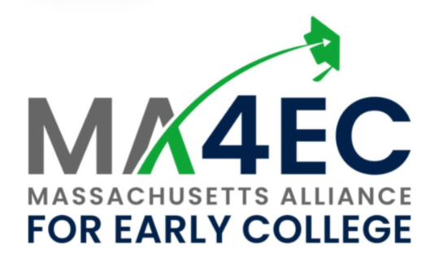
Erika Giampietro
Executive Director of the Massachusetts Alliance for Early College
To be launched early in 2022

Slide 2
The best predictor of college success is college success.

Slide 3
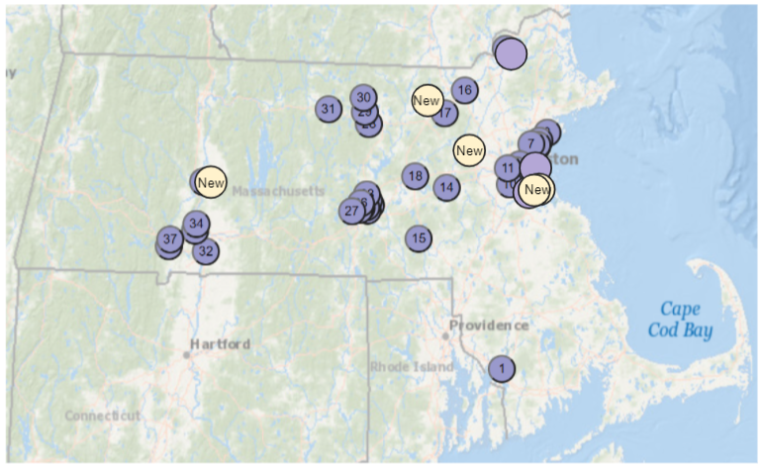
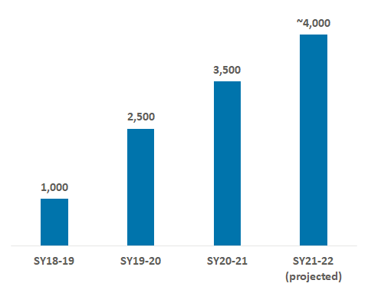
Early College in MA has grown significantly...
Early College Enrollment
Currently designated programs:
In 31 designated programs in 42 high schools and 22 higher education institutions
In 50% of Gateway Cities, and 5 of 7 WIOA Regions
Opportunities for continued growth:
15 programs applying for designation for SY22-23
$2.6M in SY21-22 budget for grants and technical assistance encouraging growth
For a list of designated Early Colleges, go to https://www.doe.mass.edu/ccte/early-college/designees.html

Slide 4
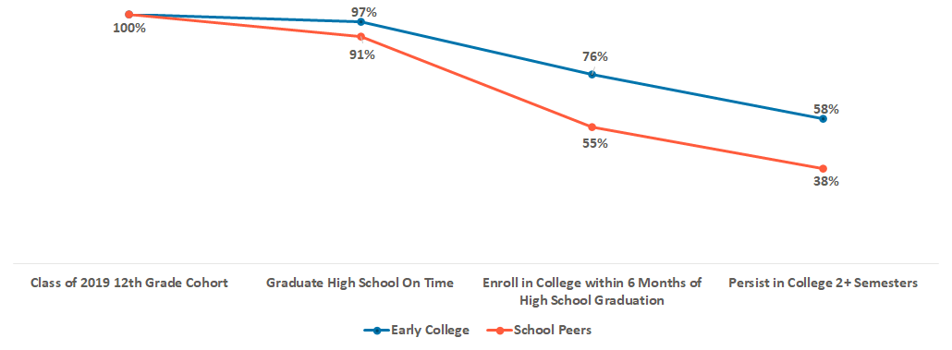
...and early indicators of outcomes are very positive
College Persistence for MA Students, Class of 2019
Source: MA Department of Elementary and Secondary Education, Early College Joint Committee, February 2021
Notes:
College enrollment and persistence: Though the MA Early College initiative is young and operating in a pandemic, early outcomes in the two most powerful predictors of college completion are promising:
Class of 2019: 76% of Early College students went to college within 6 months of high school graduation, and 58% persisted into their 2nd semester (relative to school peers at 55% and 38%, respectively)
Class of 2020: 63% of Early College students went to college within 6 months of high school graduation relative to 43% of school peers (both groups seem to be affected by the pandemic); persistence data is not yet available
Class of 2021: college enrollment data is not yet available, but FAFSA completion rates (a strong predictor of immediate college enrollment) are promising: 67% of Early College students completed the FAFSA vs. 40% of school peers
Students served: importantly, Early College is disproportionately accessed by students of color and students from lower income homes:
Class of 2020: 62% of Early College students are Black or Latinx and 45% are economically disadvantaged
Class of 2021: 61% of Early College students are Black or Latinx and 47% are economically disadvantaged

Slide 5
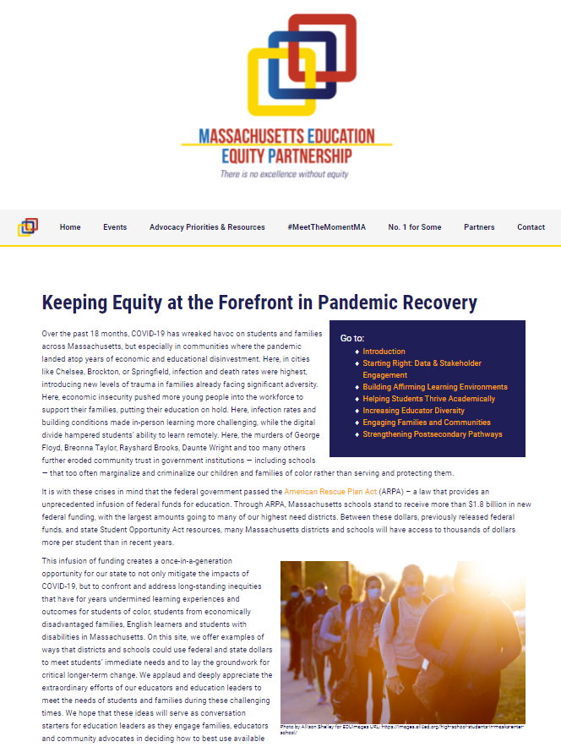
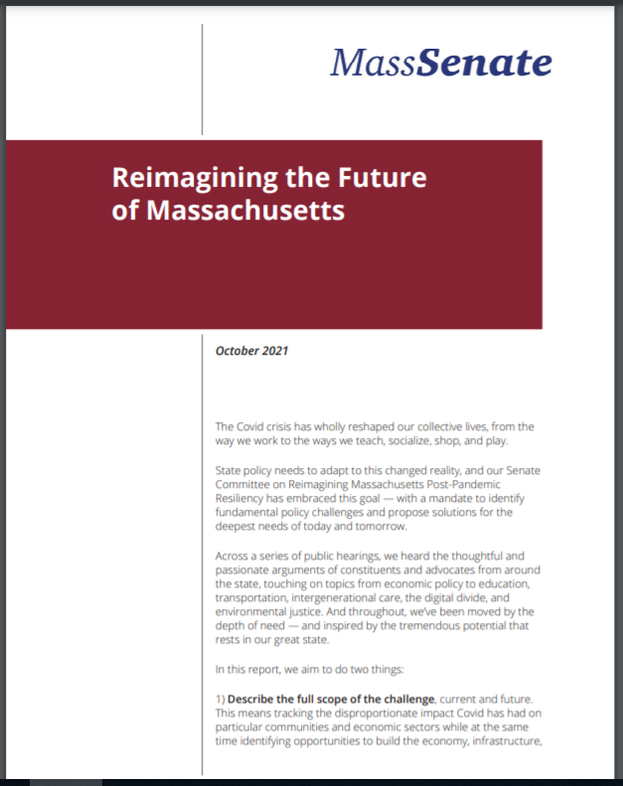
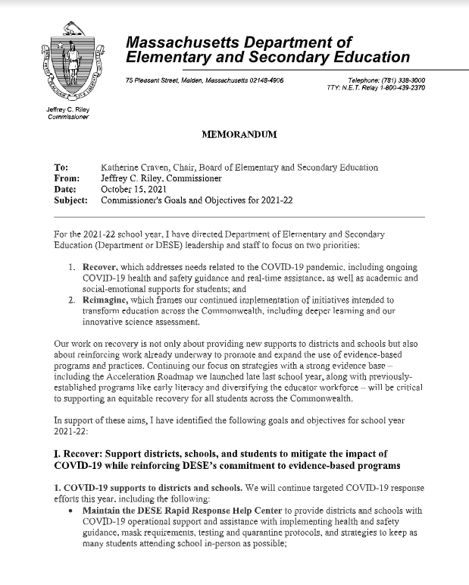
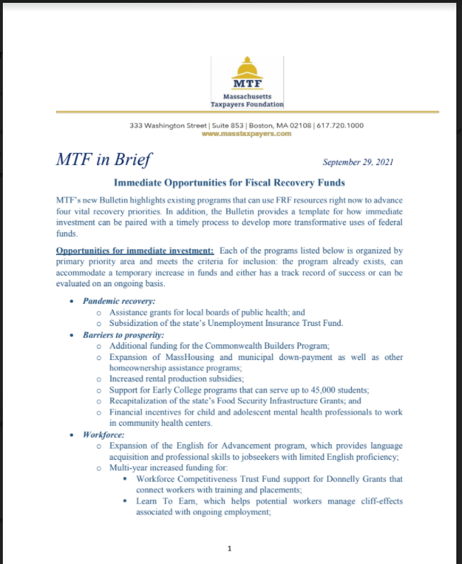
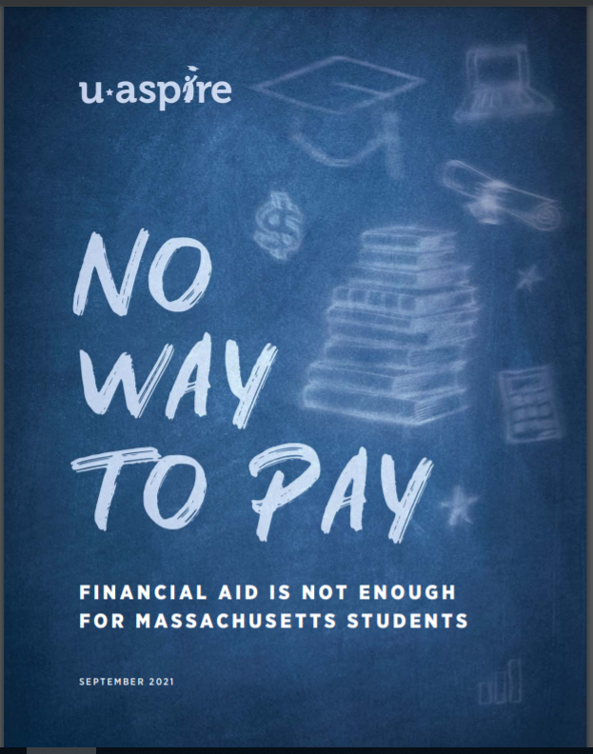
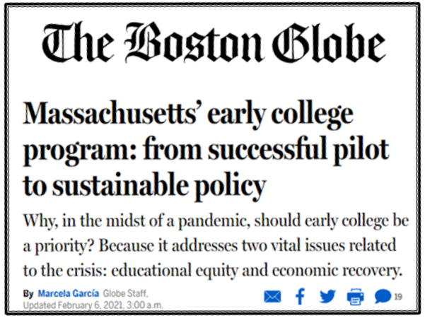
Public support for Early College is growing

Slide 6
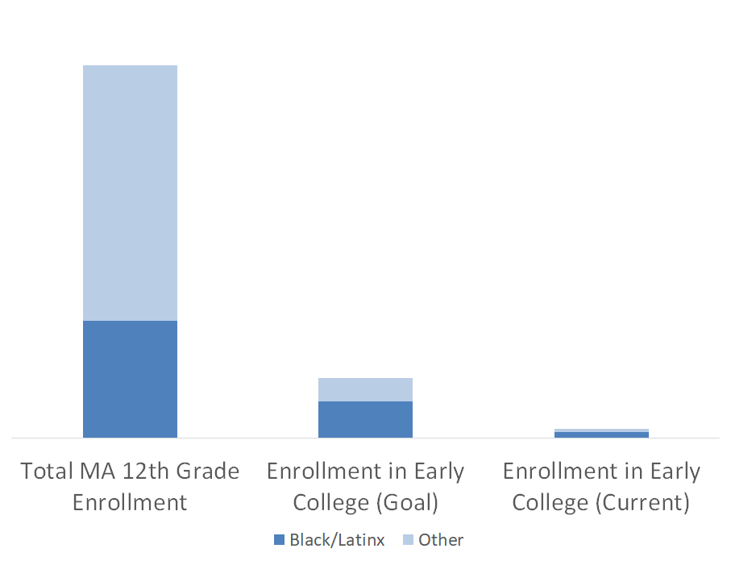
MassINC recommended a growth goal that is both highly ambitious and reasonably feasible
Early College Scale as Portion of MA Grade 12 Enrollment
70K
The Scale Goal: Early College programs will be on track to serve 45K high school students by school year 2026-27
This translates to 11K seniors in Early College, relative to ~2K seniors in Early College now, and is consistent with closing a quarter of the college success equity gap by race and income and benefiting many thousands of students beyond that
22K
11K
7000
1800
1200

Slide 7
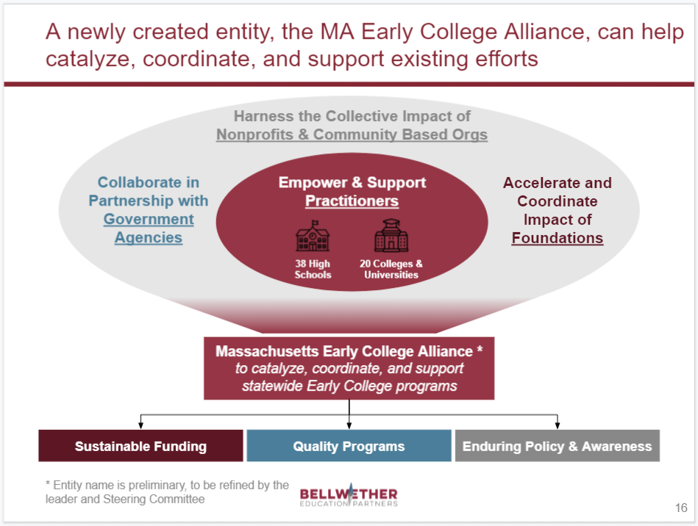
A recent study calls for the creation of an Early College Alliance to support the programs’ growth
Need to add legislature to Bellwether’s slide
Slide from Bellwether Education Partners’ “Early College Intermediary Feasibility in Massachusetts March 2021 study

Slide 8
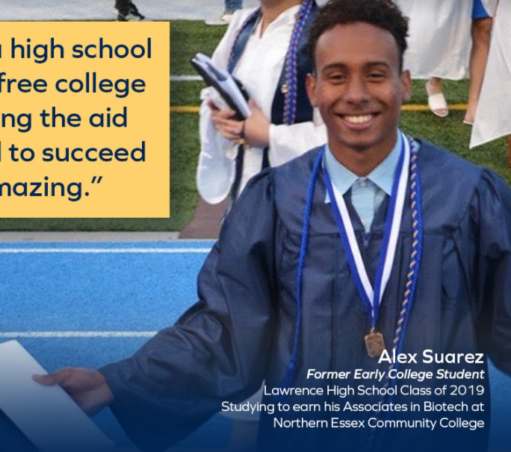
Thank you to our students, families, program leaders and practitioners, legislators, agency leaders, and today’s participants
“One of the best parts of Early College was the exposure. Having that and experiencing college first-hand really prepared me, and is helping me be successful.”

Slide 9
TO BE CUT

Slide 10
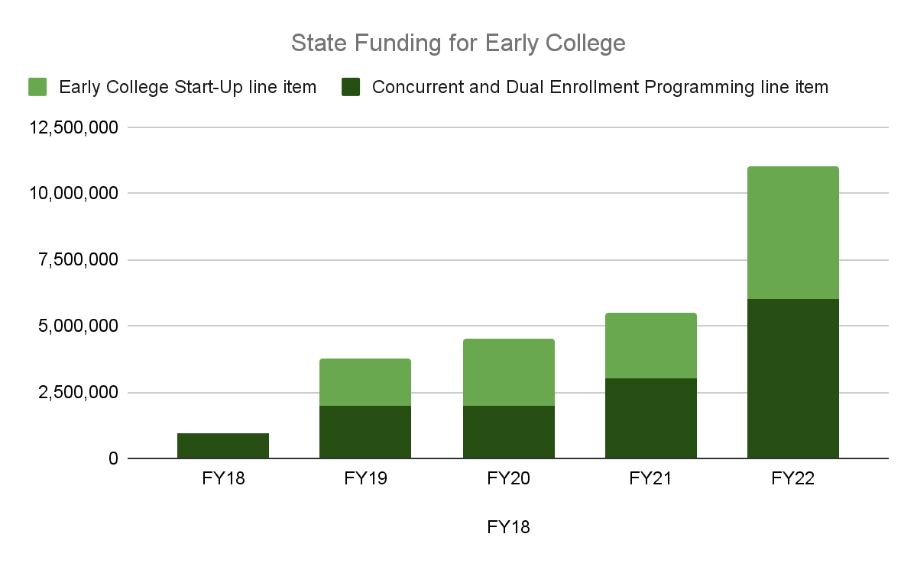
Thanks to our legislature, the state’s annual investment in Early College continues to grow
Increased funding will allow for 54% growth in credits earned, and will help lay the foundation for programs to go deeper
Created the opportunity for Early College students to earn 24,000 credits, saving their families $5.2M in tuition and fees
This funding provides critically important support and must continue to grow in line with enrollment

Slide 11
This theory of change informs MA4EC’s goals and strategies
Strategies
Goals
Collective impact: organize a broad, large-scale, energized coalition around a big goal
45K students in Early College, consistent with closing a quarter of the college success equity gap by race and income and benefiting many thousands of students beyond that
Quality support: build a high quality technical assistance provision
Policy conditions: advocate for a funding and policy environment conducive to scale and quality
Notes:
To delete: original thinking:
Collective impact: An authentic, diverse, and large-scale coalition of Early College supporters, united behind a bold and meaningful goal, can, through collective impact, inspire the shared ownership and individual actions necessary across K12 and higher education silos to significantly expand Early College and reduce college success equity gaps. And in fact, given the unique cross-sector aspects of Early College, substantive change won’t be possible without it. <Note from CG: Feels like this leaves out philanthropy, nonprofits, local government, and business>
Quality support: While Early College models can vary, there are critical elements for quality. A trained and sufficiently sized set of technical assistance providers and resource library can ensure quality in programming along with growth.
Policy conditions: The Early College funding and policy conditions in MA are currently sufficient for a pilot but will need to evolve to support significant scale.

Slide 12
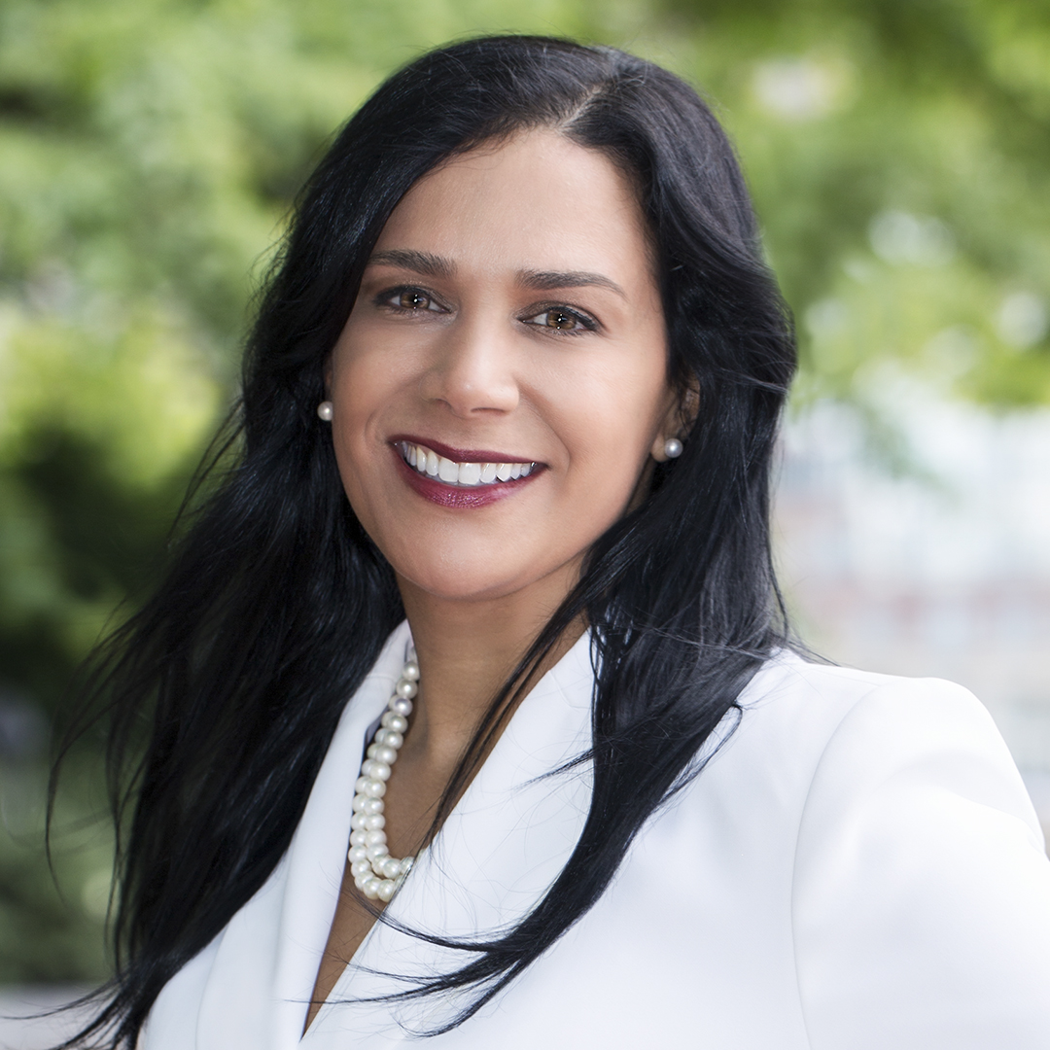
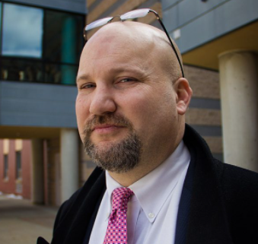
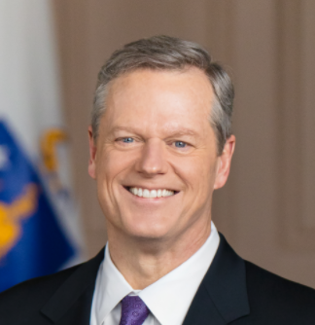
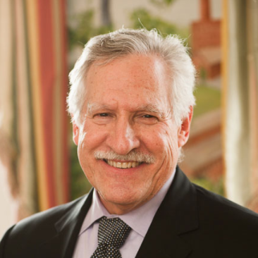
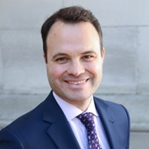
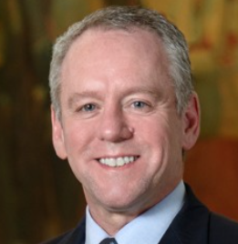
“
Postsecondary and career success is not the reality for far too many low income students and students of color, and that is why we’re focused on Early College as part of State Street’s strategy to promote racial equity. The Early College data continues to demonstrate its effectiveness closing equity gaps around college attendance and completion.
- Yvonne Garcia, Chief of Staff to CEO at State Street Corporation and Global Head of Internal Communications
“
I believe in the importance of inoculating students on the college experience while they're still in high school. This early exposure to college helps them develop a college going mentality, improve their work ethic, learn to manage their time and learn to navigate the higher education system, while receiving support and guidance from the high school, as well as from their college partner. This is particularly important for first generation students or students living in low-income communities.
- Jeff Riley, Commissioner of Elementary and Secondary Education for Massachusetts
“
We should be doing far more with [Early College] because it works, and it especially serves kids in communities who deserve a better chance, a better opportunity, and an open door that can get them into college.
- Charlie Baker, Governor of Massachusetts
“
It is clear from data in Massachusetts and nationally that college course taking in high school has a dramatic positive impact on students enrollment, persistence, and completion for the undergraduate degree. We know that Early College works. I think we all know that support is not only good, but necessary if we are to carry out our mission of public higher education.
- Carlos Santiago, Commissioner of Higher Education for Massachusetts
“
Early College is one of the most important tools we have to lift students and families out of poverty. This has been one of the most effective tools for giving young people a true leg up.
- Senator Eric Lesser, Co-Chair of the Gateway Cities Legislative Caucus for Massachusetts
“
In Massachusetts, 72% of the jobs require a credential beyond a high school diploma. So as a matter of equity and economic strength, we have an obligation to prepare students to compete and survive in this environment. We know Early College is one way to provide a pathway to success for those too often left behind.
- Representative Jeffrey Roy, Former Chair, Higher Education Committee

Slide 13
Come back to

Slide 14
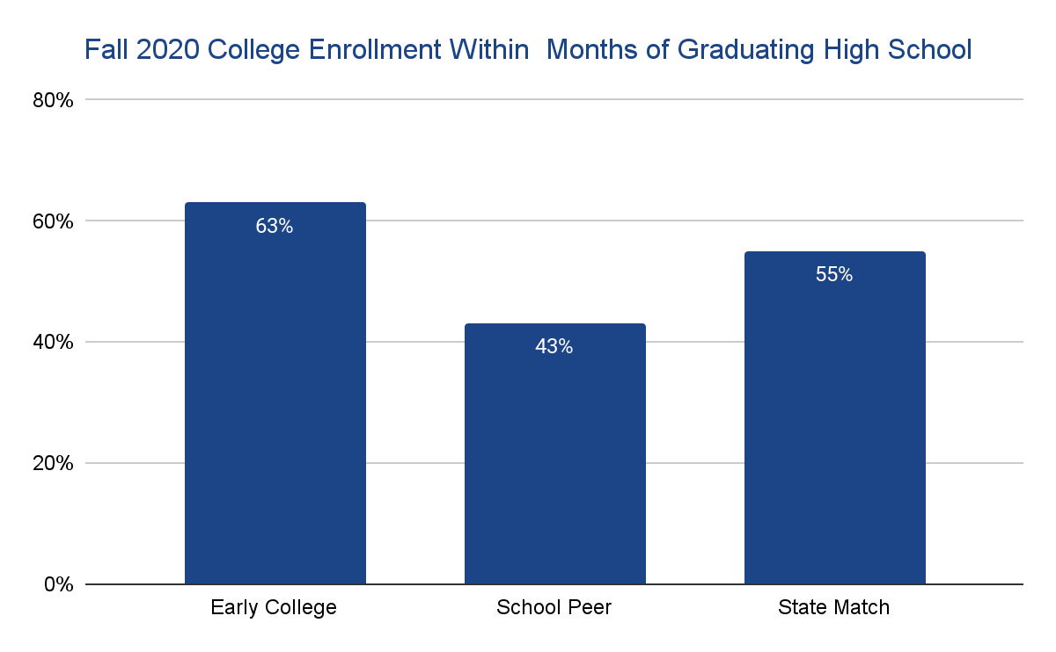
Early College graduates attend college at higher rates than school and matched peers
Tripp, we should discuss the best way to include this given the conversation on the Comms Call
Positive difference in college enrollment across both race and socioeconomic status
+ 7 percentage points for Black and Latinx students
+ 10 percentage points for economically disadvantaged students
Source: Early College Joint Committee Meeting, September 15, 2021

Slide 15
The engagement and success to date would not be possible without the broad leadership of many
Very open to suggestions on this slide! I wanted to keep it very vague to not leave anyone out, but also want it to adequately thank all those involved
The Legislature
The Coalition
The Administration
The Practitioners

Slide 16
As we look ahead, there is an inflection point and significant opportunity to take Early College to the next level in Massachusetts
This is a slide that we used at the DE21 conference in September and I wondered if it made sense to use in this context too
Public Sector
Grow support capabilities Continue to increase annual funding that keeps pace with the projected growth Invest in innovation and growth Pass enabling legislation to support long-term funding solutions and critical policies
Private Sector
Launch a new collective impact alliance to complement the public-sector efforts Expand coalition, awareness and commitment across sectors and geography Grow the engagement of the business community as partners in shaping the Early College vision and programs

Slide 17
Tripp, we had discussed a slide like this but wanted to confirm it still makes sense to include and if so, what is the best way to frame this slide
TBD slide on potential challenges scaling

