Slide 1
Lawrence Public Schools
Early College

Slide 2
Early College Enrollment by the Numbers
Partner Institution | Grade Level | Grade Level | Total Credits
Merrimack College | 11 | 12 | 16
Northern Essex Community College | 11 | 12 | 27+
Partner Institution | Enrollment | Enrollment | Current Enrollment
Merrimack College | 44 | 63 | 107
Northern Essex Community College | 63 | 66 | 129
Notes:
An overview of enrollment. Note - COVID-19 impacted last Spring’s recruitment efforts. We are currently providing substantial support so that students have a successful Fall semester and sustain their enrollment in the program until graduation.

Slide 3
Early College Success by the Numbers
Post-Secondary College Enrollment
100% of EC graduates enrolled in at least 3 courses
96% of EC graduates enrolled full-time
Post-Secondary Success
98% passed 2 or more college courses with a C- or higher
96% passed 4 or more college courses with a C- or higher
Notes:
The numbers indicate the success of the program. We are working to increase the numbers of students enrolled and persisting while maintaining the impressive success rates.

Slide 4
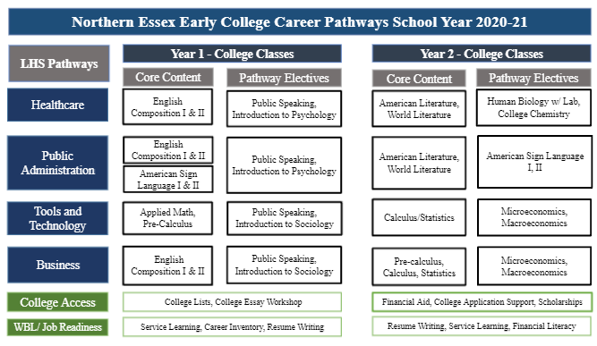
Notes:
Here are the most up-to-date pathways for the Northern Essex Community College students. The pathways were selected based on regional labor information included in the Northeast Regional Blueprint, Spring 2018. In addition, LHS and NECC have worked closely with national non-profit Jobs for the Future to dig further into labor market information and how to use this information in program design. Year 1 students also take a Summer I course that is typically a liberal arts elective.

Slide 5
Notes:
The current Merrimack College Early College pathways and design.

Slide 6
Promising Practices
Shared commitment to principles of equity and access
Strong Institutional Partnerships (Pioneer Scholarship - 10 full-tuition)
Curriculum alignment
ALA’s companion courses and teacher/professor partnerships
LHS’s support teachers and activities to align assessment expectations
Capacity-building and Staffing
Personalized support and strong program culture
Communication routines and systems
EC integrated among LHS leadership and supported by strong team
5 full-time LHS staff by Fall 2022
Notes:
Our success cannot be attributed to only one source but a mix of key components and approaches, starting with a shared commitment among college and district leaders to the principles of equity and access. Flowing from that, we have systems to support communication and collaboration which is consistently solution-oriented and centered on student success. When faced with the many challenges of teaching and learning during school closure, our teams relentlessly pursued every idea for how to make Early College work. That can-do attitude is at the heart of how our teams operate and innovate to support students. Each school has funded a variety of positions to ensure that our student-support systems are fine-tuned and able to both proactively and reactively meet students’ needs.

Slide 7
Promising Practices
Alternative Assessment
Math Course Mapping
Emerging Model
Early Identification (by student and/or by school) in Grade 9
Early Access in Grade 10
Expansion to newcomer programs
Notes:
In order to live up to the principles of equity and access, NECC/LHS have developed and refined an Accuplacer alternative. The reading and writing exam assesses skills most critical to student success in English 101, a common barrier for student advancement. The assessment is integrated into LHS’s 10th Grade ELA curriculum so teachers. Geometry and Algebra II in 10th Grade

