Slide 1

Choosing Integration:
A Discussion Paper and Policy Primer
January 2022

Slide 2
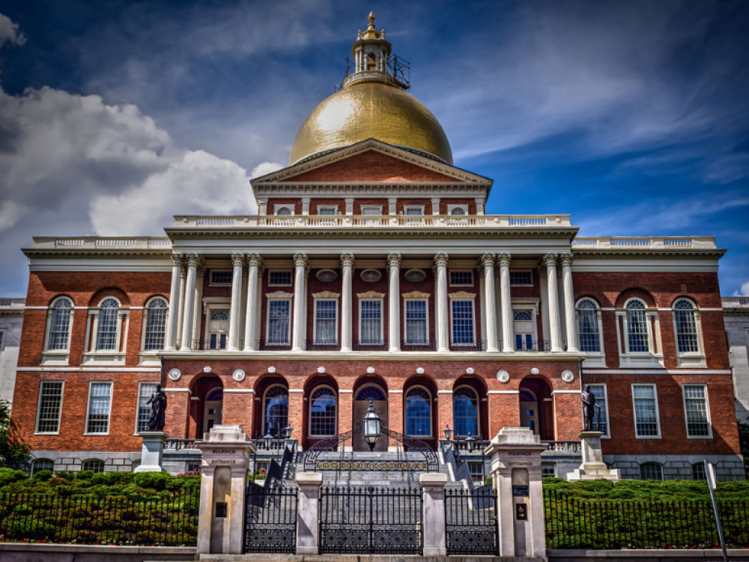
School Integration Milestones in Massachusetts
1855 Chapter 256 Desegregating Public Schools
1965 Racial Unbalance Act
1993 Education Reform Act
2001 State eliminates voluntary integration
incentives

Slide 3
The majority of Black and Hispanic students attend
high-poverty schools

Slide 4

Economic Segregation and Inequality
If the simple question – has the achievement gap closed – is asked, the answer is no...The reality is that doing more of the same will not close the achievement gap…Education leaders must ask how public policy can address the challenges of concentrated poverty in schools.

Slide 5
The Benefits of Integration
Reductions in racial bias and stereotyping
Improvements in critical thinking
Stronger leadership skills, increases in civic engagement, cultural competence
Source: Policy for Progress (2020)

Slide 6
Massachusetts has a growing number of racially and ethnically diverse schools*
Share of MA Schools That Are Diverse
* No group represents more than 70% of enrollment and at least 25% of students are White.

Slide 7
Growing enrollment in diverse schools has primarily occurred among Asian and White students
Share of Enrollment in Diverse Schools

Slide 8
Schools that saw growth in Black and Hispanic students saw large declines in White students
Percent Change in White Enrollment by Percentage Point Change in Minority Enrollment, 2000 - 2020

Slide 9
Few schools are racially and ethnically diverse and economically integrated*
* Between 20% and 40% of students are low-income.

Slide 10
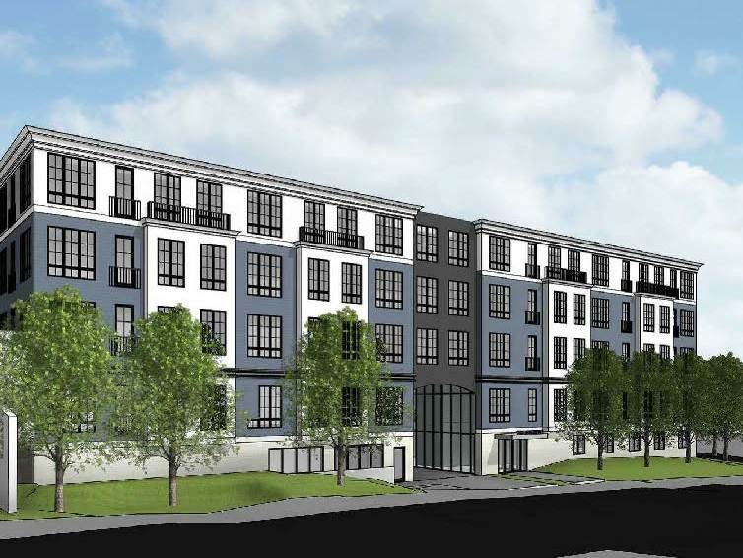
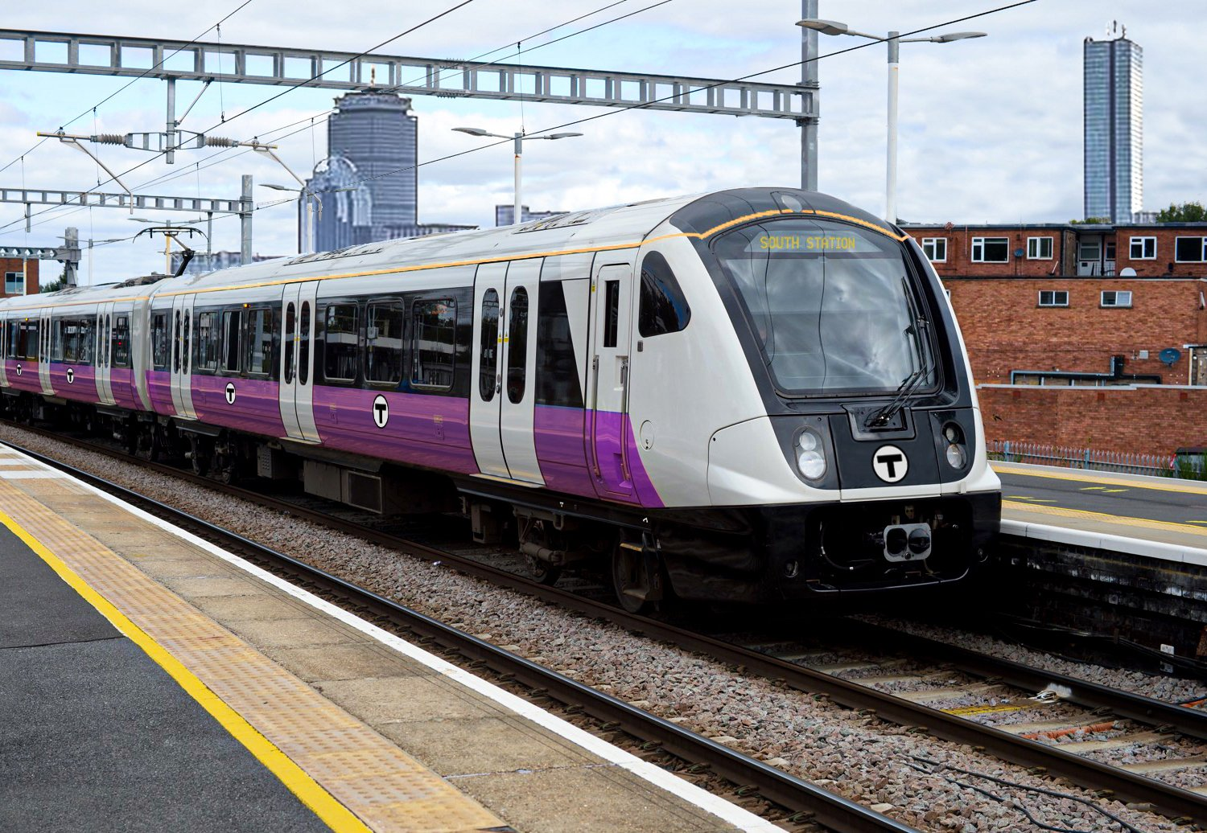
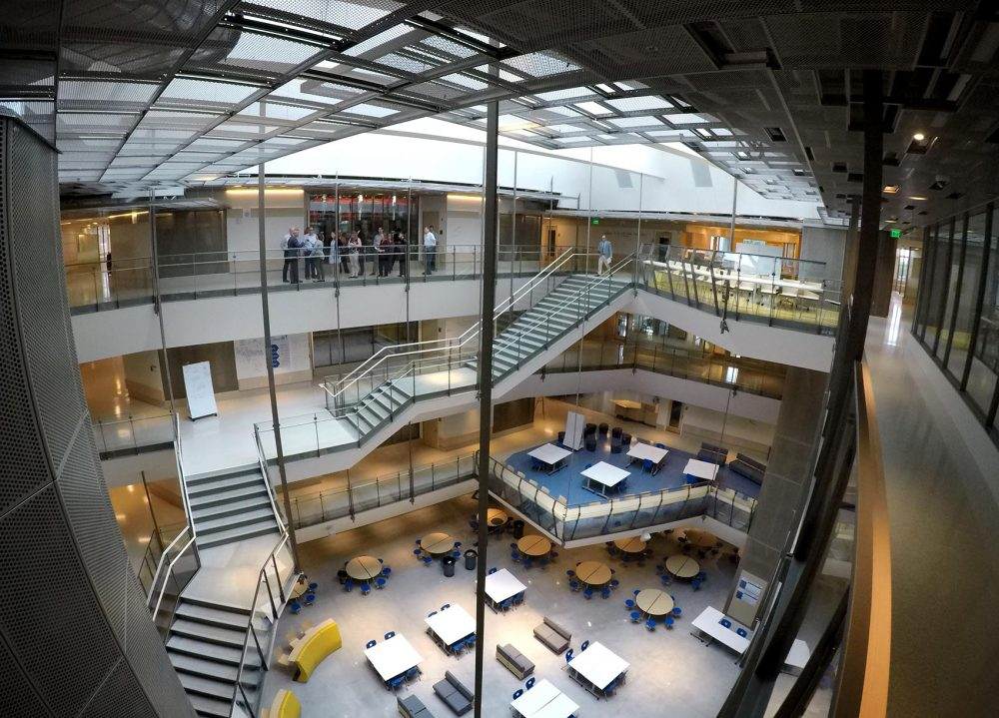

Housing
Transportation
Policy Framework
Education
Data

Slide 11
Housing
Back efforts to build mixed-income multifamily housing in suburban communities
Align neighborhood stabilization with strategic school improvement efforts
Expand funding for housing vouchers & counseling
Enforce fair housing laws and pass legislation to affirmatively further fair housing

Slide 12
Transportation
Utilize regional rail as a force for integration
Implement low-income fares on commuter rail
Expand access to affordable and reliable cars

Slide 13
Education
Build 21st-century magnet schools
Help diverse schools achieve the promise of integration
Align efforts to increase educator diversity with school integration efforts
Help charters integrate enrollment
Modernize the METCO program

Slide 14
Data
Publish integration data
Create an independent commission on performance metrics
Develop an inclusive school district designation

Slide 15
Call to Action
“If it were possible to create equal educational opportunity under conditions of segregation and economic inequality, some community—among the thousands of districts in the country—would have done so. None have. Separate is still unequal. If we are serious about reducing racial inequality in educational opportunity, then, we must address racial segregation among schools.”
- Sean Reardon (2019)

