Slide 1
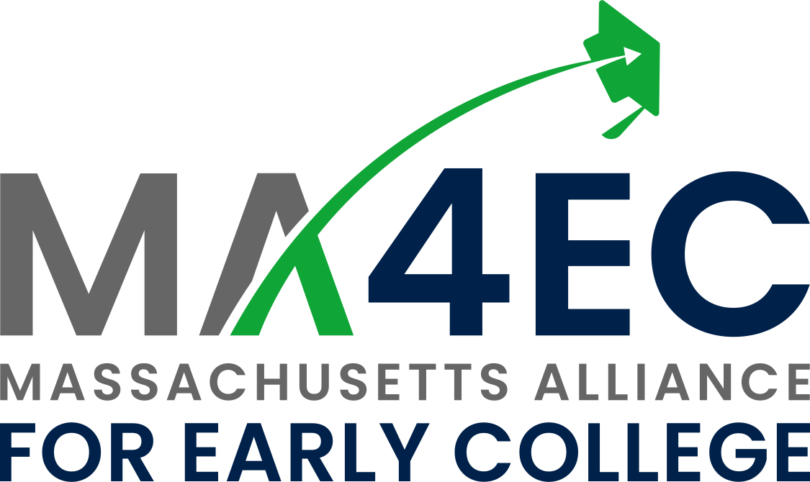
Erika Giampietro
Executive Director
Massachusetts Alliance for Early College

Slide 2
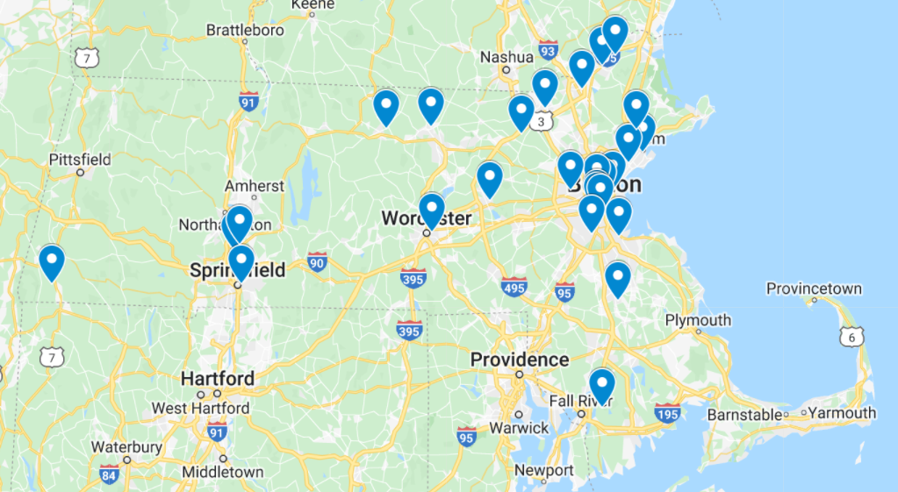
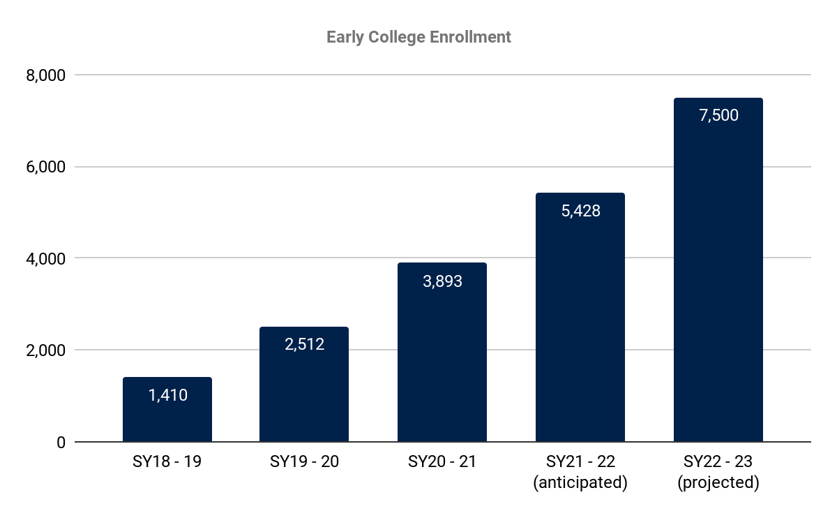
In a few short years, Massachusetts has laid a strong foundation for Early College success and scale
Communities
35 designated programs across 46 high schools and 23 institutions of higher education
50% of high schools in Gateway Cities
5 out of 7 WIOA Regions
12 out of 15 community colleges
6 out of 9 state universities
Student Enrollment
Scale and Student Demographics
5,428 students earning 37,000 college credits (+54% over SY20-21)
Two-thirds Black and Latino
57% economically disadvantaged

Slide 3
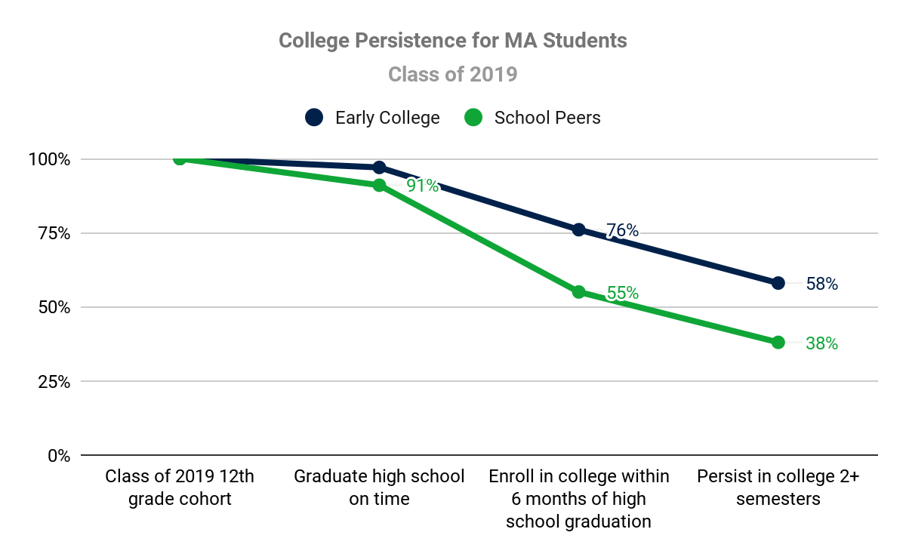
Early evidence shows that Early College is working in MA
↑ 38%
↑ 53%
Source: Massachusetts Department of Elementary and Secondary Education, February 2021, Early College Joint Committee

Slide 4
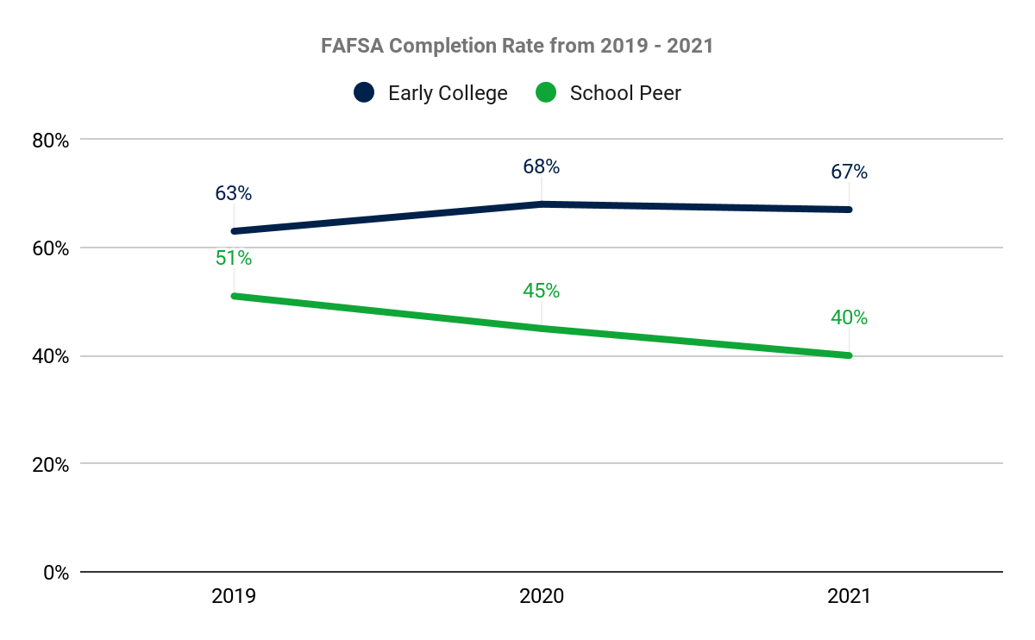
FAFSA completion rates remain steady and elevated for Early College participants
FAFSA completion is a good predictor of immediate college enrollment:
72% of low-income underrepresented minority students who complete the FAFSA enroll in college (compared to 18% who do not complete)
Source: Massachusetts Department of Elementary and Secondary Education, December 2021, Early College Joint Committee

Slide 5
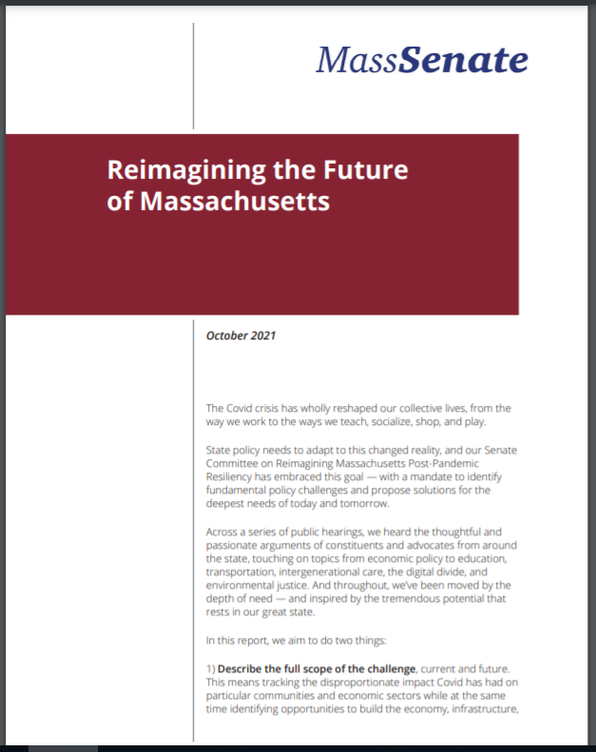
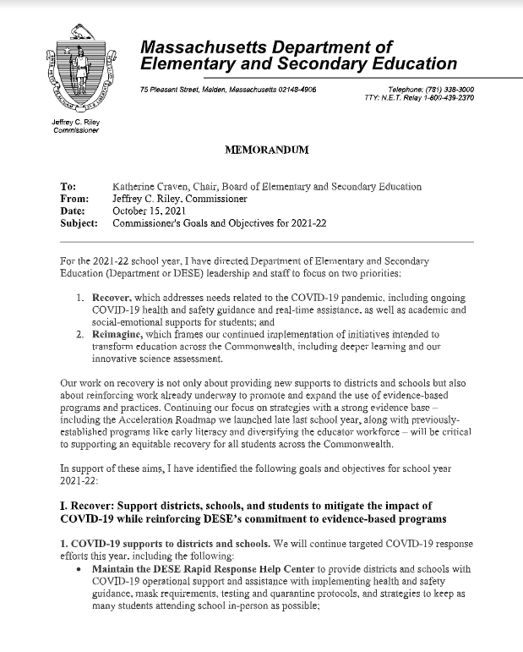
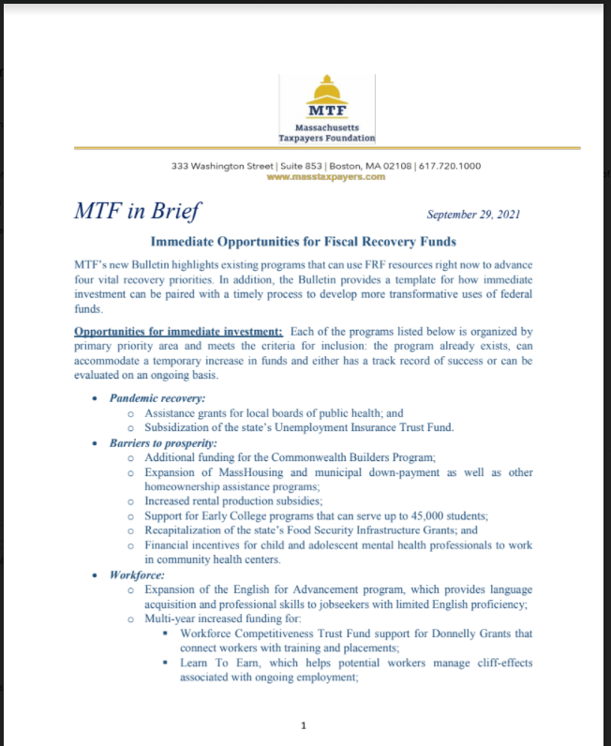
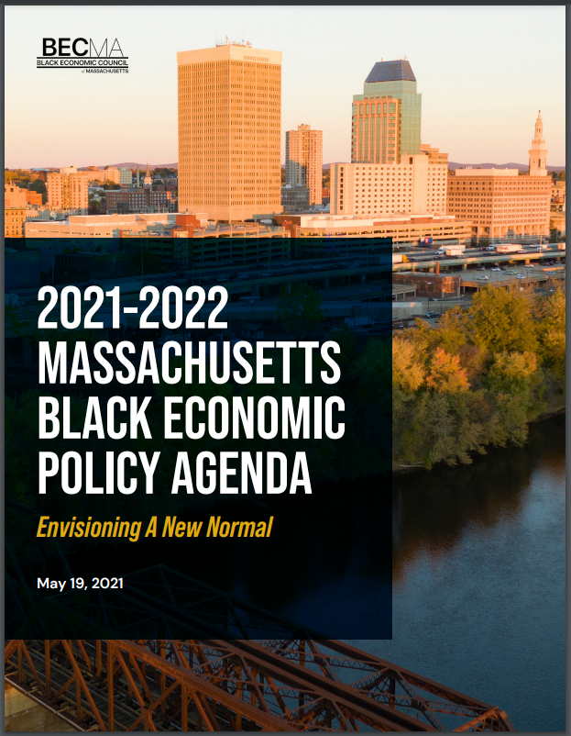
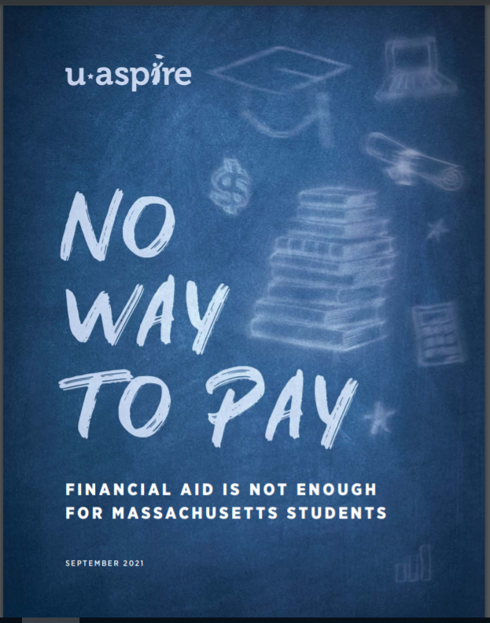
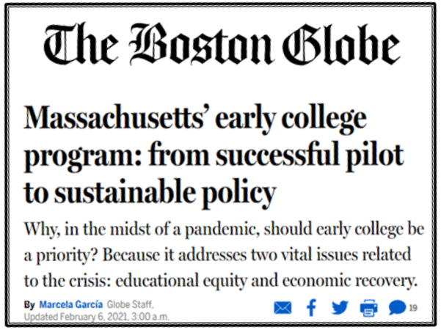
Public support for Early College is growing

Slide 6
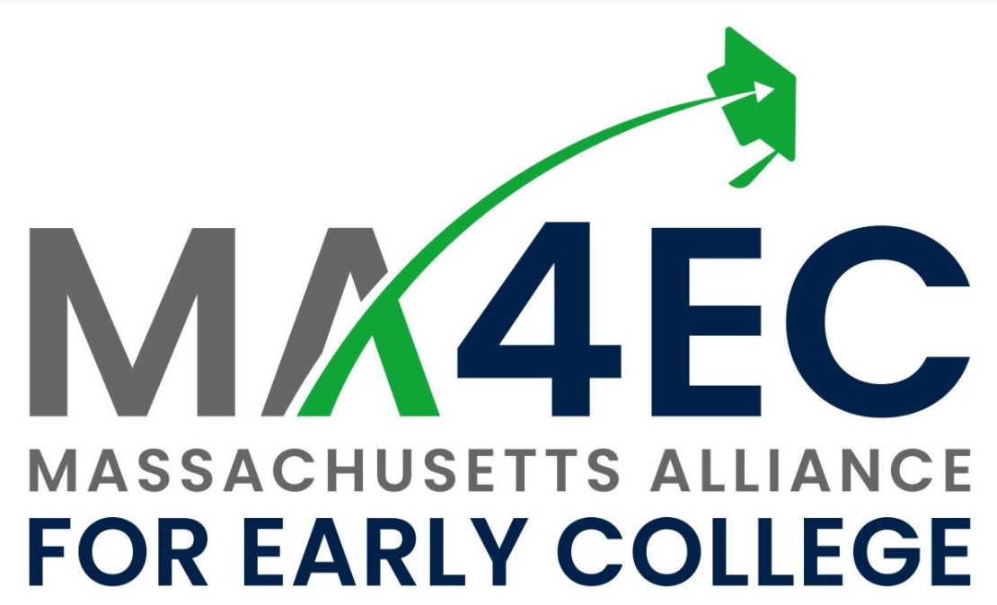
The Massachusetts Alliance for Early College launched in January 2022 with over 80 members

Slide 7
Central to the collective work of the Alliance is a meaningful goal for the Early College Initiative
The Goal
Close a quarter of the statewide college success equity gap by race and income and benefit thousands of students beyond that through the growth of high quality Early College programs in Massachusetts
Scale
Quality
45,000 students in grades 9-12, at least ⅔ students of color and half students from low income homes
Double the degree attainment rate for students of color and students from low income homes

Slide 8
Achieving this goal is feasible because of strong and growing community demand
Indicators of Strong Community Demand
Growth in Current Programs: next year, 7,500 students (+37% over FY22) are projected to take 54,000 college credits (+43% over FY22); this is on top of 54% growth in credits earned in FY22 over FY21)
Growth in New Programs: 13 programs applied for designation for SY22-23 (the 8th designation cycle), with more already expressing interest for the next cycle
Local desire to continue growing: 30 programs applied for competitive grants to build full-school programs and expand current programs. 15 programs were awarded, and those will collectively add 4,000 more seats by 2024.
Local prioritization of Early College in Student Opportunity Act (SOA) Plans: 41 districts cited Early College as a focus in their SOA Plan and 30 of those districts do not yet have a state designation qualifying them for state funding

Slide 9
Funding in the FY22 State Budget provided critical resources to increase access to and quality of Early College programs
 | Dual Enrollment Grant and Subsidies, “CDEP” (7066-0019) | Early College Programs (7009-6600)
Funding | $3M (FY21), $6M (FY22) | $2.5M (FY21), $5M (FY22)
Purpose | For reimbursing colleges for the course cost of designated Early College programs | To stimulate growth and quality via planning, implementation and growth grants, and program support and review
What the FY22 increase in funding enabled | A 54% increase in the number of credits earned in designated Early College programs Reimbursement to colleges for course costs: Reimbursement to colleges at a rate of $135/credit for courses that are part of designated Early College programs Savings to families: Nearly $8M in tuition and fees for college courses | Stimulus to fuel continued growth necessary for meeting unmet demand in communities Growth incentives: full school impact and expansion grants, projected to add 4K more EC seats Help with start-up and sustaining: planning and implementation grants to 32 districts Quality support: via technical assistance partners Research and evaluation: Program review and benchmarking study

Slide 10
We recommend increasing state funding for Early College from $11M in FY22 to $19M in FY23
Concurrent & Dual Enrollment Programming (“CDEP”) line item 7066-0019
Purpose: For reimbursing colleges for the course cost of designated Early College programs
Administering Entity: the Department of Higher Education
FY23 recommendation: $9M (up from $6M in FY22), of which $8M is for Early College
Governor’s Proposal: $8.7M
Early College line item 7009-6600
Purpose: To stimulate growth and quality via planning, implementation and growth grants, and program support and review
Administering Entity: the Executive Office of Education
FY23 recommendation: $10M (up from $5M in FY22)
Governor’s Proposal: $9.5M
Funding the Early College Initiative at this level would be sufficient to meet projected growth in school year 2022-23 and to stimulate additional growth in future years, putting the Commonwealth on a trajectory to reach meaningful scale and impact goals

Slide 11
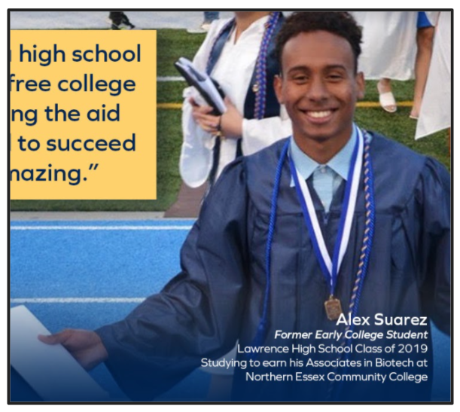
“One of the best parts of Early College was the exposure. Having that and experiencing college first-hand really prepared me, and is helping me be successful.”
To follow this briefing, we will share additional information on the Early College Initiative and the budget recommendation discussed today.

Slide 12
Appendix

Slide 13
Early College requires moderate but real costs for both the K12 and higher education partner in order to keep programs free for students
 |  | K12 Partner | Higher Education Partner
Typical costs incurred |  | Staffing (support, administrative) Transportation Textbooks and technology Family outreach | Courses costs Staffing (support, administrative)
Funding Source | Start-up | Early College Programs (7009-6600) and philanthropy
 | Sustaining | Local budgets Student Opportunity Act | Dual Enrollment Grant and Subsidies, “CDEP” (7066-0019) Local budgets
 | Growing | Early College Programs (7009-6600)

Slide 14
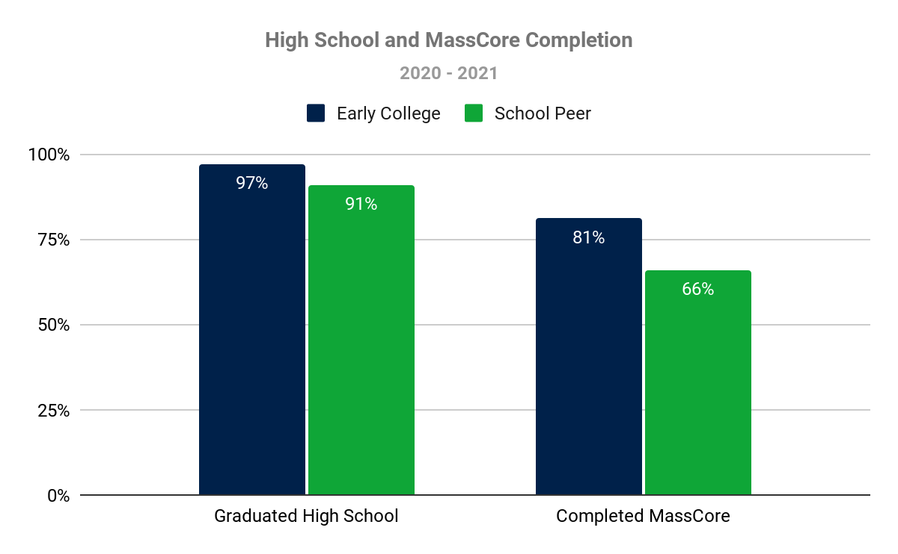
Early College students are more likely to graduate and are more college and career ready than peers.
Source: Massachusetts Department of Elementary and Secondary Education, December 2021, Early College Joint Committee

Slide 15
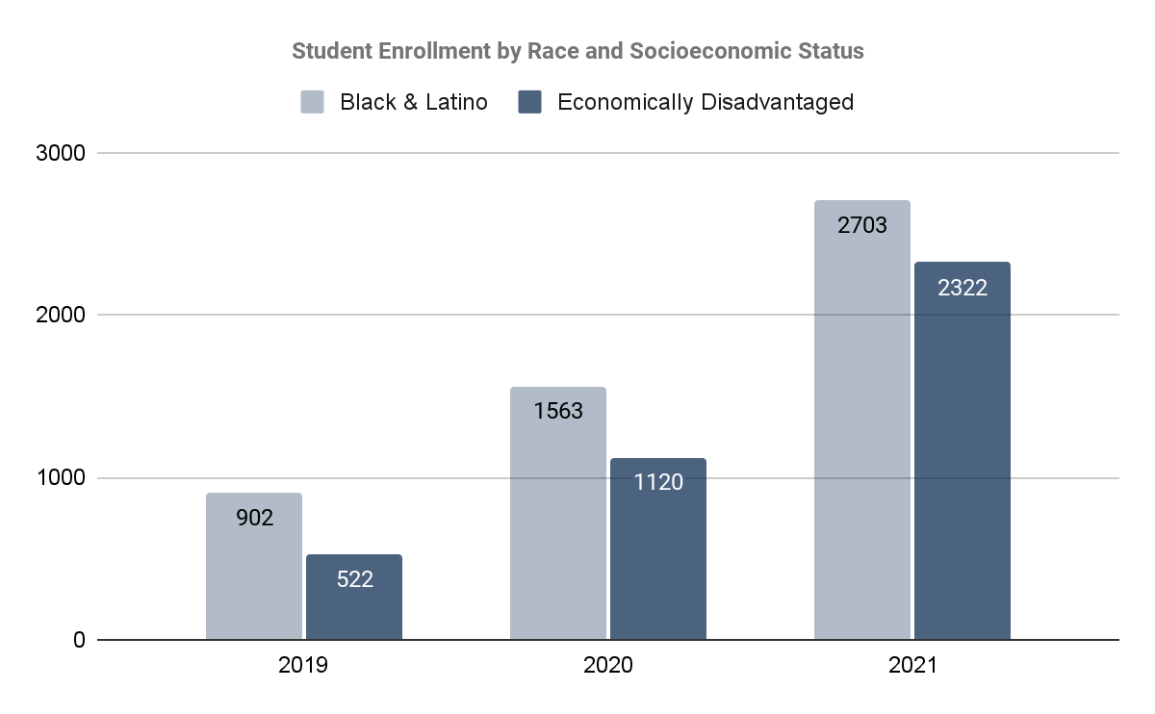
Early College programs continue to reach the most underserved students
The number of economically disadvantaged students enrolled doubled from year to year
The number of Black and Latino students enrolled increased by 73% from year to year
Source: Massachusetts Department of Elementary and Secondary Education, December 2021, Early College Joint Committee

Slide 16
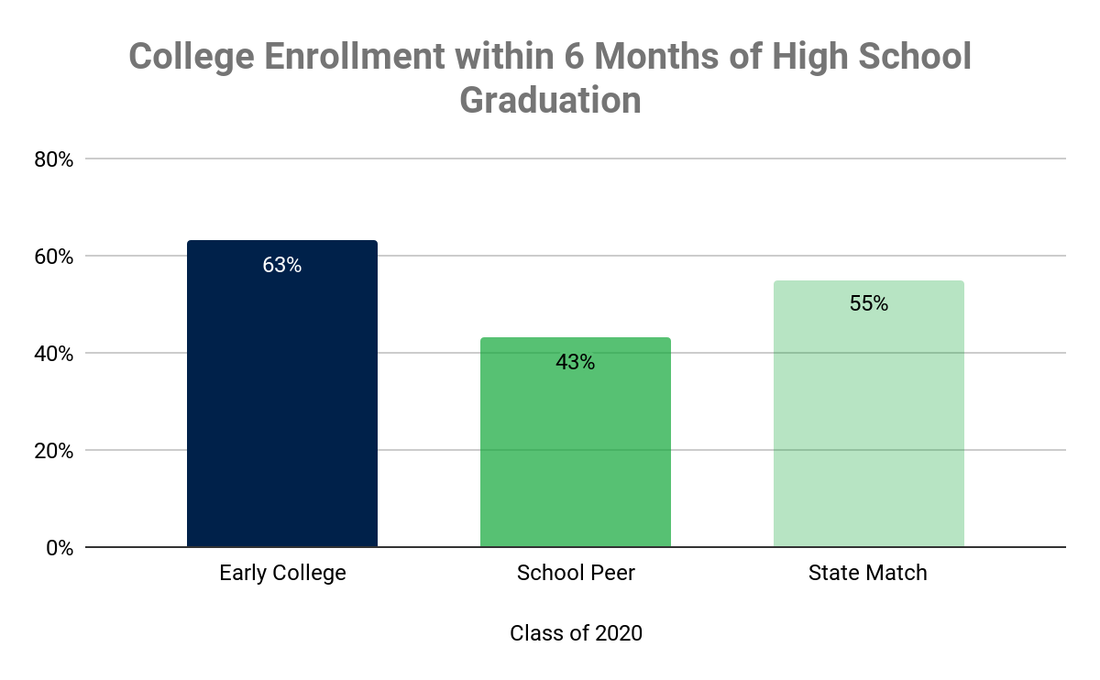
Despite the COVID-19 pandemic, the majority Early College graduates in 2020 were still able to immediately enroll in college that fall
Source: Massachusetts Department of Elementary and Secondary Education, December 2021, Early College Joint Committee

