Slide 1

Empowering Cities to Accelerate Equitable Growth
A State Policy Blueprint for Inclusive Municipal Contracting
Gateway Cities Leadership Summit
July 12, 2022

Slide 2


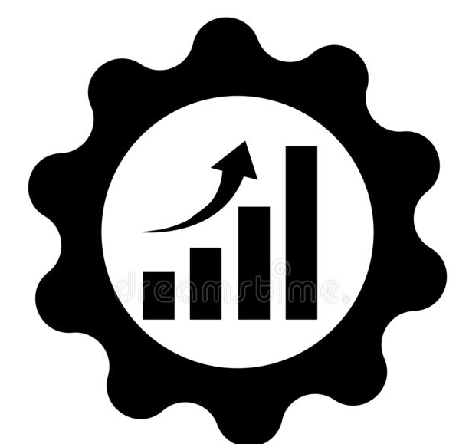

Cities across the country are focused on inclusive public contracting because it is smart economic policy.
Combating inequality.
Enhancing labor supply and productivity.
Increasing the efficacy of government investment.
Growing the number of small local businesses.

Slide 3
New business formation has declined sharply in Massachusetts.
Annual Number of New Companies in Massachusetts with Employees per 100,000 residents

Slide 4
White residents in Massachusetts are still more than twice as likely to own a business.
Share of Massachusetts workers self-employed in their own incorporated business

Slide 5
ARPA and BIL funding will send approximately $7 billion to MA cities and towns, more than 3X their typical annual capital spend.
Source: : Authors' estimates from US Census Bureau, 2019 Annual Surveys of State and Local Government Finances

Slide 6
Capital spending by municipalities in Massachusetts is largely schools and water and sewer construction.
State and local construction expenditure by category, 2019

Slide 7
Cities use a variety of contracting programs to increase supplier diversity.
Enforceable sub-contracting goals
Bid discounts
Contact set asides or sheltered markets

Slide 8
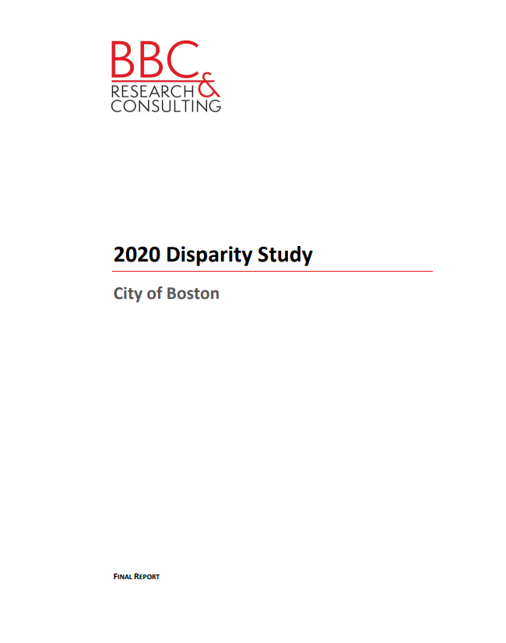
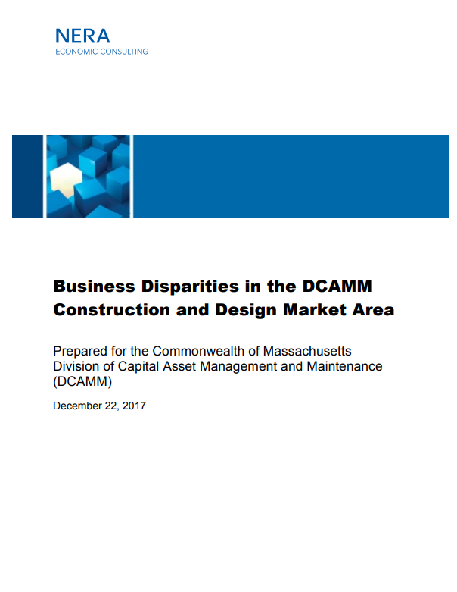
These approaches can be race-conscious or race-neutral; a race-conscious approach will require a disparity study.

Slide 9
In Massachusetts, cities have some openings to advance inclusions with goods and services purchases.
Small or local business program (Race-neutral) | For contracts below $50,000, can ensure small or local businesses are among the bidders solicited For certain contracts above $50,000 awarded through an RFP process, some ability to consider Diversity, Equity, and Inclusion criteria. No sheltered market program possible under existing law
MBE program (Race-conscious) | For contracts below $10,000, can institute a sheltered market program, but only with a disparity study. For contracts below $50,000, can ensure MBEs are among the bidders solicited For certain contracts above $50,000 awarded through an RFP process, some ability to consider Diversity, Equity, and Inclusion criteria.

Slide 10
Our cities have more power to advance inclusion with public building construction and disposition of public property.
Small or local business program (Race-neutral) | For contracts below $50,000, can ensure small or local businesses are among the bidders solicited For RFPs for disposition of public property, some ability to consider Diversity, Equity, and Inclusion criteria. No sheltered market program possible under existing law No subcontracting equity program possible under existing law
MBE program (Race-conscious) | For contracts below $50,000, can ensure MBEs are among the bidders solicited For State-funded projects, requirement to meet the Commonwealth’s MBE participation goals under the Affirmative Marketing Program (AMP) For RFPs for disposition of public property, some ability to consider Diversity, Equity, and Inclusion criteria. No sheltered market program or subcontracting equity program possible

Slide 11
Our cities have little power to advance inclusion with public works construction.
Small or local business program (Race-neutral) | For contracts below $50,000, can ensure small or local businesses are among the bidders solicited No sheltered market program possible under existing law No subcontracting equity program possible under existing law
MBE program (Race-conscious) | For contracts below $50,000, can ensure MBEs are among the bidders solicited No sheltered market program possible under existing law No subcontracting equity program possible under existing law

Slide 12
They do have considerable power to advance inclusion with design services.
Small or local business program (Race-neutral) | Considerable flexibility to ensure small or local business inclusion
MBE program (Race-conscious) | Municipal design projects that include state funding must incorporate MBE participation goals.

Slide 13
With targeted changes to state law, Massachusetts can empower municipalities to seize the opportunity.
Expand Massachusetts' existing sheltered market program to include public building and public works construction.
Expand the sheltered market program to include small and local businesses.
Create underutilized business provisions for public buildings and public works construction.
Confirm that unbundling large contracts is a permissible way to meet inclusive procurement goals.
Create a grant program to help municipalities collect and publicly report MBE participation in procurement.

