Slide 1
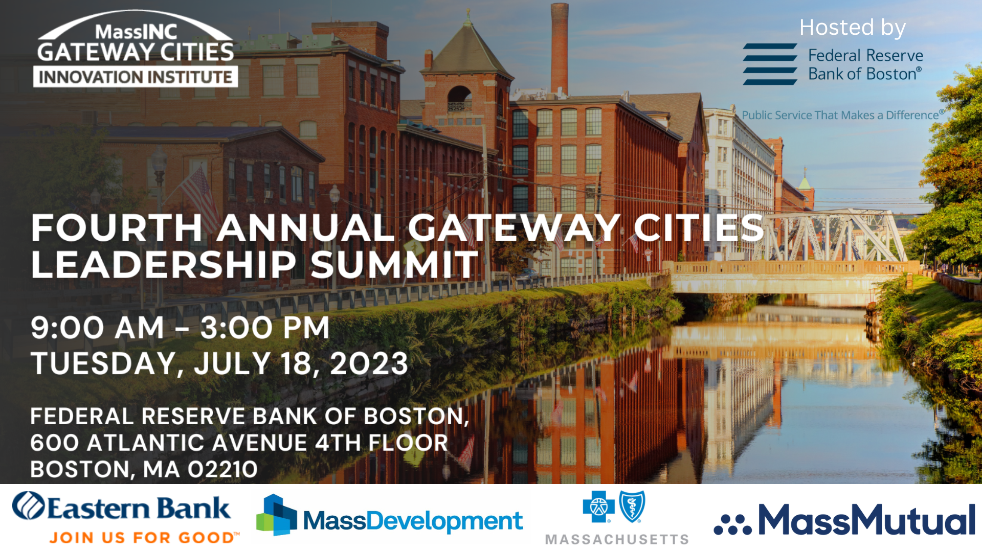

Slide 2
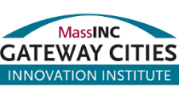
Gateway Cities Innovation Institute Research Pipeline
Forthcoming Research and Projects in Development

Slide 3
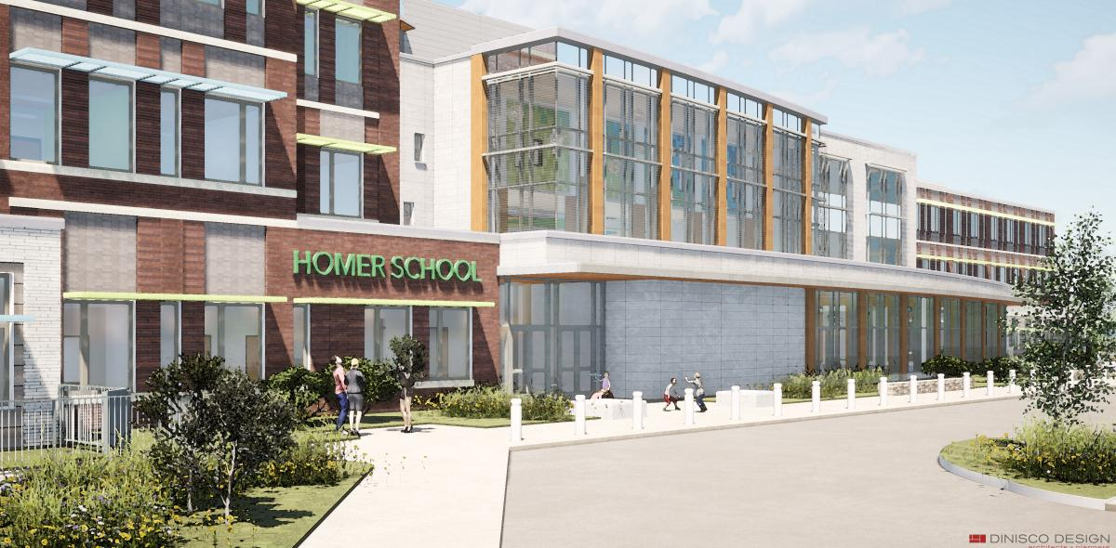
Connecting School Improvement with Housing and Community Development
Forthcoming. A “playbook” to help local education, housing, planning, and community development leaders combine investments in new housing projects with investments in neighborhood schools.
In development. A community of practice to apply strategy in targeted neighborhoods.

Slide 4
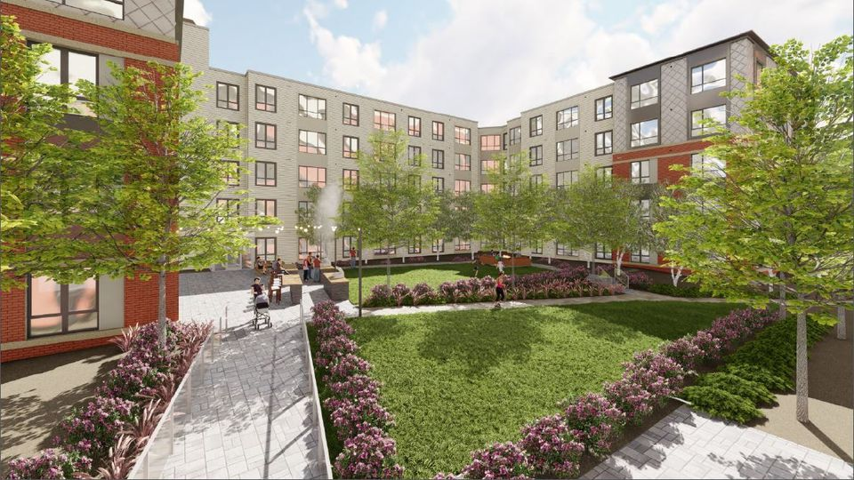
Gateway Cities Housing Report Card
Forthcoming. A standard methodology for evaluating varying housing conditions and needs across Gateway Cities and estimating targets for healthy levels of production.
In development. A template that will be replicable on an annual basis, giving Gateway Cities more voice and greater weight in housing policy debates.

Slide 5
Broadband and Digital Equity
Forthcoming:
Digital equity and ESOL services. Exploring potential to help the one-in-five limited English proficient residents of Gateway Cities connect to high-quality services.
Digital equity in affordable housing. Exploring new models/policies to provide residents of affordable housing with fast, reliable, and affordable internet service.
In development:
Supporting/encouraging municipal digital equity plans, so Gateway Cities can take full advantage of +$200 million in federal funding from ARPA and the Bipartisan Infrastructure Law.
Digital equity plans complete/underway (14):
Brockton, Chelsea, Chicopee, Everett, Holyoke, Leominster, Lowell, Lynn, New Bedford, Peabody, Pittsfield, Revere, Quincy, Springfield
No planning activity to date (12):
Attleboro, Barnstable, Fall River, Fitchburg,
Haverhill, Lawrence, Malden, Methuen, Salem, Taunton, Westfield, and Worcester

Slide 6
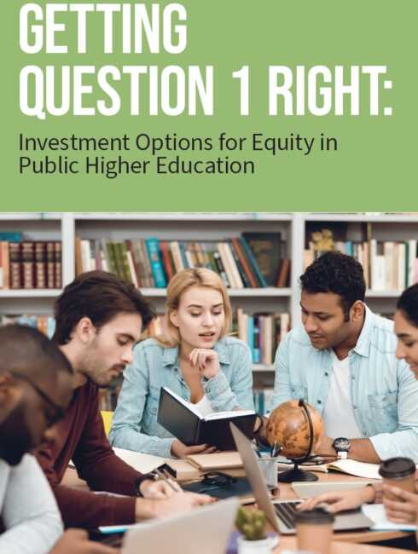
Education and Workforce Development Projects
Forthcoming/in development: Early College pathways that help meet acute needs for more skilled workers while generating upward economic mobility for Gateway City residents.
In development: Leveraging new funding for education available through both the Student Opportunity Act and Question 1.

Slide 7
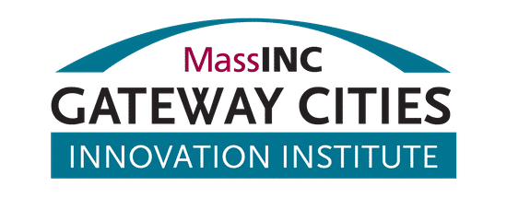
Policy Initiatives
Leadership Summit 2023

Slide 8
Success: Neighborhood Stabilization Program
Established a program at MassHousing that addresses disinvestment: offering capital grant funds for redevelopment, reconstruction, renovation or repair of substandard and/or blighted properties
Can create new homeownership opportunities in 1-4 unit properties; assist homeowners in need of extensive home repairs; or rehabilitate rental properties with 15 units or less
$7.1M appropriated in fiscal year 2024; total of $38M through FY2028
In addition, the Neighborhood Hub program provides technical assistance to help identify and implement strategies to repair and renew neighborhoods with high rates of vacant, abandoned and deteriorating homes.

Slide 9
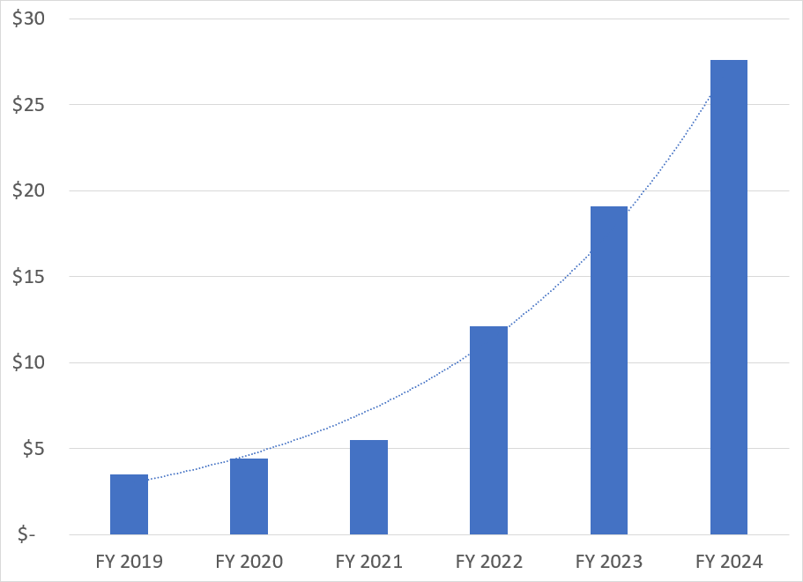
Success: Early College
From $5M to $28M in three years
More than half of Early College students are in Gateway City districts
Has been a priority since education vision project in 2013

Slide 10
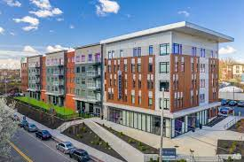
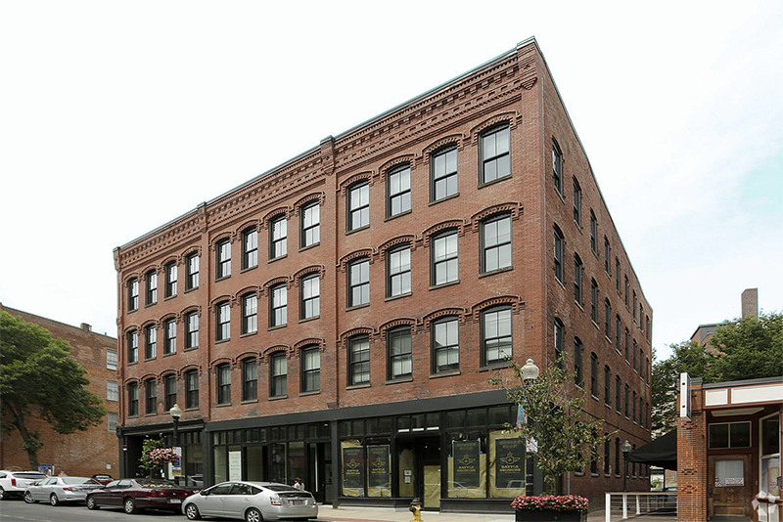
Housing Development Incentive Program (HDIP)
Proposal to raise the $10M state tax credit cap to $30M; with one-time increase to $57M to address the project backlog
Senate included language in its tax reform package
House included same text in the supplemental budget
Ideally legislative leaders will resolve the issue this month before the August break

Slide 11
An Act to Promote Downtown Vitality H.228/S.130
Would dedicate 5% of online sales tax revenues to a new fund to support small business districts through district management strategies including business improvement districts, cultural districts, and parking benefit districts. Gateway Cities would have a priority.
Referred to the Joint Committee on Community Development and Small Business
Coalition partners include: MassCreative, Mass Association of Business Improvement Districts, MAPC

Slide 12
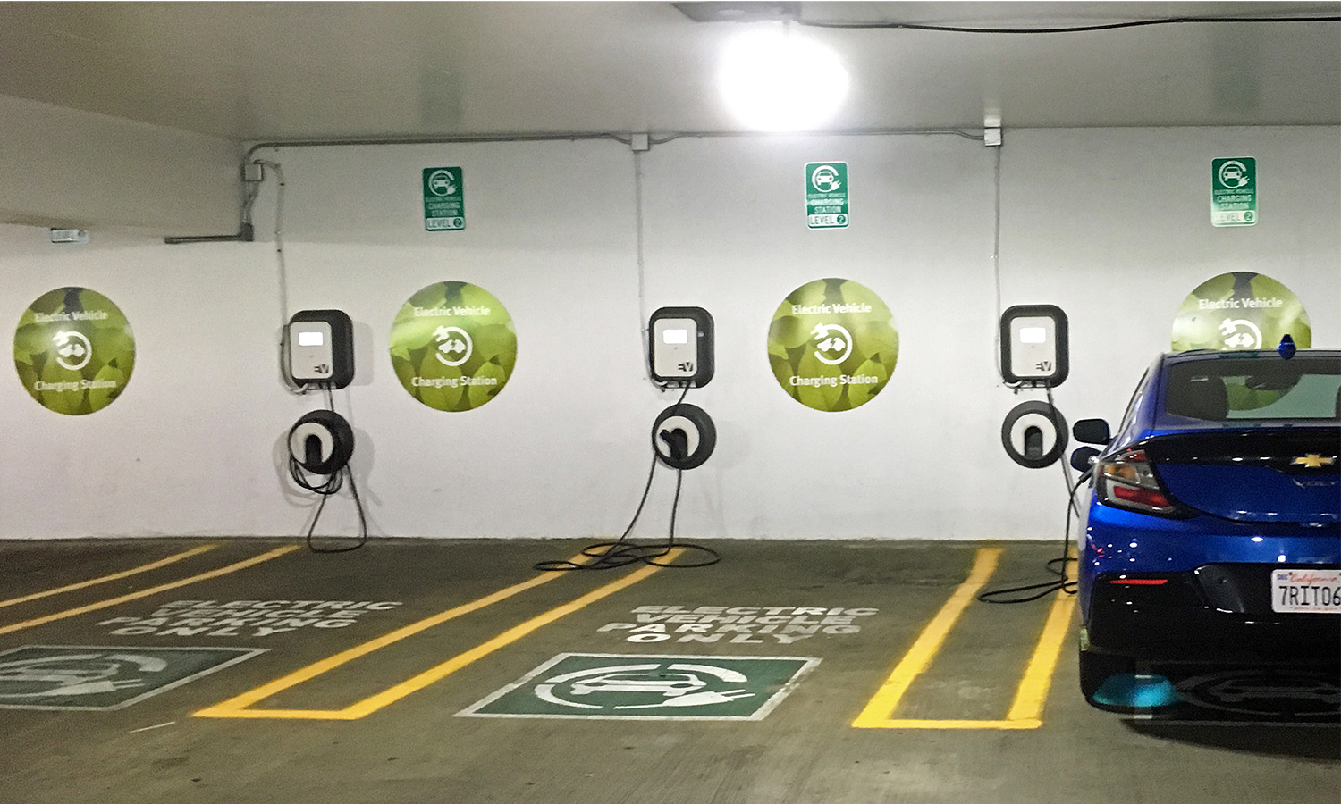
An Act to Build Future-Forward Parking Structures to Promote EV Equity and Walkable Downtowns H.3276/S.2222
A new funding program to reimburse municipalities 30-80% for the cost of public structured parking garages in downtowns and other walkable areas to reduce surface parking and improve walkability and access to EV infrastructure. Gateway Cities would have priority.Senate included language in its tax reform package
Referred to the Joint Committee on Transportation

Slide 13
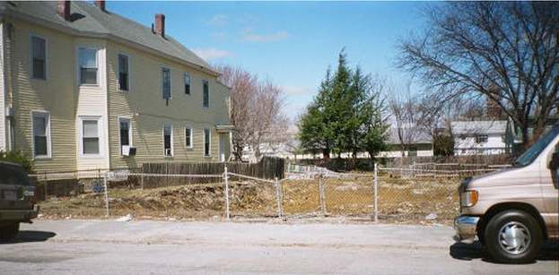
An Act Relative to Neighborhood Stabilization and Economic Development H.227/S.1777
Would build on previous neighborhood stabilization successes, such as MassHousing’s Neighborhood Hub and Neighborhood Stabilization Program. The key provisions here would modernize state laws including eminent domain to facilitate addressing scattered site vacant properties in neighborhoods.
Referred to the Joint Committee on Community Development and Small Business

Slide 14
An Act Relative to Public Procurement and Inclusive Entrepreneurship H.2997/S.1986
Includes provisions to help close racial and ethnic gaps in business ownership, which would be particularly helpful for supporting business growth in Gateway Cities. The centerpiece addresses municipal procurement reform to implement supplier diversity practices.
Referred to the Joint Committee on State Administration and Administrative Oversight

Slide 15
An Act to Increase Adequate Regional Transit Accessibility in the Commonwealth S. 2277
Increase baseline funding for regional transit agencies, in part by dedicating 50% of transportation network company fees (Uber & Lyft) to RTAs
Fund RTA capital projects at same rate as the MBTA and accelerate electrification of buses
Strengthen the RTA advisory council and stop evaluating RTAs on “fare collection per rider,” a metric that encourages higher fares on low-income riders

Slide 16
Transit Fare Equity
Fare-free bus service for Regional Transit Authorities (RTAs)
Low-income fares for the MBTA
In the state’s annual budget proposals, the House included dedicating $70M of Fair Share Amendment revenue to RTAs, while the Senate included $100M (including $56M for increasing base support, $15M for fare-free pilot programs, $4M for accessibility, and $25M for innovation grants)
The budget remains in conference committee

Slide 17
Special Commission to Study the Massachusetts School Building Authority
The proposed commission would address equitable and adequate funding for school facilities, policies to support healthy schools, and policies to advance the state’s environmental and greenhouse gas emissions reduction goals in schools.
With 186 million square feet of buildings, schools represent the largest form of public building space in Massachusetts.
Could help address MSBA funding inequities for Gateway Cities; could also increase capacity for vocational schools

Slide 18
Inclusive Economies Initiative
place-based approaches and people-centered strategies
to improve local economies

Slide 19
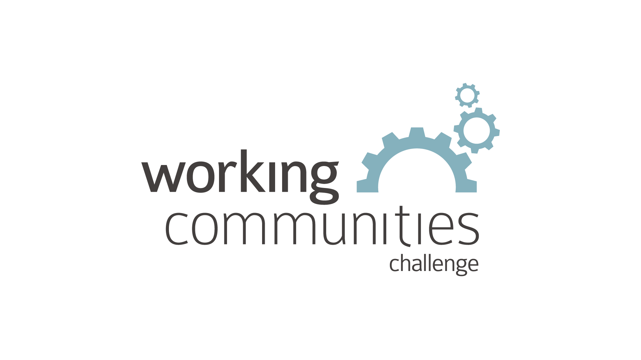
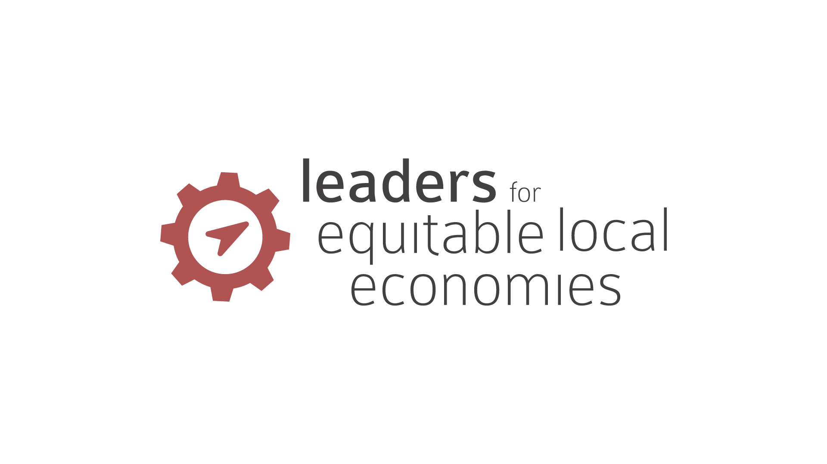
Regional and Community Outreach at the Boston Fed
Working Places
Leaders for Equitable Local Economies (LELE)
Inclusive Economies
Builds Cross-sector Teams, Shared Economic Purpose and activities
Helps Communities build diverse leadership for Economic Growth
Helps communities build their economic development pipeline and grow investment, with a collaborative and community involved approach.
Racial Wealth Divide Research & Engagement
Deep focus on racial wealth, enabling regional and state ecosystems to take smarter action to close wealth divide
Community Development Research
Research into critical issues in and for New England’s low-income communities, including childcare, job quality, small city growth
Maximum Sustainable Employment & Stable Prices Dual Mandate
Notes:
The Working Places team supports leaders in smaller cities and rural communities who are committed to building more inclusive economies.
We do this through several key initiatives that share the principles of collaborative leadership, community engagement, learning orientation, and systems change:
1) Working Cities Challenge
Built on Boston Fed research : collaborative leadership is key to economic resurgence in smaller cities
Supported teams in 12 cities across MA, RI, and CT committed working across sectors to change systems in ways that allowed more residents to participate and thrive in local economies
Cross-sector teams received 3-year grants of $400-500k (funds provided by state govt, private sector, and philanthropy) plus technical assistance, coaching, and opportunities to learn with/from peers
2) Working Communities Challenge
WCC model adapted to integrate lessons from southern New England and meet the needs of rural context in VT and ME
Structure: 4 years, winning communities receive grants of $400k-$500k provided by partners
Currently in progress: 8 teams in VT, 6 teams in ME

Slide 20
Working Places at the Boston Fed
The Working Places team supports leaders in smaller cities and rural communities who are committed to building more inclusive economies.
We do this through several key initiatives that share the principles of collaborative leadership, community engagement, learning orientation, and systems change:
1) Working Cities Challenge
Built on Boston Fed research : collaborative leadership is key to economic resurgence in smaller cities
Supported teams in 12 cities across MA, RI, and CT committed working across sectors to change systems in ways that allowed more residents to participate and thrive in local economies
Cross-sector teams received 3-year grants of $400-500k (funds provided by state govt, private sector, and philanthropy) plus technical assistance, coaching, and opportunities to learn with/from peers
2) Working Communities Challenge
WCC model adapted to integrate lessons from southern New England and meet the needs of rural context in VT and ME
Structure: 4 years, winning communities receive grants of $400k-$500k provided by partners
Currently in progress: 8 teams in VT, 6 teams in ME

Slide 21
Working Places at the Boston Fed
3) Leaders for Equitable Local Economies (LELE)
Rooted in lessons from the WCC about the need for supporting and sustaining representative leadership
Experiment to test what it would take to increase the impact and influence of community leaders working to make their cities’ economies stronger, more racially equitable and inclusive
Pilot concluding in June 2023; currently supporting (with stipends, small grants, and TA) 5 teams of 2-3 leaders/city in MA to test or accelerate approaches to make their economies more racially equitable and inclusive
Independent evaluation underway to determine whether/how the Boston Fed might continue this approach
4) Inclusive economies!
Notes:
Ask colleen if this is the one she wants to use or what, do we want examples? And/or LELE?

Slide 22
The Boston Fed
Inclusive Economies Initiative
Definition (draft): economic inclusion results when all people in a community benefit from and contribute to growing a strong local economy, with an emphasis on the benefits of growth reaching people of color, residents with lower incomes, and places often left out of traditional job-growth and economic development activities.
The work builds on what we’ve learned from the WCC and LELE
Investing in leadership, collaboration, leaders of color and social infrastructure in communities is critical to advance inclusive economic growth

Slide 23
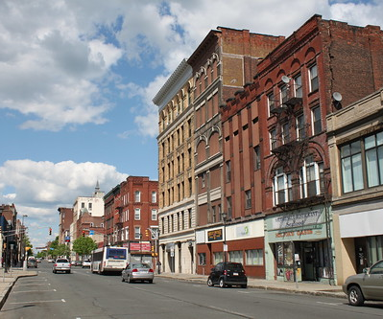
Inclusive Economies: Why This / Why Now?
This is a moment of historic investment of federal dollars into communities: American Rescue Plan Act (ARPA), Infrastructure Investment and Jobs Act (IIJA), Inflation Reduction Act.
Without intentional change, capital will flow but it will likely recreate inequitable patterns of the past.
Many communities, including WP communities, are increasingly focused on inclusive development, i.e., economic development that is designed to boost economic growth and inclusion and outcomes for lower-income residents.
This Photo by Unknown Author is licensed under CC BY-SA-NC

Slide 24
Inclusive Economies Objectives
Connect federal, philanthropic and private investment with local efforts in small and mid-size cities and rural areas to expand inclusion-driven economic development.
Build new capacity at the local level to leverage capital, support on cross-sector collaboratives, and uplift community voice and priorities in economic development processes.
Identify broader system level interventions in both policy and capital markets that support greater investment in smaller cities and rural places.

Slide 25
Inclusive Economies: consists of three distinct strategies
Learning Network
Labs
Flexible Capital
Greater Investment in smaller cities and rural places
The Learning Network will support learning, foster connections and relationship building for practitioners focused on advancing inclusive economic growth in smaller cities and rural communities. Open to all.
The Labs will help places accelerate a single project or series of community-driven investment opportunities with potential to improve economic outcomes. Deeper, longer-term partnerships.
The Capital Fund will invest in projects and leverage capital markets for broader systems change.

Slide 26
What is an Inclusive Economies Project?
Growing economies while directly helping residents of color and/or low-income residents build wealth or income. Examples:
Small Business Loan Funds
Child Care Growth & Expansion
Climate: e.g./community solar, climate workforce, climate clusters
Local workforce
Anchor strategi
Housing
Mixed-Use Development

Slide 27
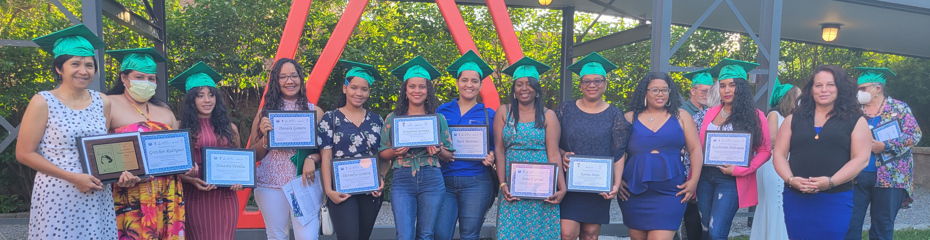
LELE in a snapshot – Fitchburg, MA
Led by Marites MacLean and Beth Robbins and launched in January 2022, the team is expanding access to quality childcare by identifying and training prospective childcare providers and helping them find jobs or start home daycares
Because of the LELE team, 30 (and counting!) majority Latina women and non-English speakers are now credentialed Child Development Associates
Because of those women, 38 more Fitchburg children have childcare, opening up economic opportunities for their families
Because of this early impact, the City of Fitchburg established a $40,000 Childcare Entrepreneur Fund to support costs of opening childcare facilities
Thinking through What’s next?

Slide 28
Participate in Learning Network
What does this look like for Communities?
Learning Activates
Approx. 20 communities
Organized by theme e.g./ childcare, small business, housing
TA / Consulting support
Inclusive Economies will engage
Community Builders (nonprofits, community development corporations, grassroots groups, entrepreneurs)
Inclusive Growth Collaborators (Municipalities, think tanks, planning groups)
Capital Innovators (CDFIs, loan funds, developers, local philanthropy and investors)
Labs: Pilot
Approx. 2-3 communities
Capacity grants
Wrap around TA and consulting
<18 mos
Light technical assistance, exchange, project inventory, open to all
Investment Ecosystem Analysis
More Labs
~10
Convenings
Capital Fund or other strategies to expand investment

Slide 29
Connecting Partners
Local
Nonprofits, CDCs, grassroots groups,
Regional
State Govt & Leaders
National
Federal Agencies
Boston Fed
Technical Assistance Orgs & Consultants
Impact Investors
Key Inclusive Growth Nonprofits: NGIN, others
Municipalities, think tanks, planning groups)
Low Income Smaller Cities and Rural Areas
CDFIs, loan funds, developers, local philanthropy and investors)
National Philanthropy: RWJ & Share our Strength (so far)
entrepreneurs

Slide 30
Inclusive Economies: Too Long Didn’t Read it (TLDR)
Goal: Help communities connect with capital to support inclusive economic growth projects, focusing on smaller cities/rural areas across New England.
Strategies:
Learning Network: Gather, Share, Connect
Labs: Build Capacity, Accelerate, Partner
Capital: Improve Community investment Systems/Find Capital Solutions
This work is emergent.
It will adapt and shift based on what we learn in partnership with communities.

Slide 31
Next Steps: If you’re interested in participating in Inclusive Economies here is how to plug in
Strengthen
Team get clear on the Vision
Who is at the table?
Racial Equity Lens
What tools are in your local toolbox?
Is there alignment around a shared vision and outcomes?
Complete the Project Inventory Tool
Assess your local landscape as a team
Copy paste is encouraged
Connect with the Boston Fed
Communities
Advancing more inclusive economies
Watch for more on Labs
Deeper engagement. Build Capacity, Partner, and Accelerate projects in real time
Join the Learning Network
Open to all with ongoing programming to build relationships, strengthen connections, and talk shop
Connect to Capital
Strategies to expand investment in smaller cities and rural communities
Site Visits & Peer Exchange
Enhance your
Perspective
Let us know if you’re interested
We’re Looking to organize around themes e.g. Childcare, small business, housing
Explore what it takes to advance the inclusive economies
You’ll find others in the region and nationally doing similar work
TA and project specific capacity building

