Slide 1
Massachusetts Education-to-Career Research and Data Hub (E2C Hub)
2nd Annual FoLDS Fall Symposium
October 18, 2023

Slide 2
2017
2019
2021
2022
National College
Data
EOE
Adult Ed
K-12 Data
Early Ed & Care
Higher Ed
Public Preschool
Work-force
EOLWD
Illustrative – not all connections shown
Notes:
We have built a strong foundation of high-quality longitudinal data, thanks to $26m in federal grants. We connected up our K-12 data with higher ed outcomes

Slide 3
2017
2019
2021
2022
National College
Data
EOHHS
WIC
EOE
Early Inter-vention
Adult Ed
K-12 Data
Early Ed & Care
Higher Ed
Housing
Home visiting
Public Preschool
Work-force
EOED
Medicaid
EOLWD
EOHHS
Illustrative – not all connections shown
Notes:
In 2019, the state took some major steps to connect up more data. We connected our education data to earnings data. We established a data sharing project focused on birth-to-five services, and a second one focused on job training and education programs.

Slide 4
2017
2019
2021
2022
National College
Data
EOHHS
WIC
EOE
Early Inter-vention
Adult Ed
K-12 Data
Early Ed & Care
Higher Ed
Early College
Housing
Home visiting
Public Preschool
Work-force
EOED
Medicaid
EOLWD
EOHHS
Illustrative – not all connections shown
Notes:
We have used these data to analyze important policy initiatives. We used K-12 and higher ed data to build a data system for Early College. We’ve also used the K-12 and earnings link to analyze how MCAS scores in high school predict later life outcomes.

Slide 5
2017
2019
2021
2022
National College
Data
EOHHS
WIC
EOE
Early Inter-vention
Adult Ed
K-12 Data
Early Ed & Care
Higher Ed
Early College
Housing
Home visiting
Public Preschool
Work-force
EOED
Medicaid
EOLWD
EOHHS
Illustrative – not all connections shown
Notes:
And in 2022 we made one of the final key connections, linking early education data to public preschool data. So now we have the agreements to make the data sharing possible, and integrated data systems where the data are matched. This has been possible to the hard work of many people on all sides, and thanks to the support we’ve had from the federal government.
So now the question that many of you are probably thinking: How do we make use of all these data? Where do I find the data?

Slide 6
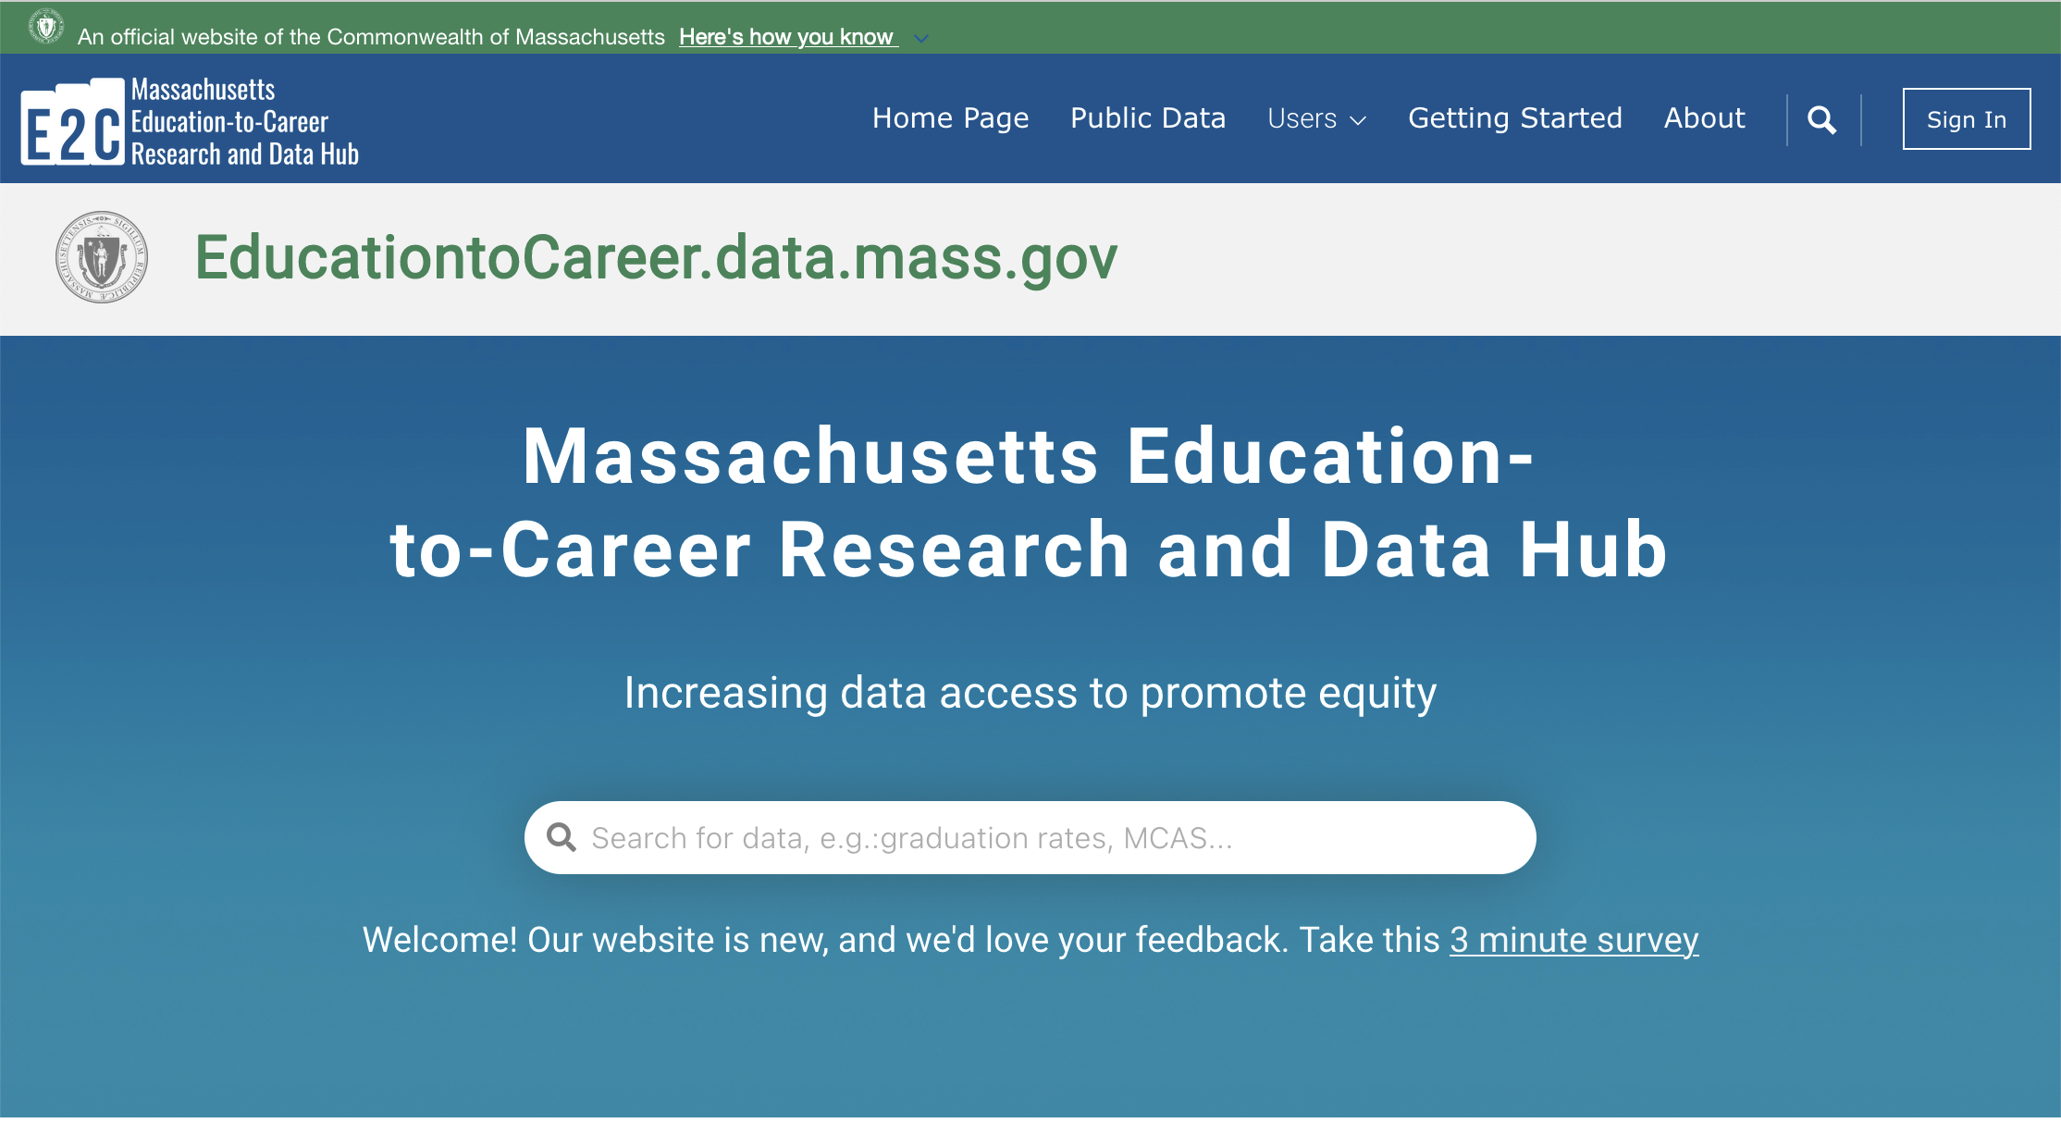
Notes:
This is the goal of the Education-to-Career Research and Data Hub. We are working to increase data access to promote equity.

Slide 7
Education-to-Career Research and Data Hub
Our Vision
Increasing data access to promote equity
Researcher
Policymaker
Student
HS Principal
Family Member
College Dean
Teacher
Agency Staff
Notes:
We think about a wide range of users, including experts and non-expert data users. I’ll tell you about some of what we’ve built in the last year.

Slide 8
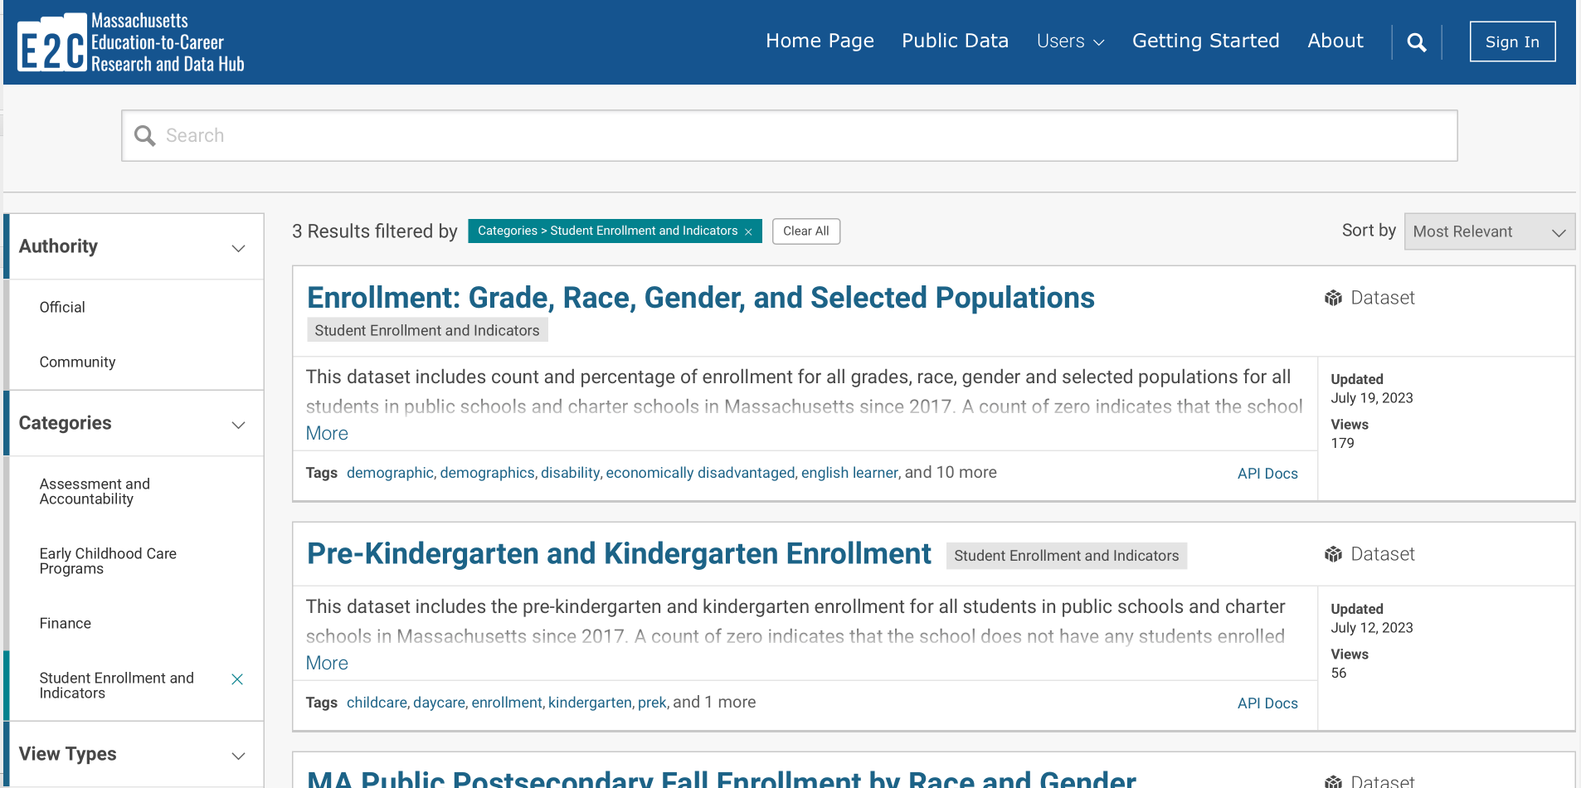
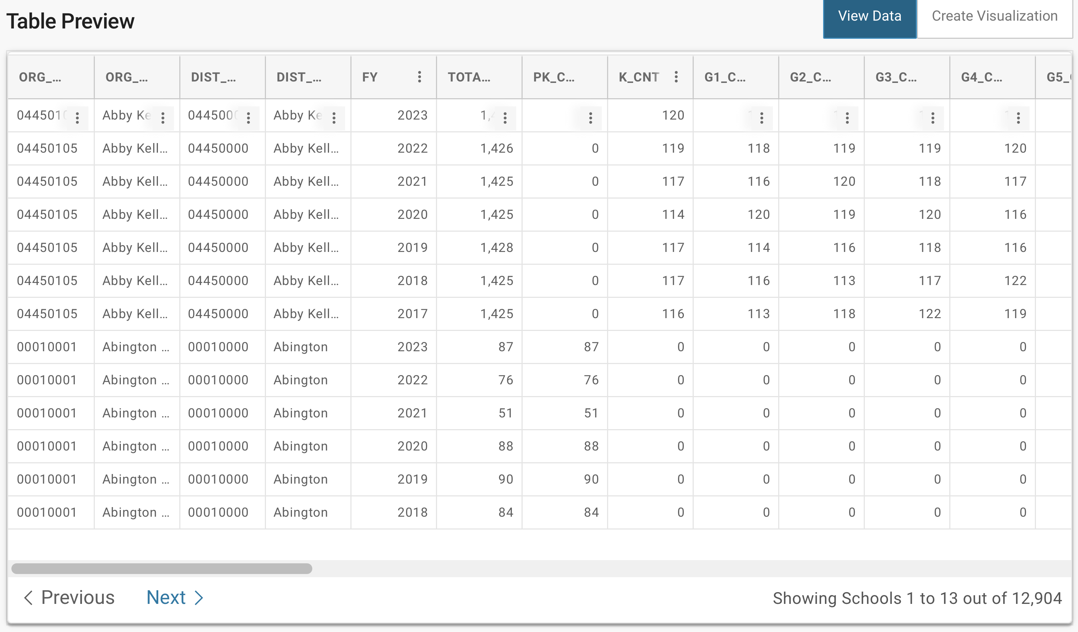
Full datasets for download and API
Researcher
Policymaker
Agency/ district Staff

Slide 9
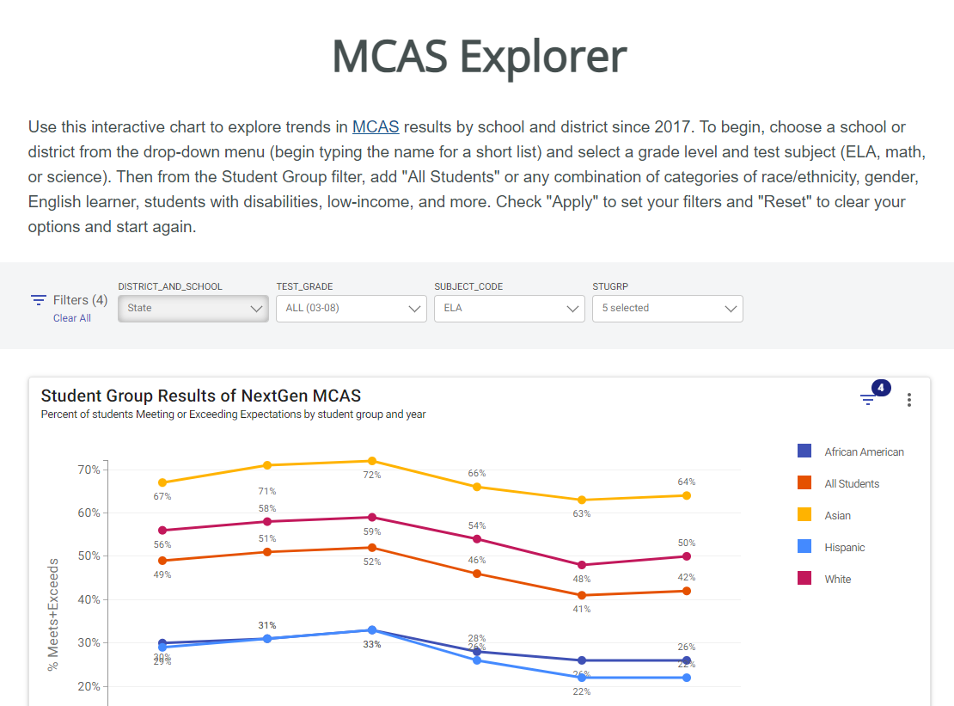
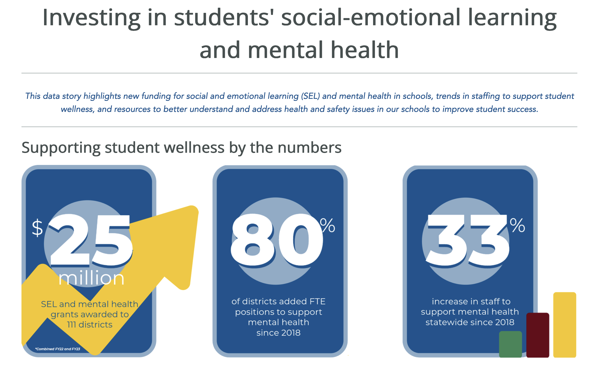
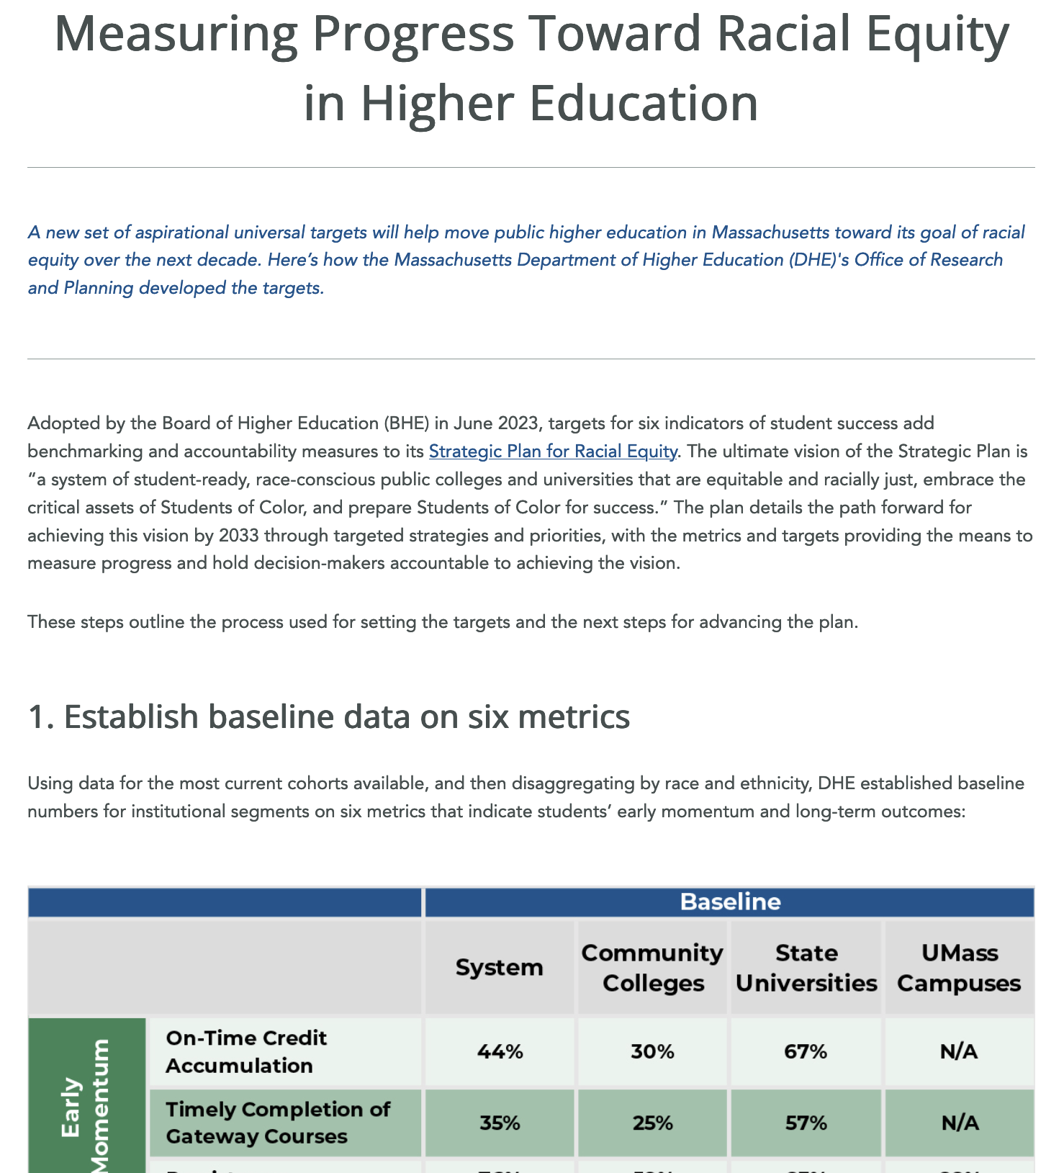
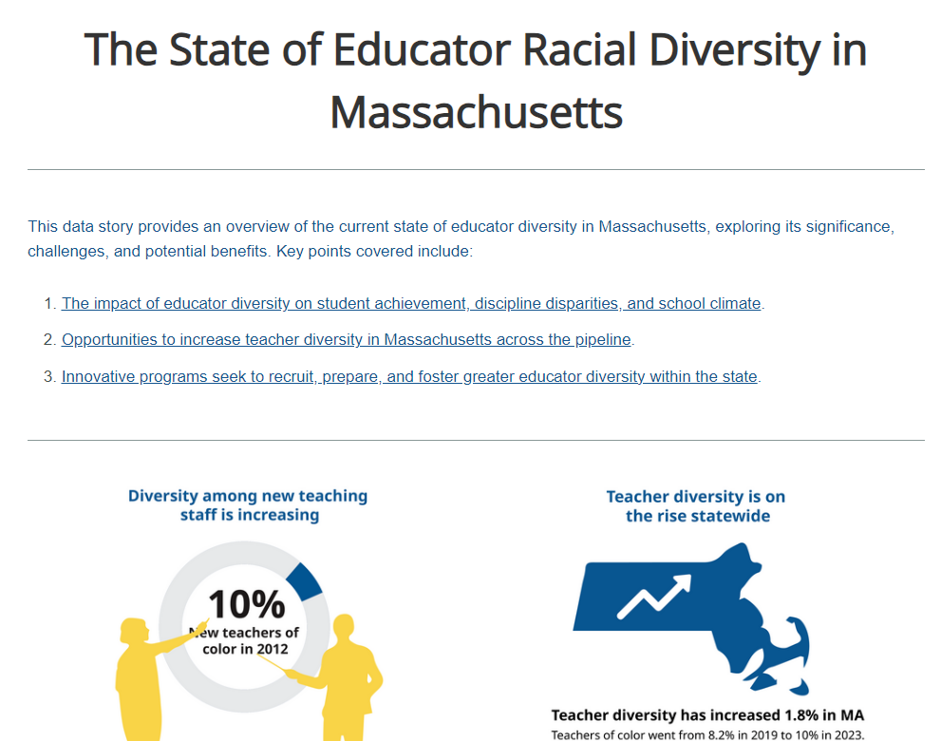
Data stories on major policy topics
Policymaker
Family Member
Agency/ district Staff

Slide 10
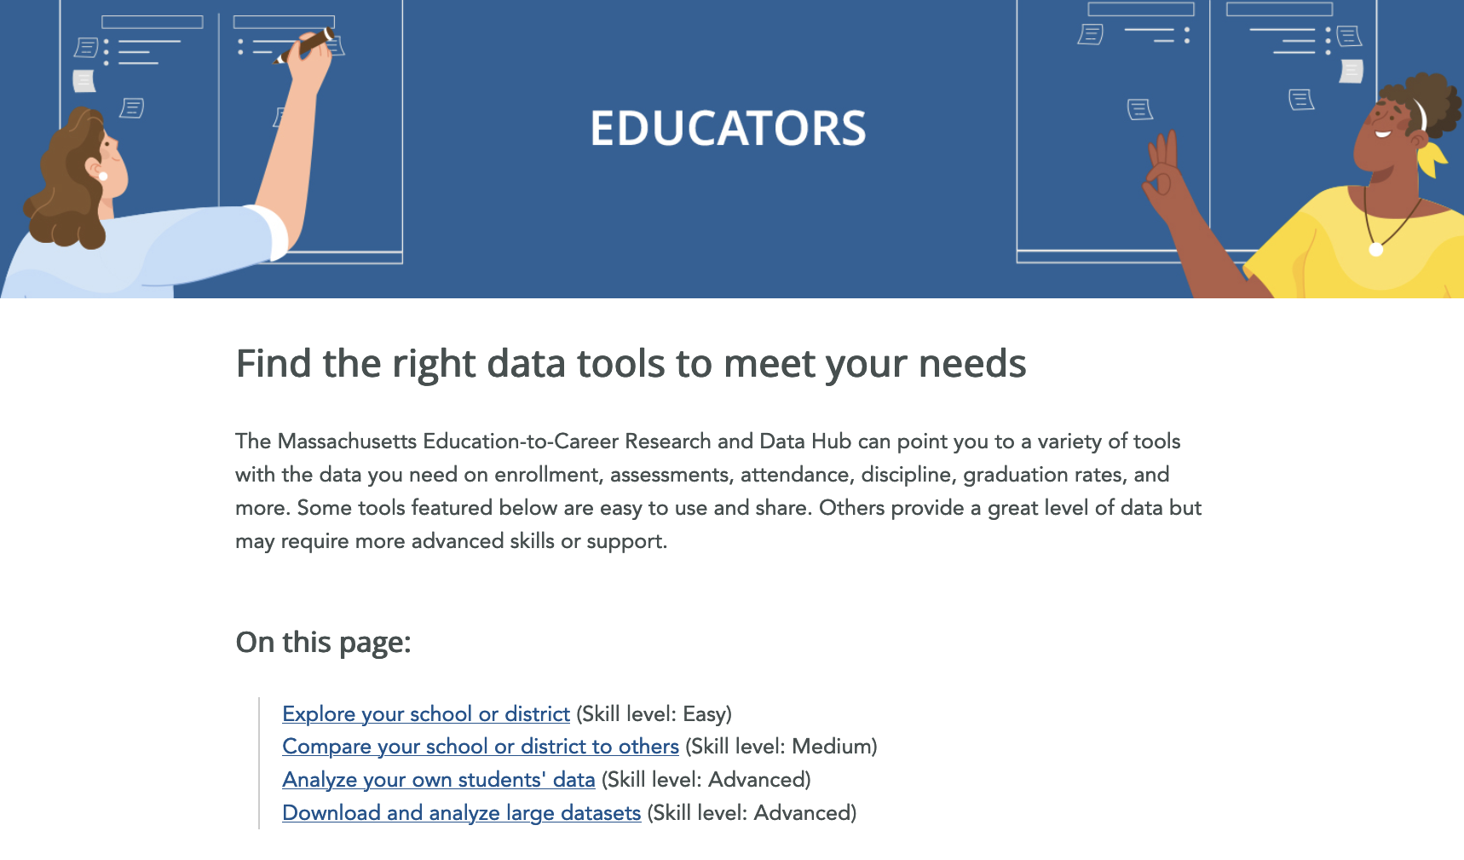
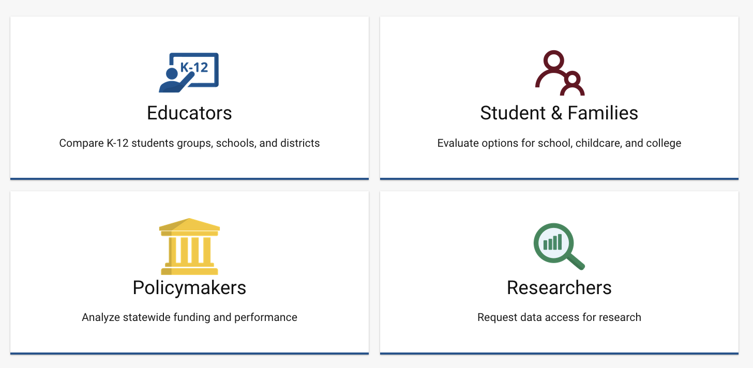
Easy entry points for new data users
HS Principal
College Dean
Family Member
Teacher
Student

Slide 11
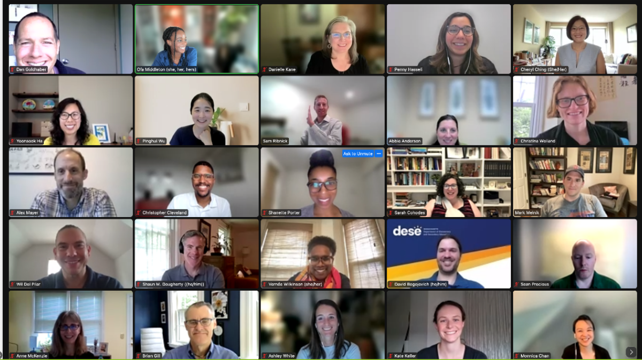
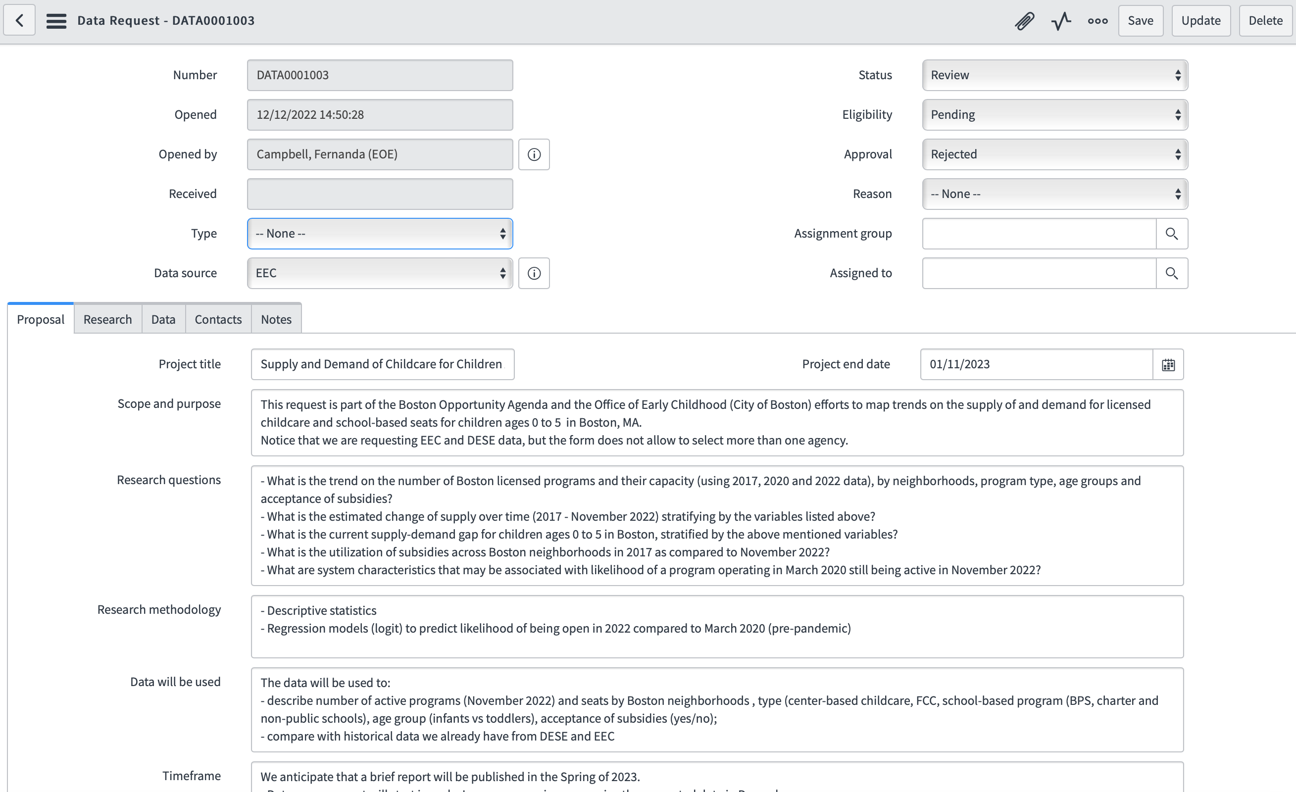
For 2024: Policy-driven research agenda and
unified research processes
Research Advisory Committee
New research portal

Slide 12
E2C Hub Guiding Principles
1
2
3
4
Promote shared ownership for progress on state goals for education and career
Facilitate actionable research on what leads to progress on long-term outcomes
Increase access to more complete data
Enable more efficient, effective and transparent reporting and data use

Slide 13
Governance and Decision-Making
Research Advisory Committee
✓
Executive Group
Cross-Agency
Leadership Group
Student and Family Voice Committee
ECIDS Board
E2C Research and Data Hub
EOTSS
Learn-to-Earn Board
Cross-Agency
Data Council
EOE
EEC
Data Council
DESE Data Council
DHE Data Council
EOLWD
Notes:
We have put together a structure that supports shared decision-making and leadership. Our cross-agency leadership group includes both data and program leaders from each agency, and we engage commissioners and secretaries regularly in the Executive Group to ensure we are focused on the highest policy priorities, and that we have the support needed to make headway.
Starting this year, we’ve also put together a Research Advisory Committee to give researchers and advocacy groups a voice in our plans and decisions. And soon we will be launching a student and family voice committee.

Slide 14
Sustainability for the future
Total: 31 FTE
Executive Director
Executive Staff Advisor
Research (19 FTE)
Business Analytics and Project Management (3 FTE)
Information Systems
(7 FTE)
Director
Director
Senior Director
Sr Research Analyst
Business Analyst
Lead Developer
Research Analysts (14 FTE)
Publications Coordinator
Business Systems Analyst
Software Developer
(4 FTE)
Research Staff Assistant
Manager – Labor Market Information
Systems IT Consultant
Notes:
We can look to states like Kentucky, who are recognized national leaders on this. They have built their Center for Statistics into a service that provides data and reports to the public, to policymakers, to researchers. They have built true integrated data systems and they’ve been empowered to use the data.

Slide 15
Sustainability for the future
Grant-funded contractor (6 positions)
Grant ends in Feb 2025
Full-time staff (2 positions)
Researchers
Community Members
Advocacy Groups
Families & Students
Long-term planning
UX Designer
Julian Smith-Sparks
Executive Director
Sam Ribnick
Equity and Research Manager
Ofa Middleton
Data and Policy Analyst
David Bogojevich
Data and Policy Analyst
Ana Vasconcelos
Data and Policy Analyst
Filled soon
Cross-Agency Data Analyst
Filled soon
Outreach and Engagement Manager
Danielle Kane
Funding
Positions
DESE
EEC
DHE
EOLWD & Other Agencies
Notes:
We have made a lot of progress and have built out the team we needed to get the ball rolling. But we still need to work toward a sustainable long-term plan.

Slide 16
Hey Data Hub, are low-income students who take calculus in high school more likely to choose a STEM major in college?
Sure, let me make that chart for you.
Notes:
When I think about the future of data in MA, I dream big of a platform where everyone can get the data they need at the moment of decision-making.

Slide 17
What are your hopes or goals for the E2C Hub?
What are your questions or concerns?
Please visit our website at mass.gov/E2C to submit a question or comment to us.
Thank you!
Notes:
The E2C team is here all day, and we want to know your dreams for the future of data.

