Slide 1
11th Annual Gateway Cities Innovation Institute Awards & Summit
Shaping (and Financing) the Energy Transition
November 14, 2023
Dr. Luis Aguirre-Torres
Director, Financial Planning & Analysis and Financing Solutions,
New York State Research and Development Authority

Slide 2
About the Energy Transition
It is hard
It is expensive
Can be overwhelming
Requires a ton of political will
Requires to pay attention
We need to be bold
We need to be smart

Slide 3
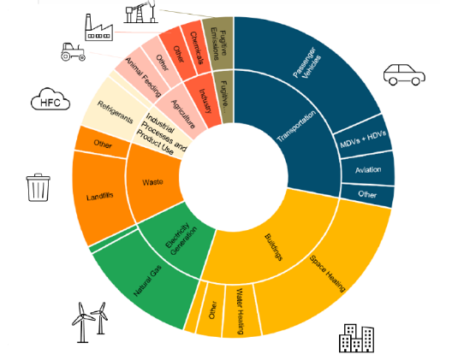
Climate Leadership and Community Protection Act (CLCPA)
Carbon neutral economy, mandating at least an:
85% reduction in emissions below 1990 levels by 2050
40% reduction in emissions by 2030
100% zero-emissions electricity by 2040
70% renewable electricity by 2030
9,000 MW of offshore wind by 2035
6,000 MW of distributed solar by 2025
3,000 MW of energy storage by 2030
185 TBtu on-site energy savings by 2025
Commitments to climate justice and just transition

Slide 4
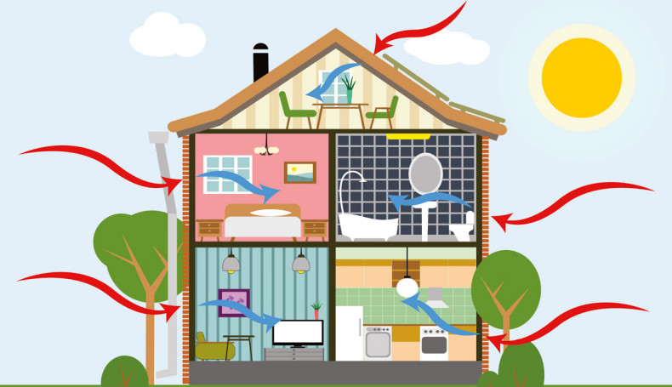
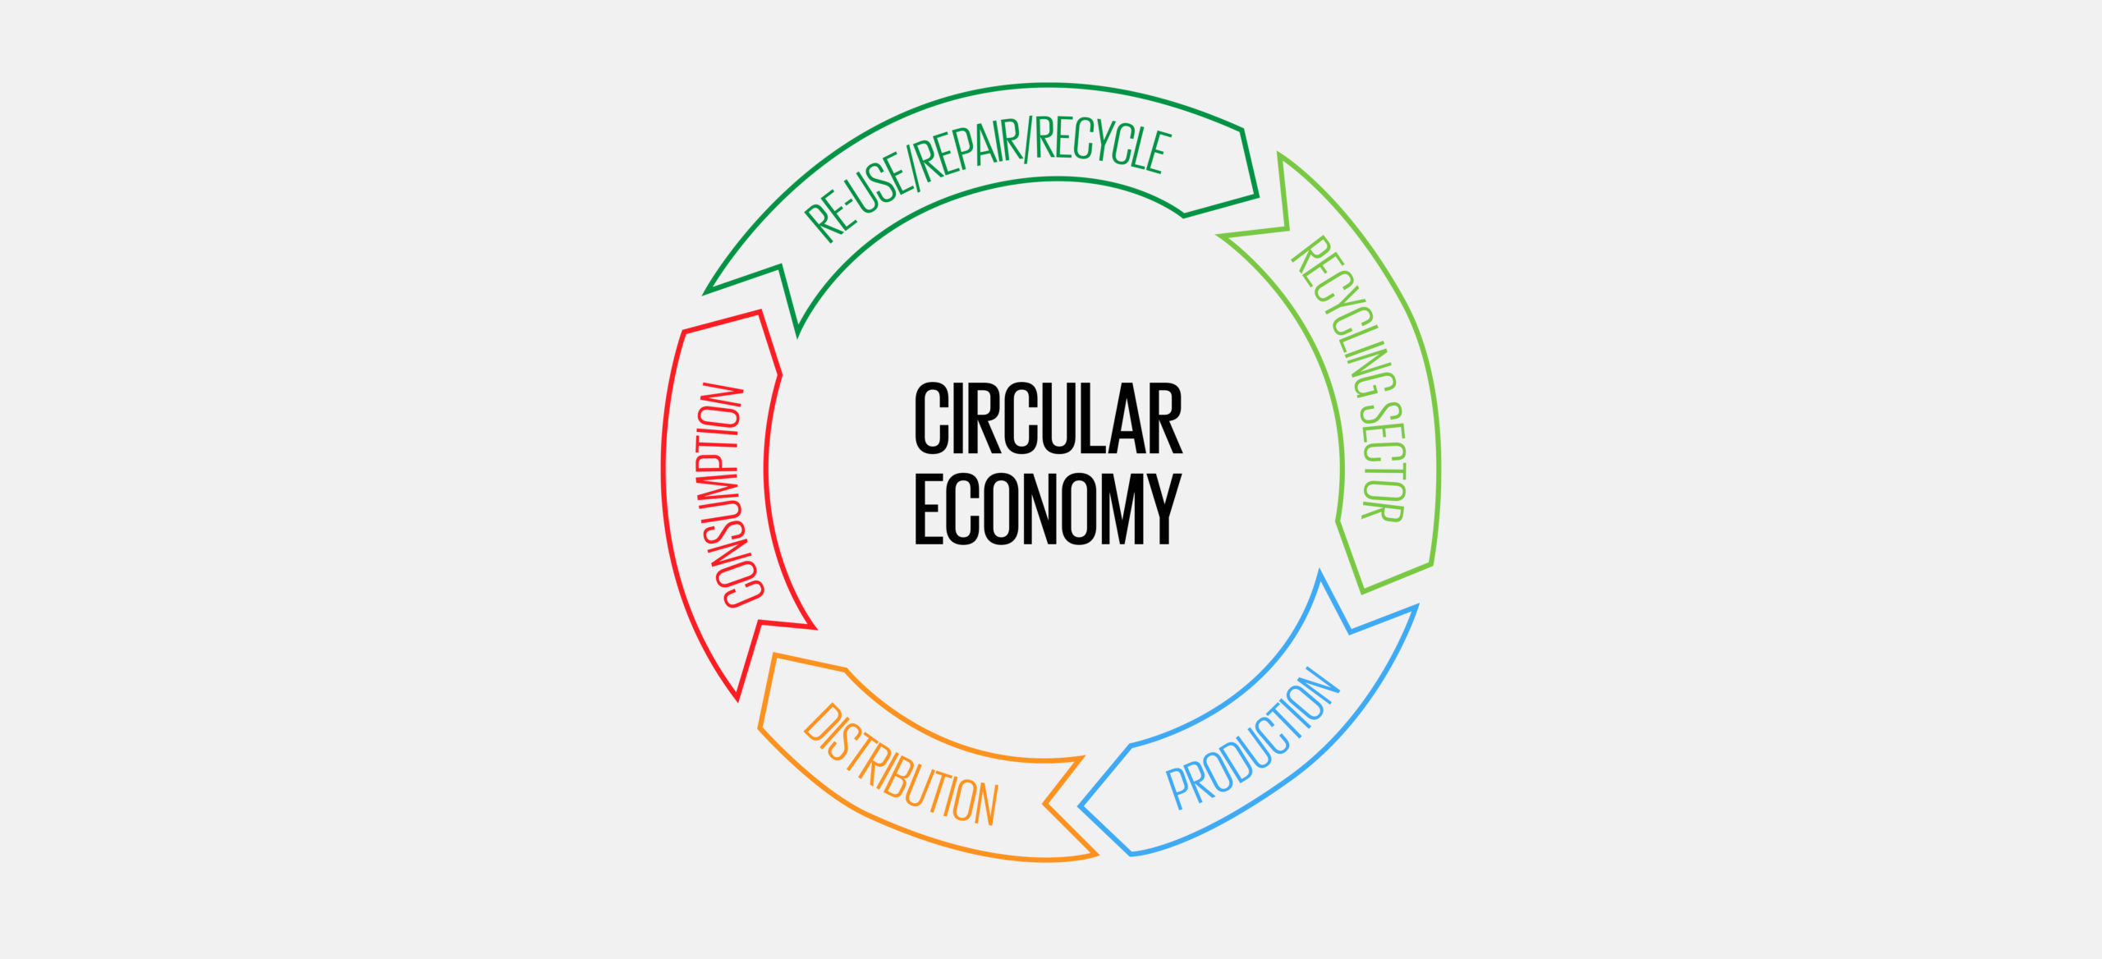
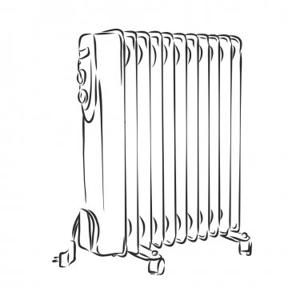
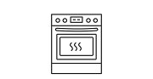
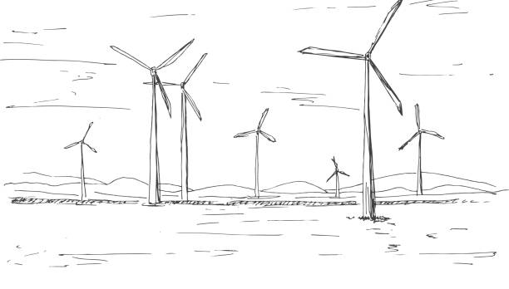
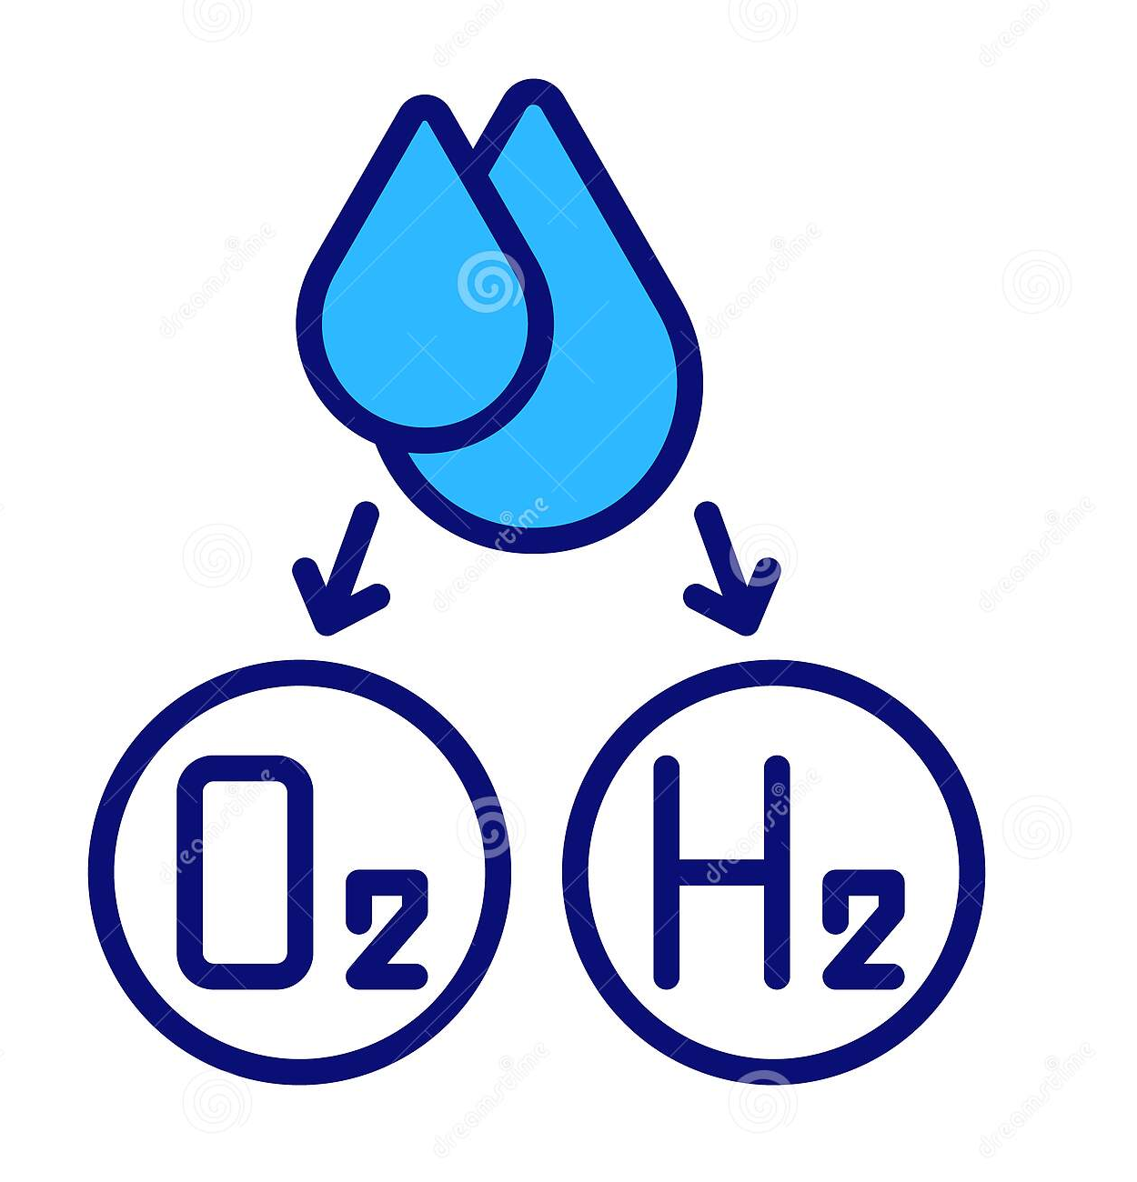
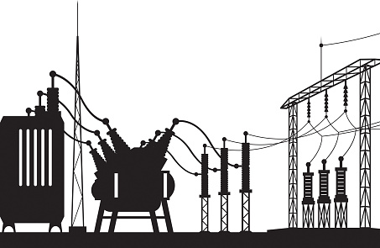
What goes into decarbonization?
Climate Action Plan
Energy Efficiency
(30%)
Democratic Engagement
Electrification
(30%)
Workforce Development
Decarbonization
(20%)
Carbon capture and sequestration
(20%)
Resilient and reliable infrastructure
Energy management and grid flexibility

Slide 5
NYSERDA

Slide 6
NYSERDA – Technical Services
FlexTech
50% cost-share of energy and emission reduction studies
Commercial, Industrial, Agricultural & Multi-Family Buildings
Focuses on energy, indoor air quality and electrification
Strategic Energy Management
Self-paced training and technical support with consultant to help develop a plan and pipeline of projects.
Commercial and Industrial
On-site Energy Manager
Support addition of staff or consultant to engage in developing a plan and pipeline of projects across a campus or portfolio
Commercial and Industrial

Slide 7
NYSERDA – Commercial Sector
Clean Green Schools: Funding for under-resourced public schools to decarbonize building portfolio and improve indoor air quality. Program Budget $59M available state-wide.
Clean Green Campuses: Program and membership network dedicated to advancing clean energy across New York’s colleges and universities. Helps colleges identify strategies for reducing campus carbon footprint, provides access funding opportunities and resources, offers recognition for clean energy achievements.
Empire Building Challenge: Competitive funding for demonstration projects that illustrate repeatable pathways to phase out fossil fuel use and increase efficiency of existing large commercial and multifamily buildings. Please register to stay up to date on future competitive funding opportunities.

Slide 8
NYSERDA – Green Jobs Green New York
The GJGNY Program provides New Yorkers with access to energy assessments, installation services, low interest financing, and pathways to training for various green-collar careers.
The Residential Energy Audit Program provides no cost home energy assessments.
The Assisted Home Performance Program provides incentives and home energy assessments for income-eligible New Yorkers.
Residential energy efficiency loans for the purchase and installation of energy efficiency measures.
The Photovoltaic (PV) Program provides incentives for solar PV+Storage.
The purchase and installation of clean heating and cooling solutions like Air Source or Ground Source heat pumps.

Slide 9
NYSERDA – Credit Enhancements
Loan Loss Reserve
The Loan Loss Reserve fund is in the form of a credit enhancement, provided at no cost to lenders or their customers.
The program supports a wide variety of clean energy projects, and covers up to 90% of Qualifying Eligible Losses on the remaining loan balance in the event of a default.
This added risk mitigation allows you to approve a wider set of customers or offer more competitive rates and terms.
Ideal for qualified financing lenders—including local and regional banks, community-based lenders, and other financial firms—that will develop financing products related to energy efficiency upgrades for residential, multifamily, small businesses and non-profit organizations.
9

Slide 10
NYGB – Community Decarbonization Fund
The New York Green Bank is a division of NYSERDA.
Earlier this year NYGB launched of a $250 million Community Decarbonization Fund (CDF).
It encourages Community Development Financial Institutions (CDFIs) and other specialty lenders to apply for this highly concessionary funding pathway.
Focus on delivering climate justice to residents of disadvantaged communities (DACs).
The CDF is expected to expand and accelerate the lending capacity of smaller community-based and mission-driven investors.

Slide 11
State Energy Financing Fund
The State Energy Financing Fund provides a complementary funding opportunity for entities actively working with or applying to the U.S. DOE Loan Programs Office Title 17 Clean Energy Financing Program’s Section 1703, to support capital deployment for projects in NYS that reduce emissions from the built environment.
NYSERDA expects to deploy up to $20 Million of direct capital and credit enhancements to eligible entities, at an amount not to exceed the lesser of $5 Million or 3% of an eligible applicant’s proposed project portfolio amount.

Slide 12
So, yeah this is hard
But also doable

Slide 13
Thank you!
Contact info:
Luis Aguirre-Torres
Luis.Aguirre-Torres@nyserda.ny.gov
Find a NYSERDA program:
https://www.nyserda.ny.gov/All-Programs
13

